Slide 1



Shippensburg Area School District
24 June 2019

Slide 2








Shippensburg Area SD Feasibility Study
Project Team
EI Associates
Architects & Educational Facilities Planners
K&W
Civil / Site Engineering
Gatter & Diehl
Mechanical, Electrical, Plumbing Engineering
Reynolds Construction Managers
Construction Management / Cost Estimating
Advanced Foodservice Solutions
Food Service / Kitchen Design
Baker, Ingram & Associates
Structural Engineering
Atlantic Aquatic Engineering, Inc.
Aquatic Facility Consultant

Slide 3
Shippensburg Area SD Feasibility Study
Process / Contents of the Study
Demographic Review
(Student Enrollment, Population, Housing)
Facilities Study
(Building Improvements & Construction Cost)
Educational Program Review
(Requirements / Needs)
Next Steps:
Solutions (Construction Options)
Cost and Financing of Options
Schedule
Note: Study per PDE Requirements

Slide 4
Shippensburg Area SD Feasibility Study
Demographic Exploration - Population
2000 - 2010
Gain of Population
+ 4,480
2010 - 2017
Gain of Population
+ 1,699
2000 - 2017
Gain of Population
+ 6,179

Slide 5
Shippensburg Area SD Feasibility Study
Demographic Exploration - Housing
2000 - 2010
Gain of Housing
+ 2,128
2010 - 2017
Gain of Housing
+ 1,620
2000 - 2017
Gain of Housing
+ 3,748

Slide 6
Shippensburg Area SD Feasibility Study
Demographic Exploration – Historical Student Enrollment
2000 - 2010
Gain of Students
+ 197
2010 - 2017
Loss of Students
- 58
2000 - 2017
Gain of Students
+ 139

Slide 7
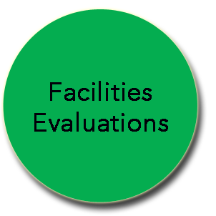
Facilities Evaluation Process
Improvement Lists: Itemized, Priced, and Prioritized
Architects and MEP Engineers survey buildings and sites
  Security
  Safety
  Codes
  Condition
PHYSICAL PLANT
  Mechanical
  Electrical
  Plumbing
  Site
EDUCATIONAL PROGRAMMING
  Efficient Program-Use of Facilities
  Size / Future Capacity of Schools
  Grade Realignment / Grade Levels
  Students per Classroom
  Use of Core Facilities
  Site – Parking, Drives, Playfields

Slide 8
Facilities Evaluation Process
Improvement Lists: Itemized, Priced, and Prioritized
Architects and MEP Engineers estimate costs for each work individually
ITEMIZED ESTIMATED COSTS
  Estimates by Reynolds Construction Managers Professional Estimating Department.

Slide 9
Facilities Evaluation Process
Improvement Lists: Itemized, Priced, and Prioritized
Architect, Engineers, and SD Team prioritize the work items and assign ranking to each work item
RANK 1
HIGH PRIORITY
RANK 2
MEDIUM PRIORITY
RANK 3
LOW PRIORITY
FUTURE CONSIDERATION
RANK 4
OPTIONAL
SEPARATE FUTURE PROJECTS

Slide 10
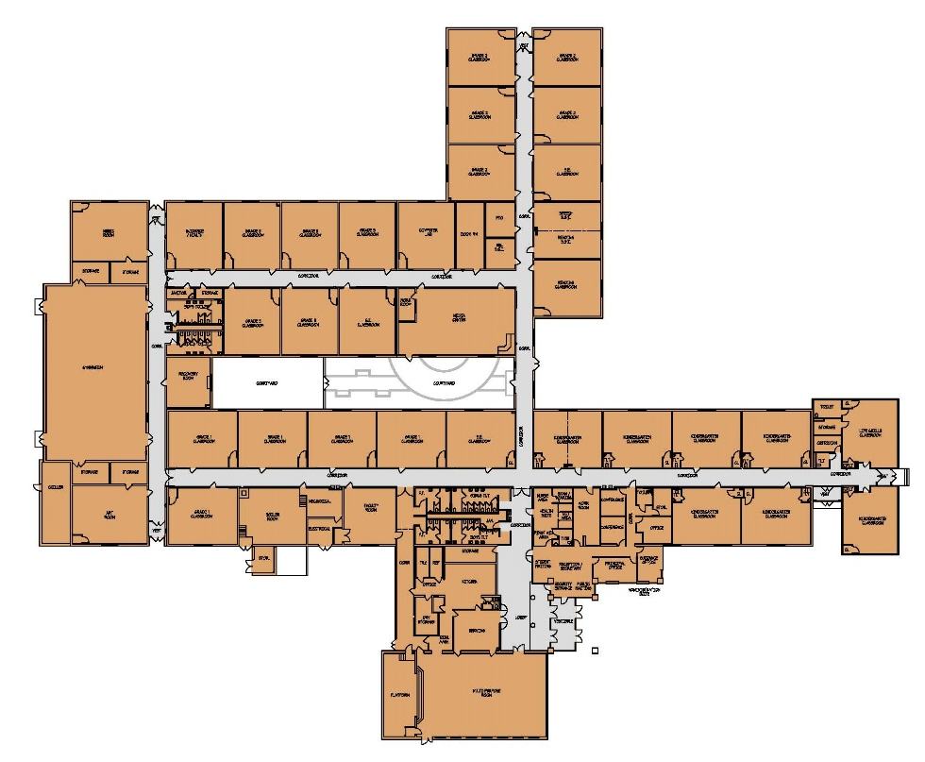
James Burd Elementary School
Existing Conditions
Grades K-3
Built: 1959, 1987, 1991, 2007
GESA Project: Dec. 2011
Site: 37.37 acres
Area: 66,620 SF
District Capacity: 470
Current Enrollment: 475
Facilities Improvements:
Site Improvements
Repair / Clean Exterior Building Finishes
Window Replacement
Repair / Refurbish Interior Finishes
Upgrade Kitchen / Kitchen Equipment
Upgrade Plumbing Systems
Building Code Upgrades
Safety / Security Upgrades
Accessibility Upgrades
FIRST FLOOR

Slide 11
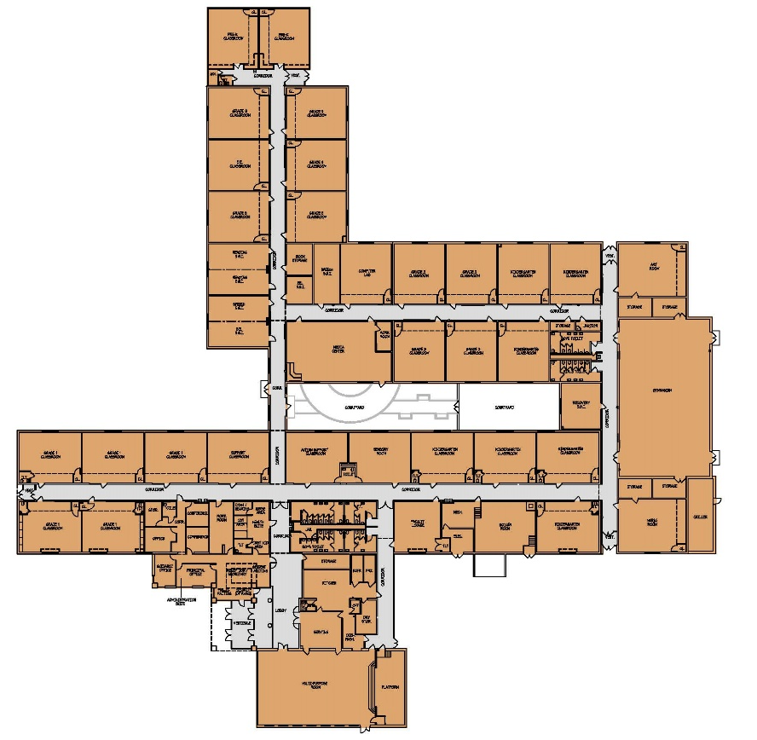
Nancy Grayson Elementary School
Existing Conditions
Grades K-3
Built: 1959, 1987, 1991, 2007
GESA Project: Dec. 2011
Site: 11.25 acres
Area: 66,090 SF
District Capacity: 448
Current Enrollment: 449
Facilities Improvements:
Limited Site Repair
Repair / Clean Exterior Building Finishes
Window Replacement
Repair / Refurbish Interior Finishes
Upgrade Kitchen / Kitchen Equipment
Upgrade Plumbing Systems
Building Code Upgrades
Safety / Security Upgrades
Accessibility Upgrades
FIRST FLOOR

Slide 12
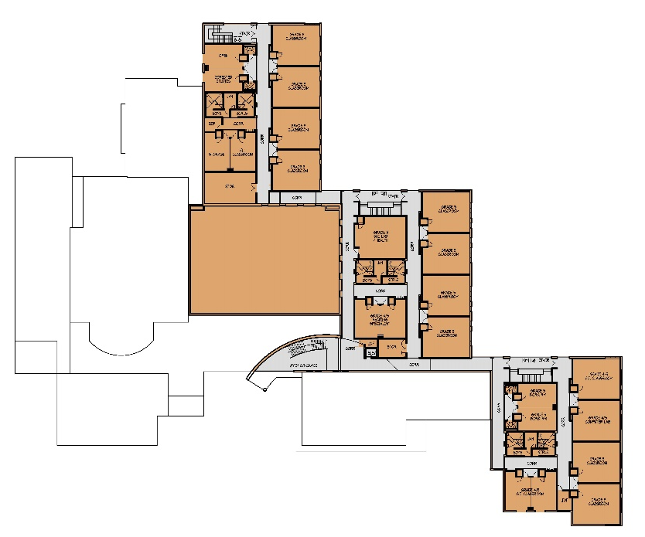
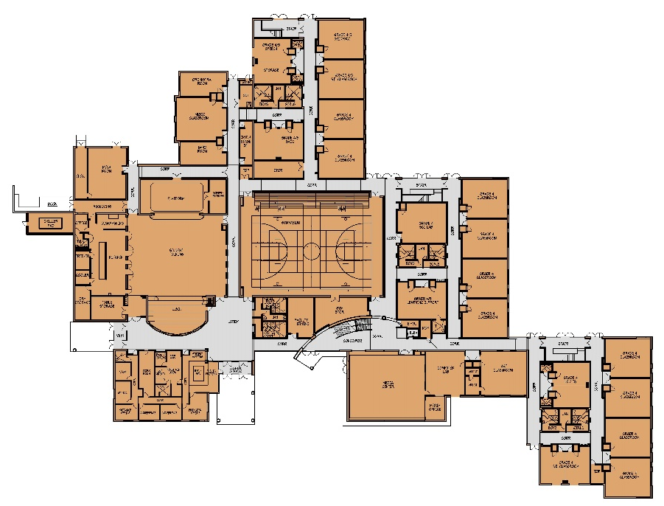
Shippensburg Area Intermediate School
Existing Conditions
Grades 4-5
Built: 2005
GESA Project: Dec. 2011
Site: 37.37 acres
Area: 100,150 SF
District Capacity: 480
Current Enrollment: 472
Facilities Improvements:
Limited Site Repair & Upgrade
Repair / Clean Exterior Building Finishes
Repair / Refurbish Interior Finishes
Upgrade Kitchen / Kitchen Equipment
Building Code Upgrades
Safety / Security Upgrades
Accessibility Upgrades
SECOND FLOOR
FIRST FLOOR

Slide 13
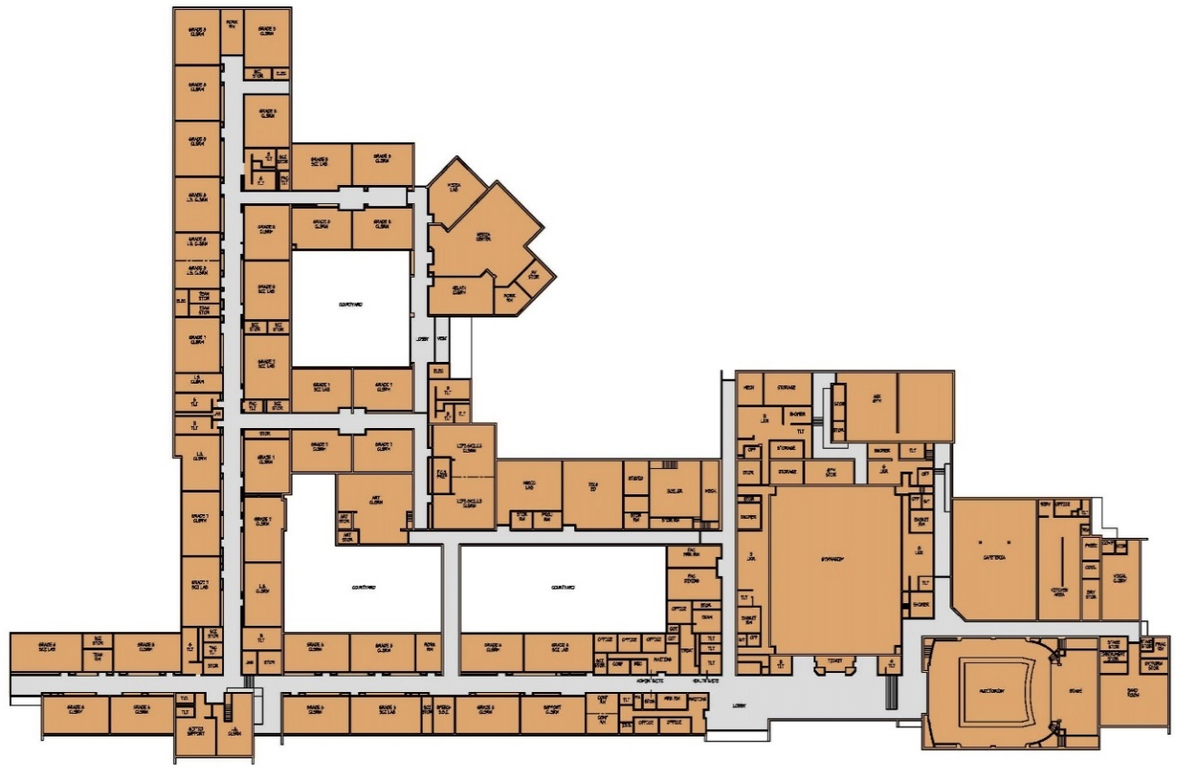
Shippensburg Area Middle School
Existing Conditions
Grades 6-8
Built: 1953, 1968, 1987, 1997
GESA Project: Dec. 2011
Site: 71.5 acres
Area: 128,724 SF
District Capacity: 779
Current Enrollment: 814
Site Improvements:
Site Repair & Upgrades
Site Circulation Upgrades (Options)
  Separate Parent & Bus Drop-off Areas
  Separate Service Areas
  Additional Staff & Visitor Parking
Facilities Improvements:
Repair / Clean Exterior Building Finishes
Window Replacement
Repair / Refurbish Interior Finishes
Upgrade Casework & Furnishings
Upgrade Mechanical, Electrical,
& Plumbing Systems
Upgrade Kitchen / Kitchen Equipment
Building Code Upgrades
Safety / Security Upgrades
Accessibility Upgrades
FIRST FLOOR

Slide 14
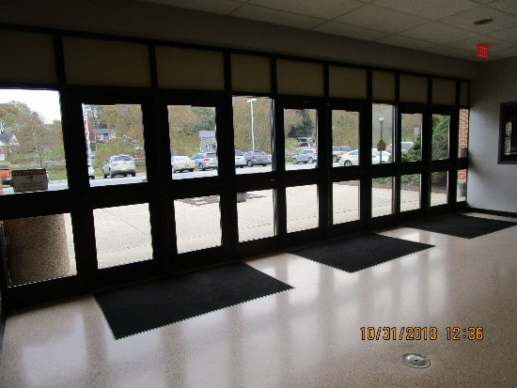
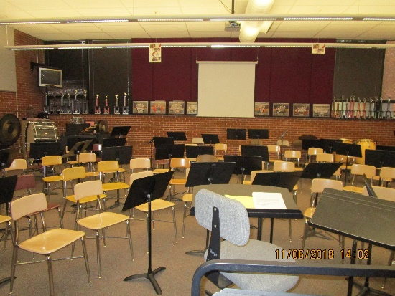
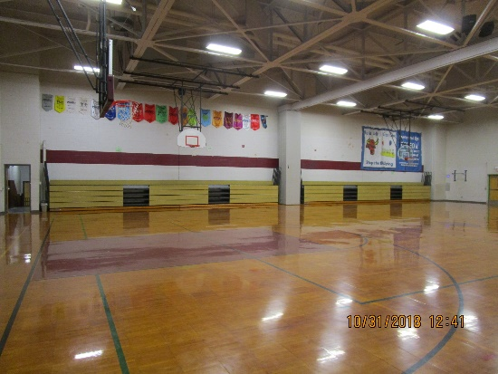
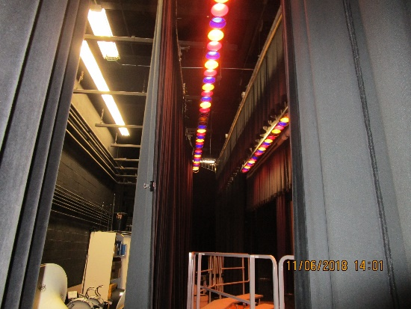
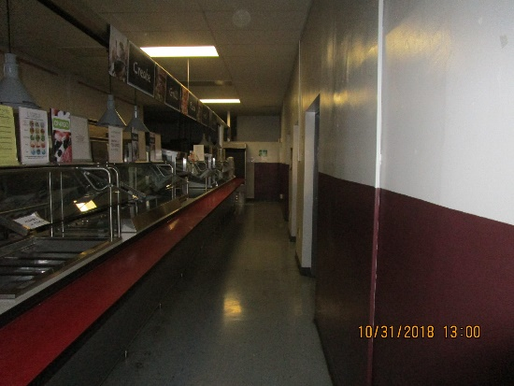
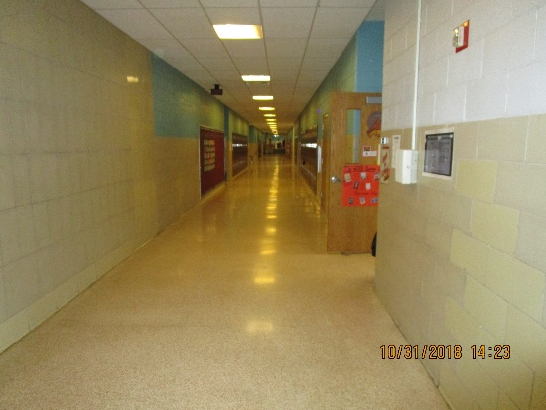
Shippensburg Area Middle School
Existing Conditions
Educational Program Improvements:
Additional Classrooms for Grade Teams
  Accommodates Core Subjects, Special Education & Exploratory Subjects
Expand Student Dining & Kitchen Areas
  Relieves current student overcrowding during lunch & shorter serving lines/times
Enlarge & Upgrade Music Department
  Locates music areas together with adequate s.f. sizes & support areas
Upgrades for Auditorium & Stage Storage
Upgrade Security Entrances
  Create two security entrances:
    Front of School for Parent Drop-off
    Back of School for Bus Drop-off

Slide 15
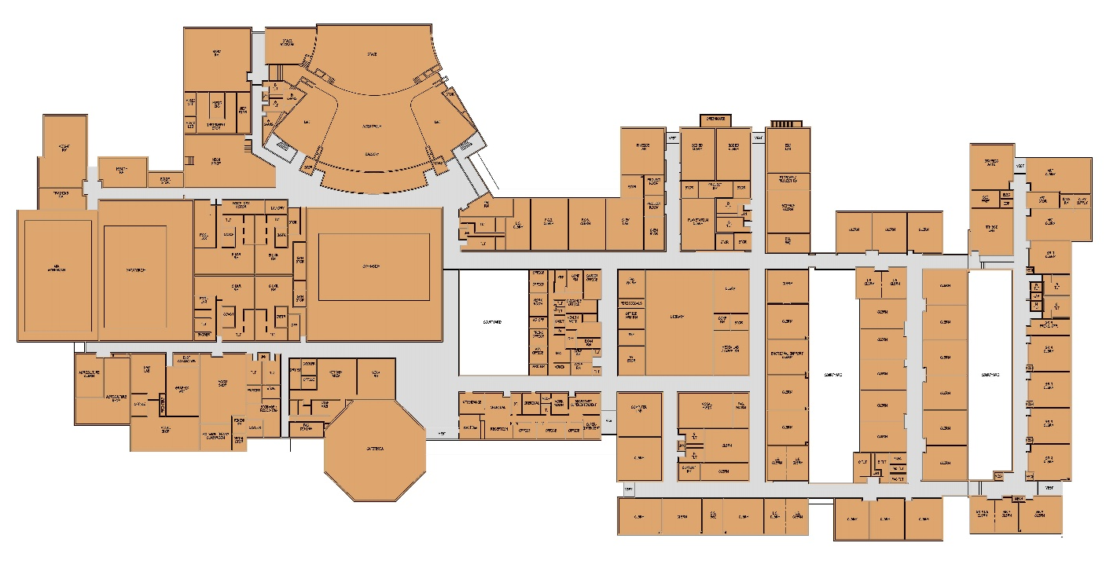
Shippensburg Area Senior High School
Existing Conditions
Grades 9-12
Built: 1970, 1997, 2008
GESA Project: Dec. 2011
Site: 71.5 acres
Area: 197,258 SF
District Capacity: 1,034
Current Enrollment: 1,033
Site Improvements:
Site Repair & Upgrades
Site Circulation Upgrades (Options)
  Separate Parent & Bus Drop-off
  Separate Service Areas
  Additional Staff & Visitor Parking
  Additional Athletic Parking
Facilities Improvements:
Repair / Clean Exterior Building Finishes
Window Replacement
Repair / Refurbish Interior Finishes
Upgrade Casework & Furnishings
Upgrade Mechanical, Electrical, & Plumbing Systems
Upgrade Kitchen / Kitchen Equipment
Building Code Upgrades
Safety / Security Upgrades
Accessibility Upgrades
FIRST FLOOR

Slide 16
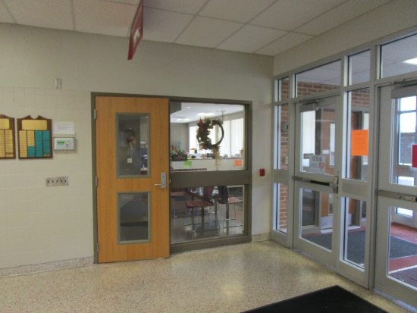
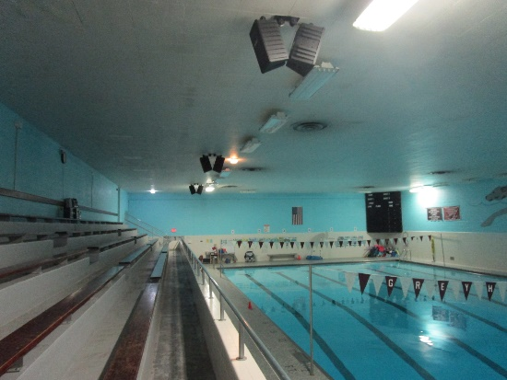
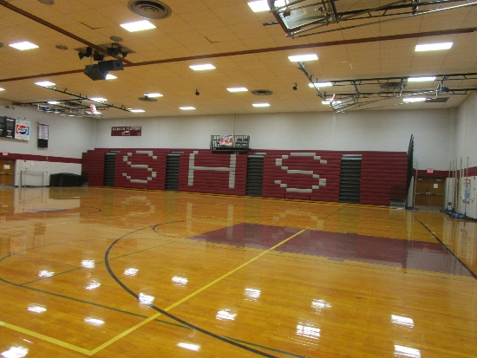
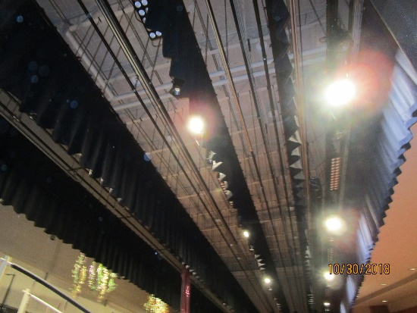
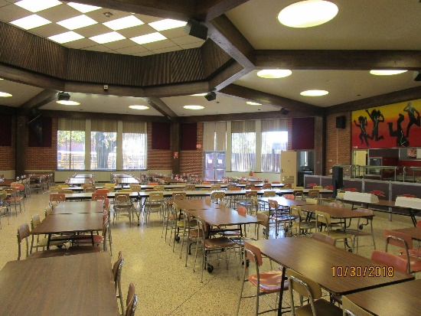
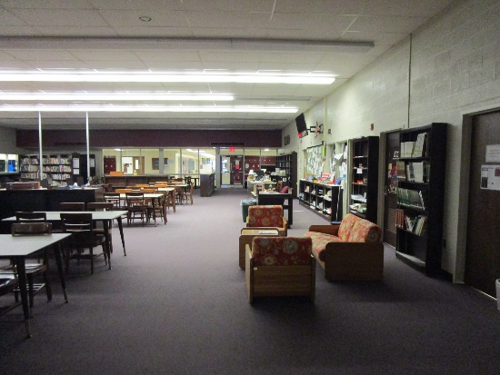
Shippensburg Area Senior High School
Existing Conditions
Educational Program Improvements:
Additional Classrooms for Grade Teams
  Accommodates 9th Grade, Core Subjects, Special Education & Exploratory Subjects
Expand Student Dining & Kitchen Areas
  Relieves current student overcrowding during lunch & shorter serving lines/times
  Creates break-out / large group spaces for students & staff during non-lunch times
Upgrade Music Department & Stage Areas
  Locates music areas together with adequate s.f. sizes & support areas
  Creates stage & performance support areas
Expand Athletic Areas
  Accommodates wrestling room & athletic support areas
Upgrade Security Entrances
  Create two security entrances:
    Front of School for Bus Drop-off
    Back of School for Parent Drop-off

Slide 17
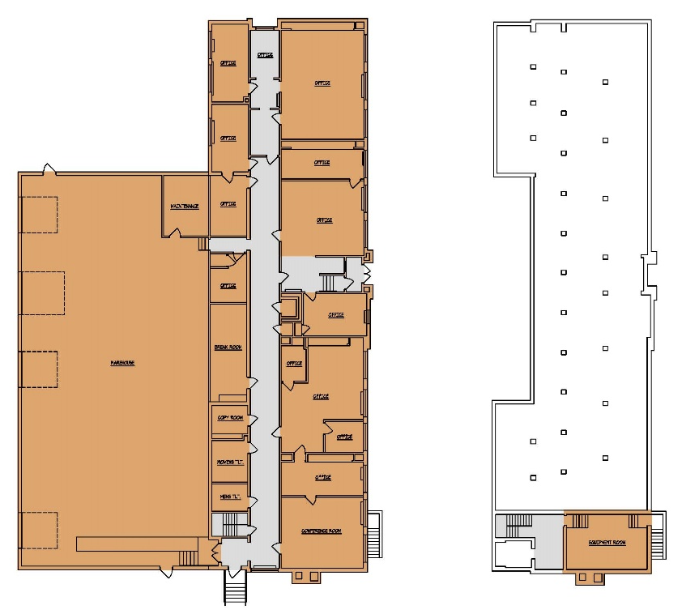
Shippensburg Area District Administration Offices
Existing Conditions
Built: 1949, 1965
GESA Project: Dec. 2011
Site: 11.25 acres
Area: 13,324 SF
District Capacity: 15
Facilities Improvements:
Repair / Clean Exterior Building Finishes
Repair / Refurbish Interior Finishes
Upgrade Casework & Furnishings
Upgrade Mechanical, Electrical, & Plumbing Systems
Upgrade Kitchen / Kitchen Equipment
Building Code Upgrades
Safety / Security Upgrades
Accessibility Upgrades
FIRST FLOOR
BASEMENT

Slide 18
Shippensburg Area School District
Summary - Building Improvement Construction Costs
  ** Note: Construction Cost x 1.25 = Total Project Cost

Slide 19
Shippensburg Area School District
Summary - Building Improvement Construction Costs
  ** Note: Construction Cost x 1.25 = Total Project Cost

Slide 20
Shippensburg Area SD Feasibility Study
Process / Contents of the Study
Demographic Review
(Student Enrollment, Population, Housing)
Facilities Study
(Building Improvements & Construction Cost)
Educational Program Review
(Requirements / Needs)
Next Steps:
Solutions (Construction Options)
Cost and Financing of Options
Schedule
Note: Study per PDE Requirements

Slide 21
Shippensburg Area School District
24 June 2019

Slide 22
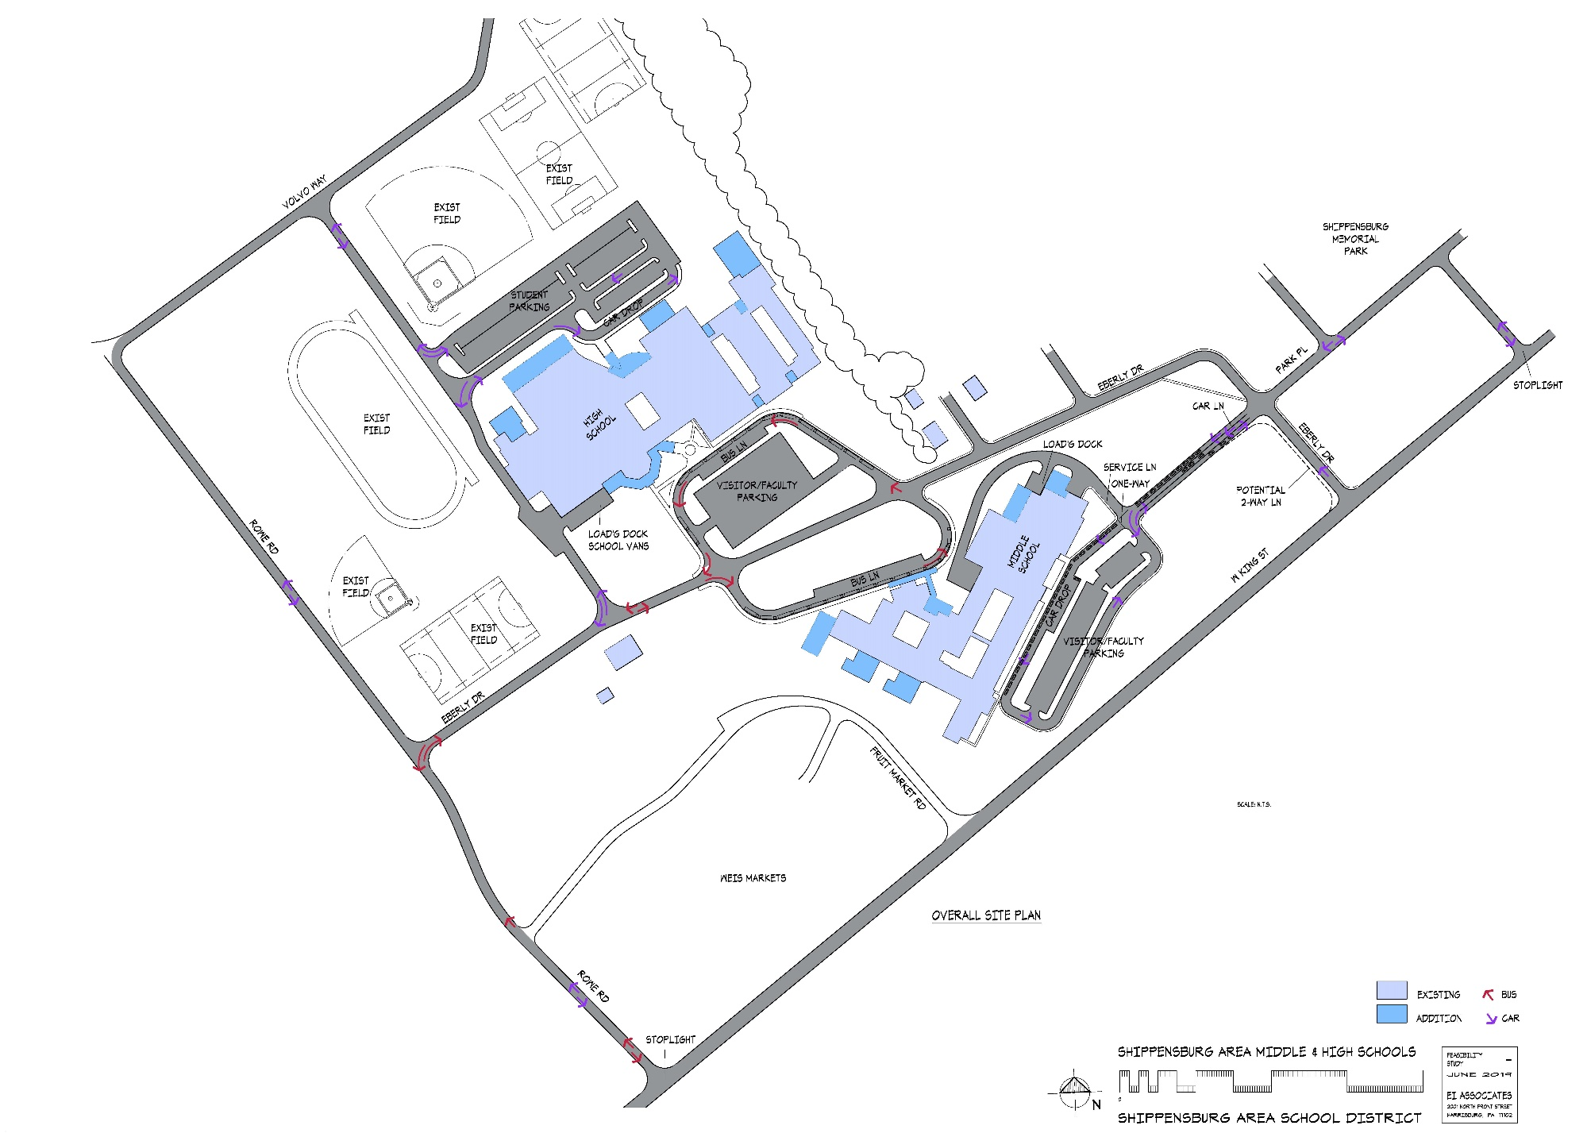
Shippensburg Area School District
Proposed Campus Site Plan

