Slide 1


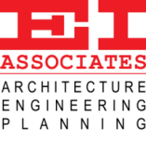
Chestnut Ridge School District
DRAFT
Part 2 - Study
14 November 2019

Slide 2






Chestnut Ridge SD Feasibility Study
Project Team
Chestnut Ridge School District
Owner
EI Associates
Architects & Educational Facilities Planners
K&W
Civil / Site Engineering
Gatter & Diehl
Mechanical, Electrical, Plumbing Engineering
Advanced Foodservice Solutions
Food Service / Kitchen Design
Baker, Ingram & Associates
Structural Engineering

Slide 3
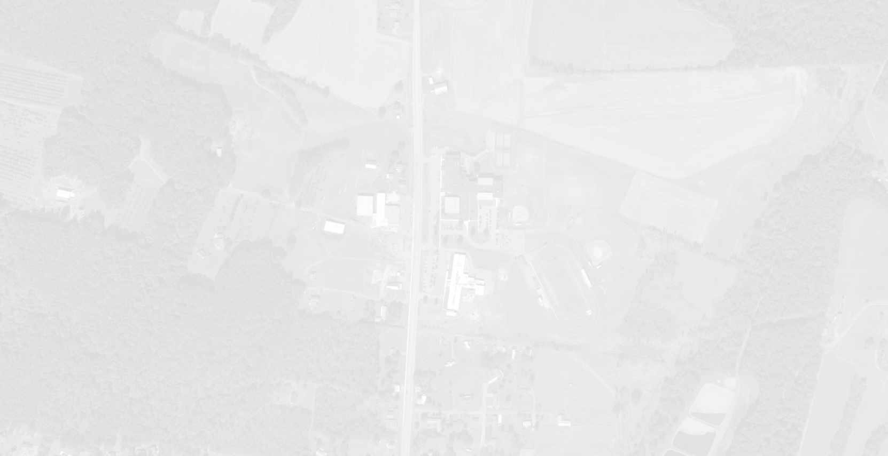
Chestnut Ridge SD Feasibility Study
Process / Contents of the Study
Demographic Review
(Student Enrollment, Population, Housing)
Facilities Study
(Building Improvements & Construction Cost)
Educational Program Review
(Requirements / Needs)
Solutions
  (Construction Options)
  Cost and Financing of Options
    (Construction Options)
Schedule
Note: Study per PDE Requirements

Slide 4
Chestnut Ridge SD Feasibility Study
Demographic Exploration – Population & Housing
2000 - 2010
Loss of Population
- 39
2010 - 2017
Loss of Population
- 171
2000 - 2017
Loss of Population
- 245
2000 - 2010
Loss of Housing
- 98
2010 - 2017
Gain of Housing
+ 133
2000 - 2017
Gain of Housing
+ 35

Slide 5
Chestnut Ridge SD Feasibility Study
Demographic Exploration – Historical Student Enrollment
2000 - 2010
Loss of Students
- 264
2010 - 2017
Loss of Students
- 193
2000 - 2017
Loss of Students
- 463

Slide 6
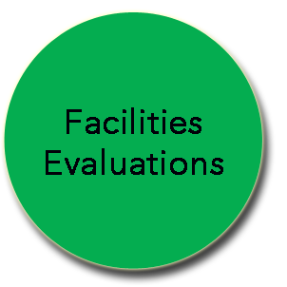
Facilities Evaluation Process
Improvement Lists: Itemized, Priced, and Prioritized
Architect, Engineers, and SD Team prioritize the work items and assign ranking to each work item
RANK 1
HIGH PRIORITY
RANK 2
MEDIUM PRIORITY
RANK 3
LOW PRIORITY
FUTURE CONSIDERATION
RANK 4
OPTIONAL
SEPARATE FUTURE PROJECTS

Slide 7
Chestnut Ridge School District
Summary - Building Improvement Construction Costs
  * Note: Construction Cost x 1.25 = Total Project Cost

Slide 8
Chestnut Ridge School District
Overview
Last
Reimbursement Project
Next PlanCon
Reimbursable Period
Year Built
Central
ES
1961
1991
2011
MS / DAO
1954
2004
2024
HS
1954
2006
2026
  *Recommendation: Wait until 20 year reimbursement period is expired for HS & MS Buildings and update these 2 buildings when reimbursement becomes available.

Slide 9

Chestnut Ridge SD Feasibility Study
Option Profiles Considered
Central
Elementary
Building
Middle
School
Building
High
School
Building
Option 4B
(Status Quo)
PK-2
3-7
8-12
Option 5
Close
(demo)
5-8
9-12
PK-4
Option 6
NEW
PK-4
5-8
9-12

Slide 10
Chestnut Ridge SD Feasibility Study
Option 4B
4B (Status Quo)
OPTION
3 SCHOOLS: PK-2 E.S.; 3-7 M.S.; 8-12 H.S.

Slide 11
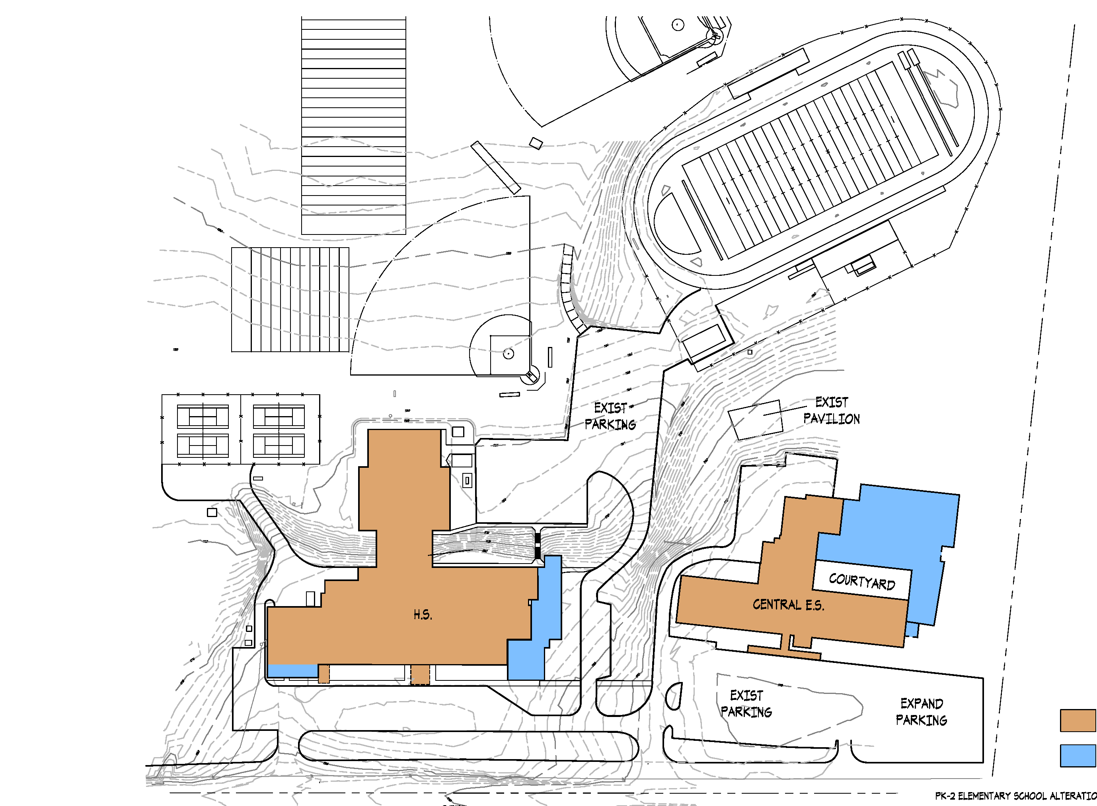
Chestnut Ridge Central Elementary School
Option 4B – Status Quo
Site Improvements:
Existing site accommodates the new additions.

Slide 12
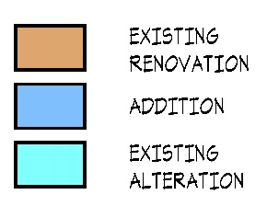
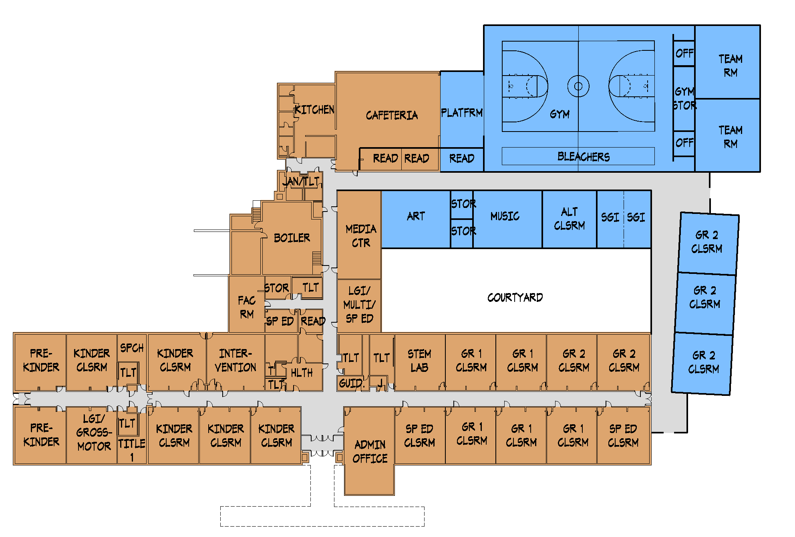
Chestnut Ridge Central Elementary School
Option 4B – Status Quo
Grades PK-2

Slide 13
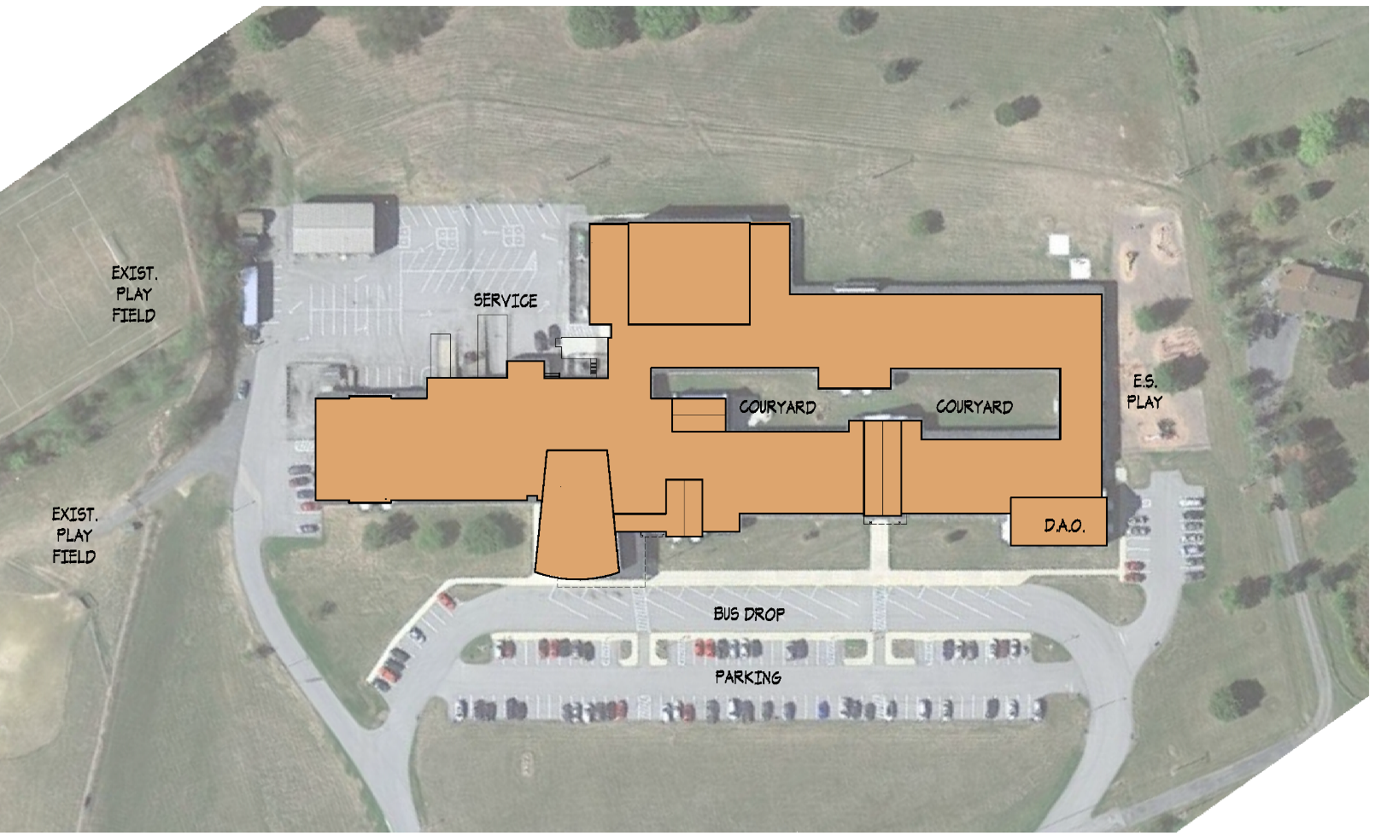
Chestnut Ridge Middle School / DAO
Option 4B – Status Quo
Site Improvements:
Existing site accommodates the new additions.

Slide 14
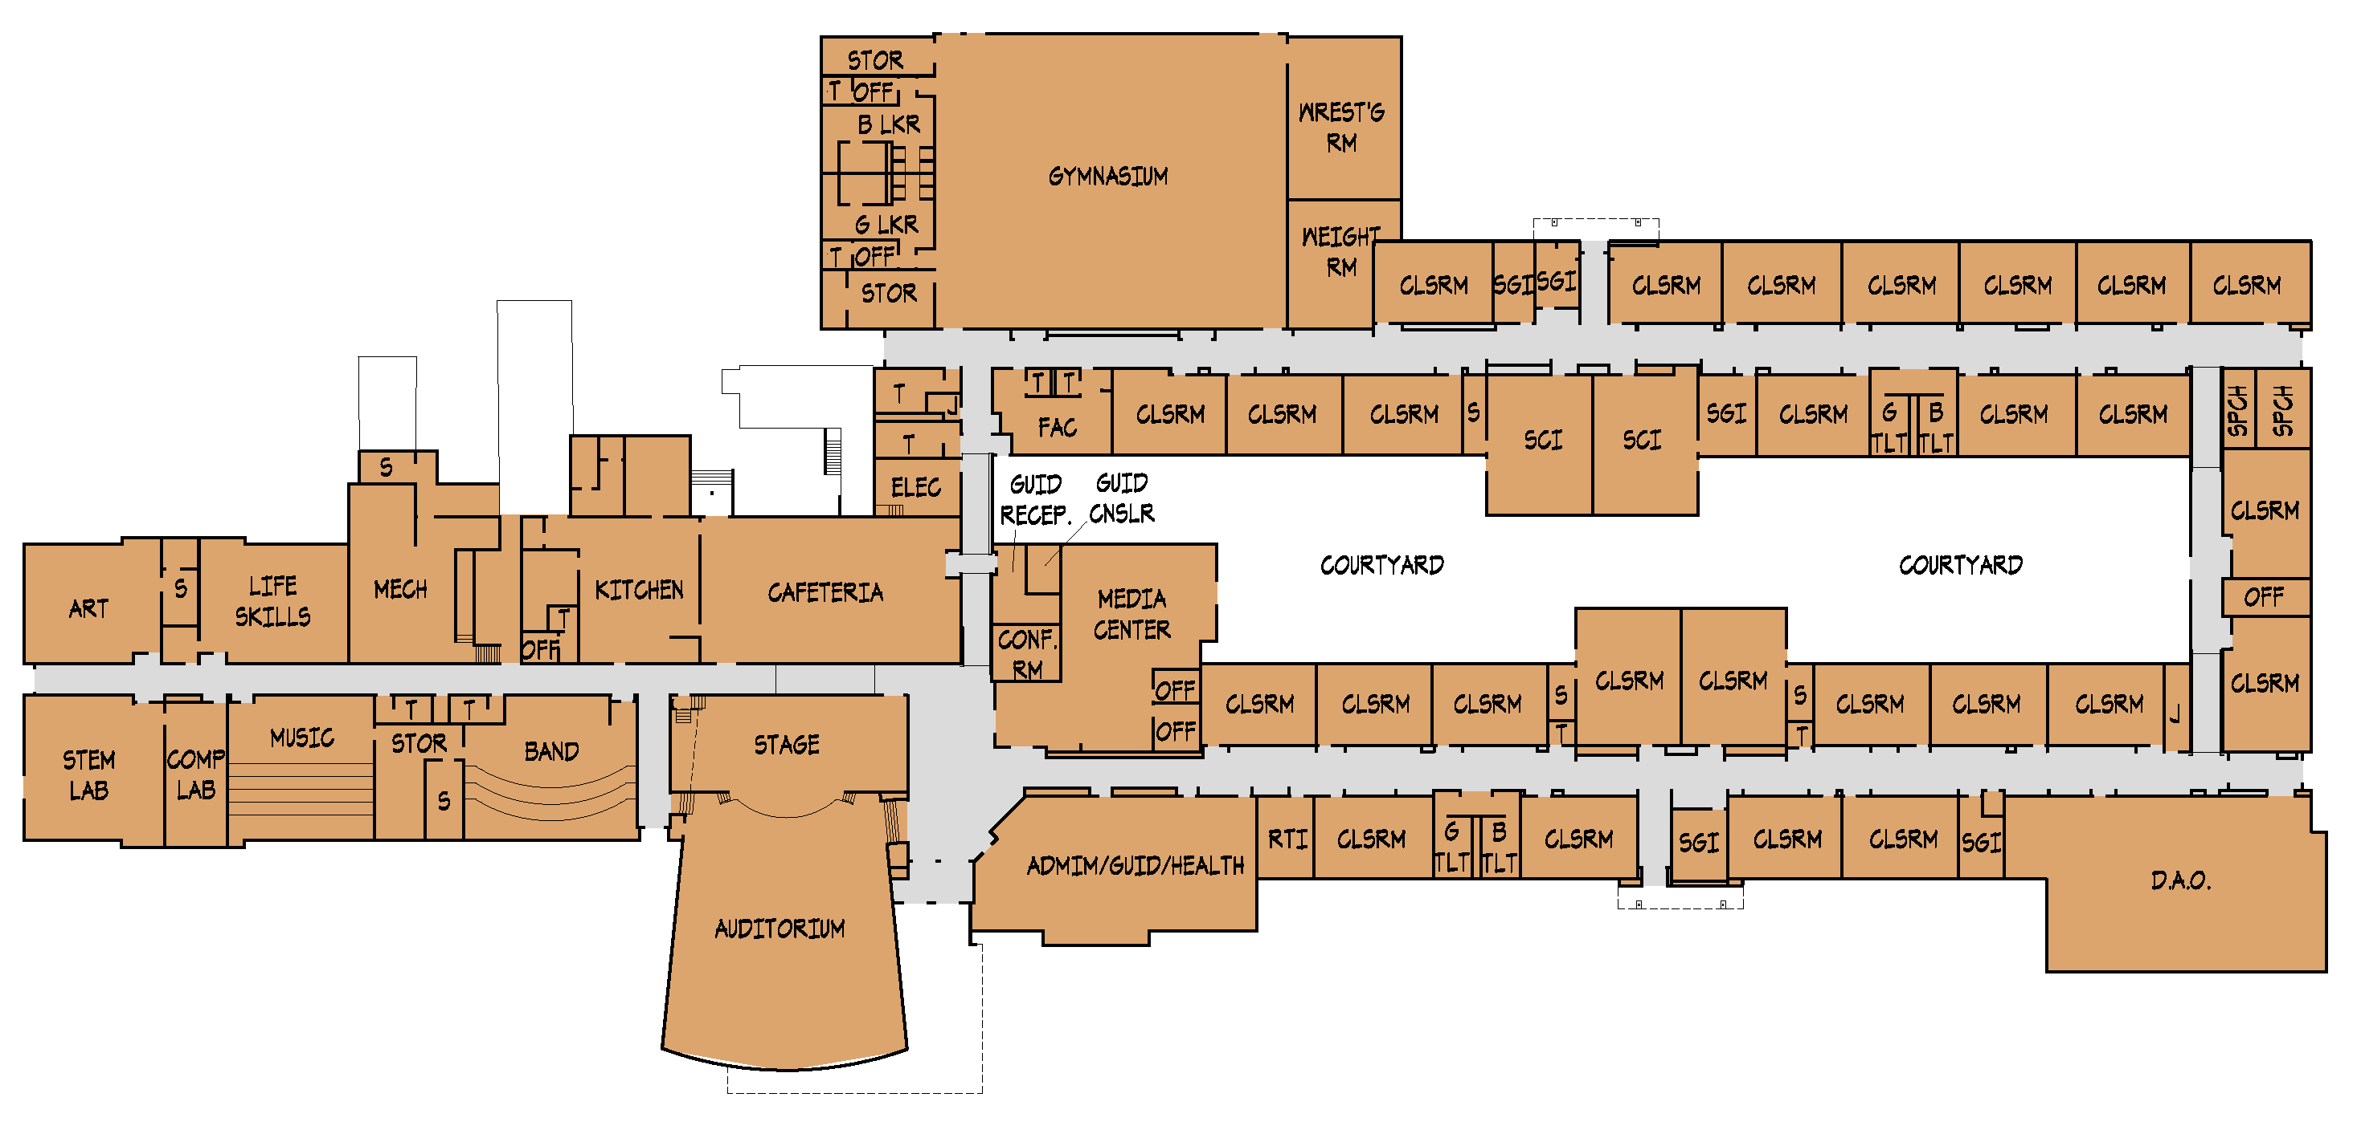
Chestnut Ridge Middle School / DAO
Option 4B – Status Quo
Grades 3-7

Slide 15
Chestnut Ridge Senior High School
Option 4B – Status Quo
Site Improvements:
Existing site accommodates the new additions.

Slide 16
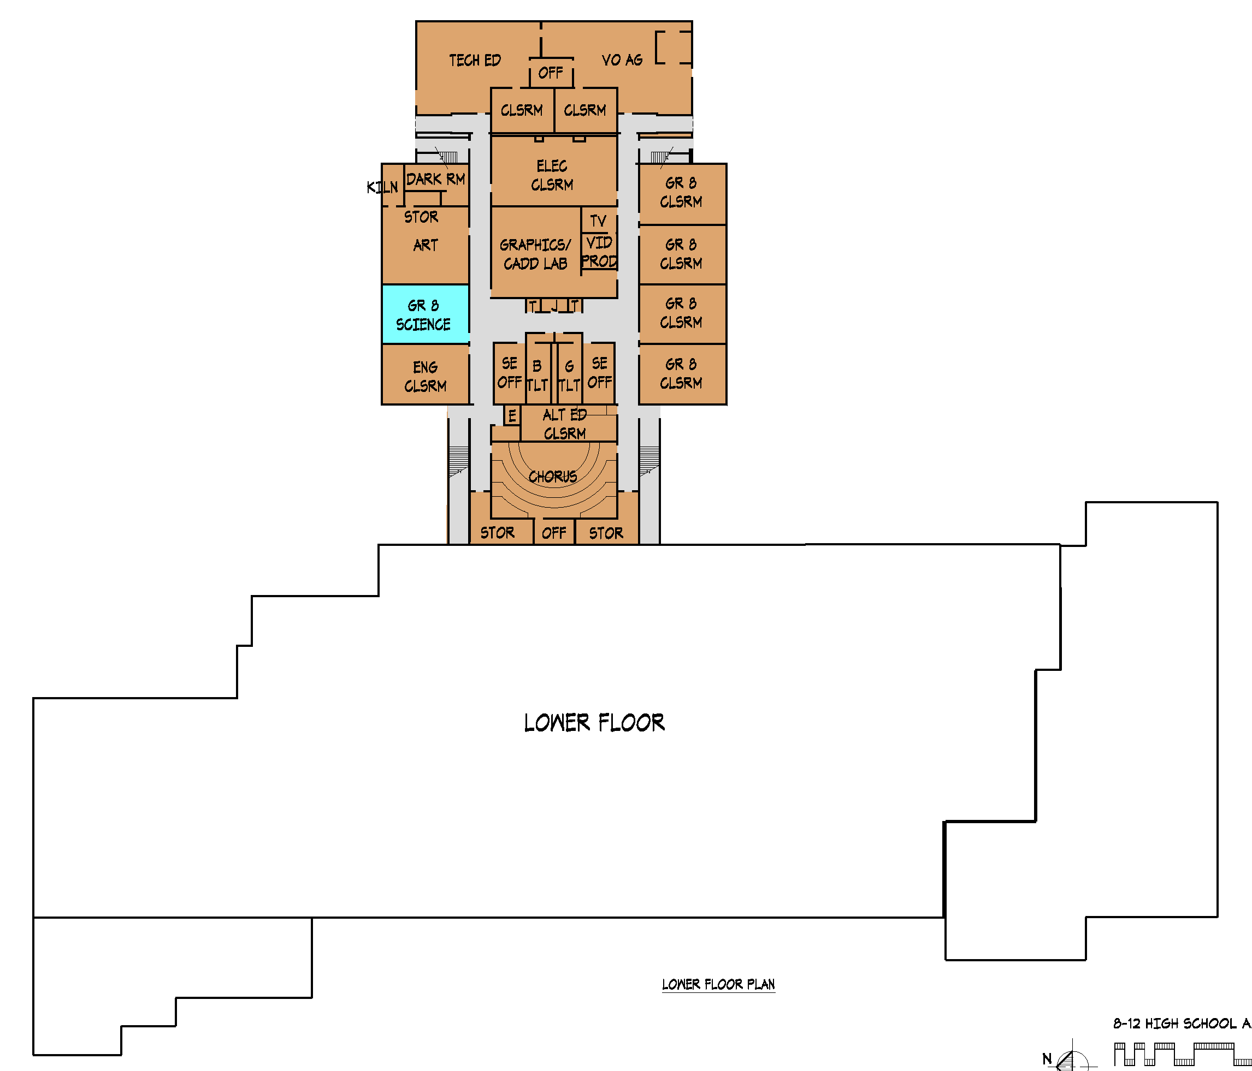
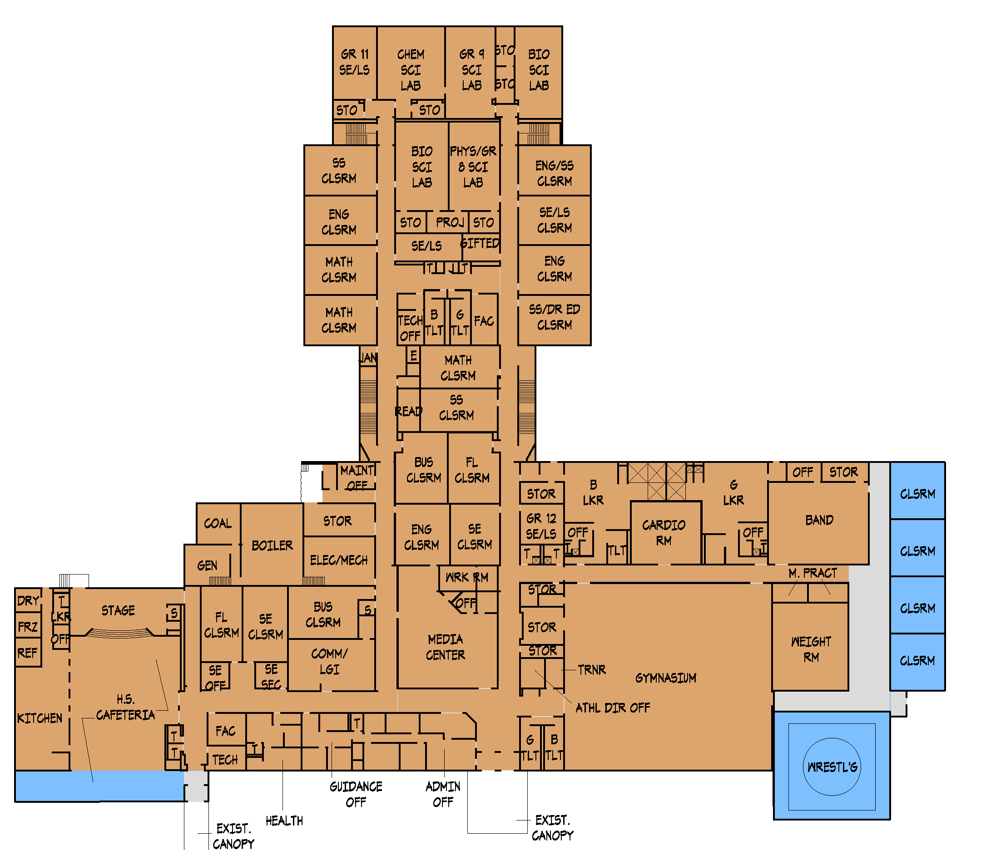
Chestnut Ridge Senior High School
Option 4B – Status Quo
Grades 8-12
LOWER FLOOR
FIRST FLOOR

Slide 17
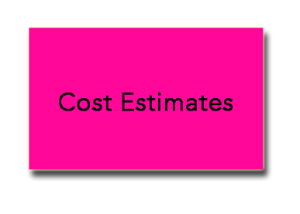
Chestnut Ridge SD Feasibility Study
Option 4B - Cost Summary
ES
(Grades PK-2)
Total Construction Cost: $14,621,900
x 1.25
Total Project Cost: $18,277,000
MS
(Grades 3-7)
Total Construction Cost: $2,130,000
x 1.25
Total Project Cost: $2,663,000
HS
(Grades 8-12)
Total Construction Cost: $3,400,000
x 1.25
Total Project Cost: $4,250,000
Option 6 Total Project Cost: $25,190,000
+ Construction Market Contingency: $1,000,000
Option 6 Total Project Cost: $26,190,000

Slide 18
Chestnut Ridge SD Feasibility Study
Option 5
5
OPTION
2 SCHOOLS: PK-4 E.S. @ M.S. Bldg; 5-8 M.S. & 9-12 H.S. @ H.S. Bldg
Close existing Central Elementary School (Demolish & Add Parking)
M.S. Building grade re-alignment to PK-4 Elementary School
Minor alternations to accommodate Pre-School; No renovation work
H.S. building grade re-alignment to 5-8 M.S. & 9-12 H.S.
Add Wrestling Room; No renovation work

Slide 19
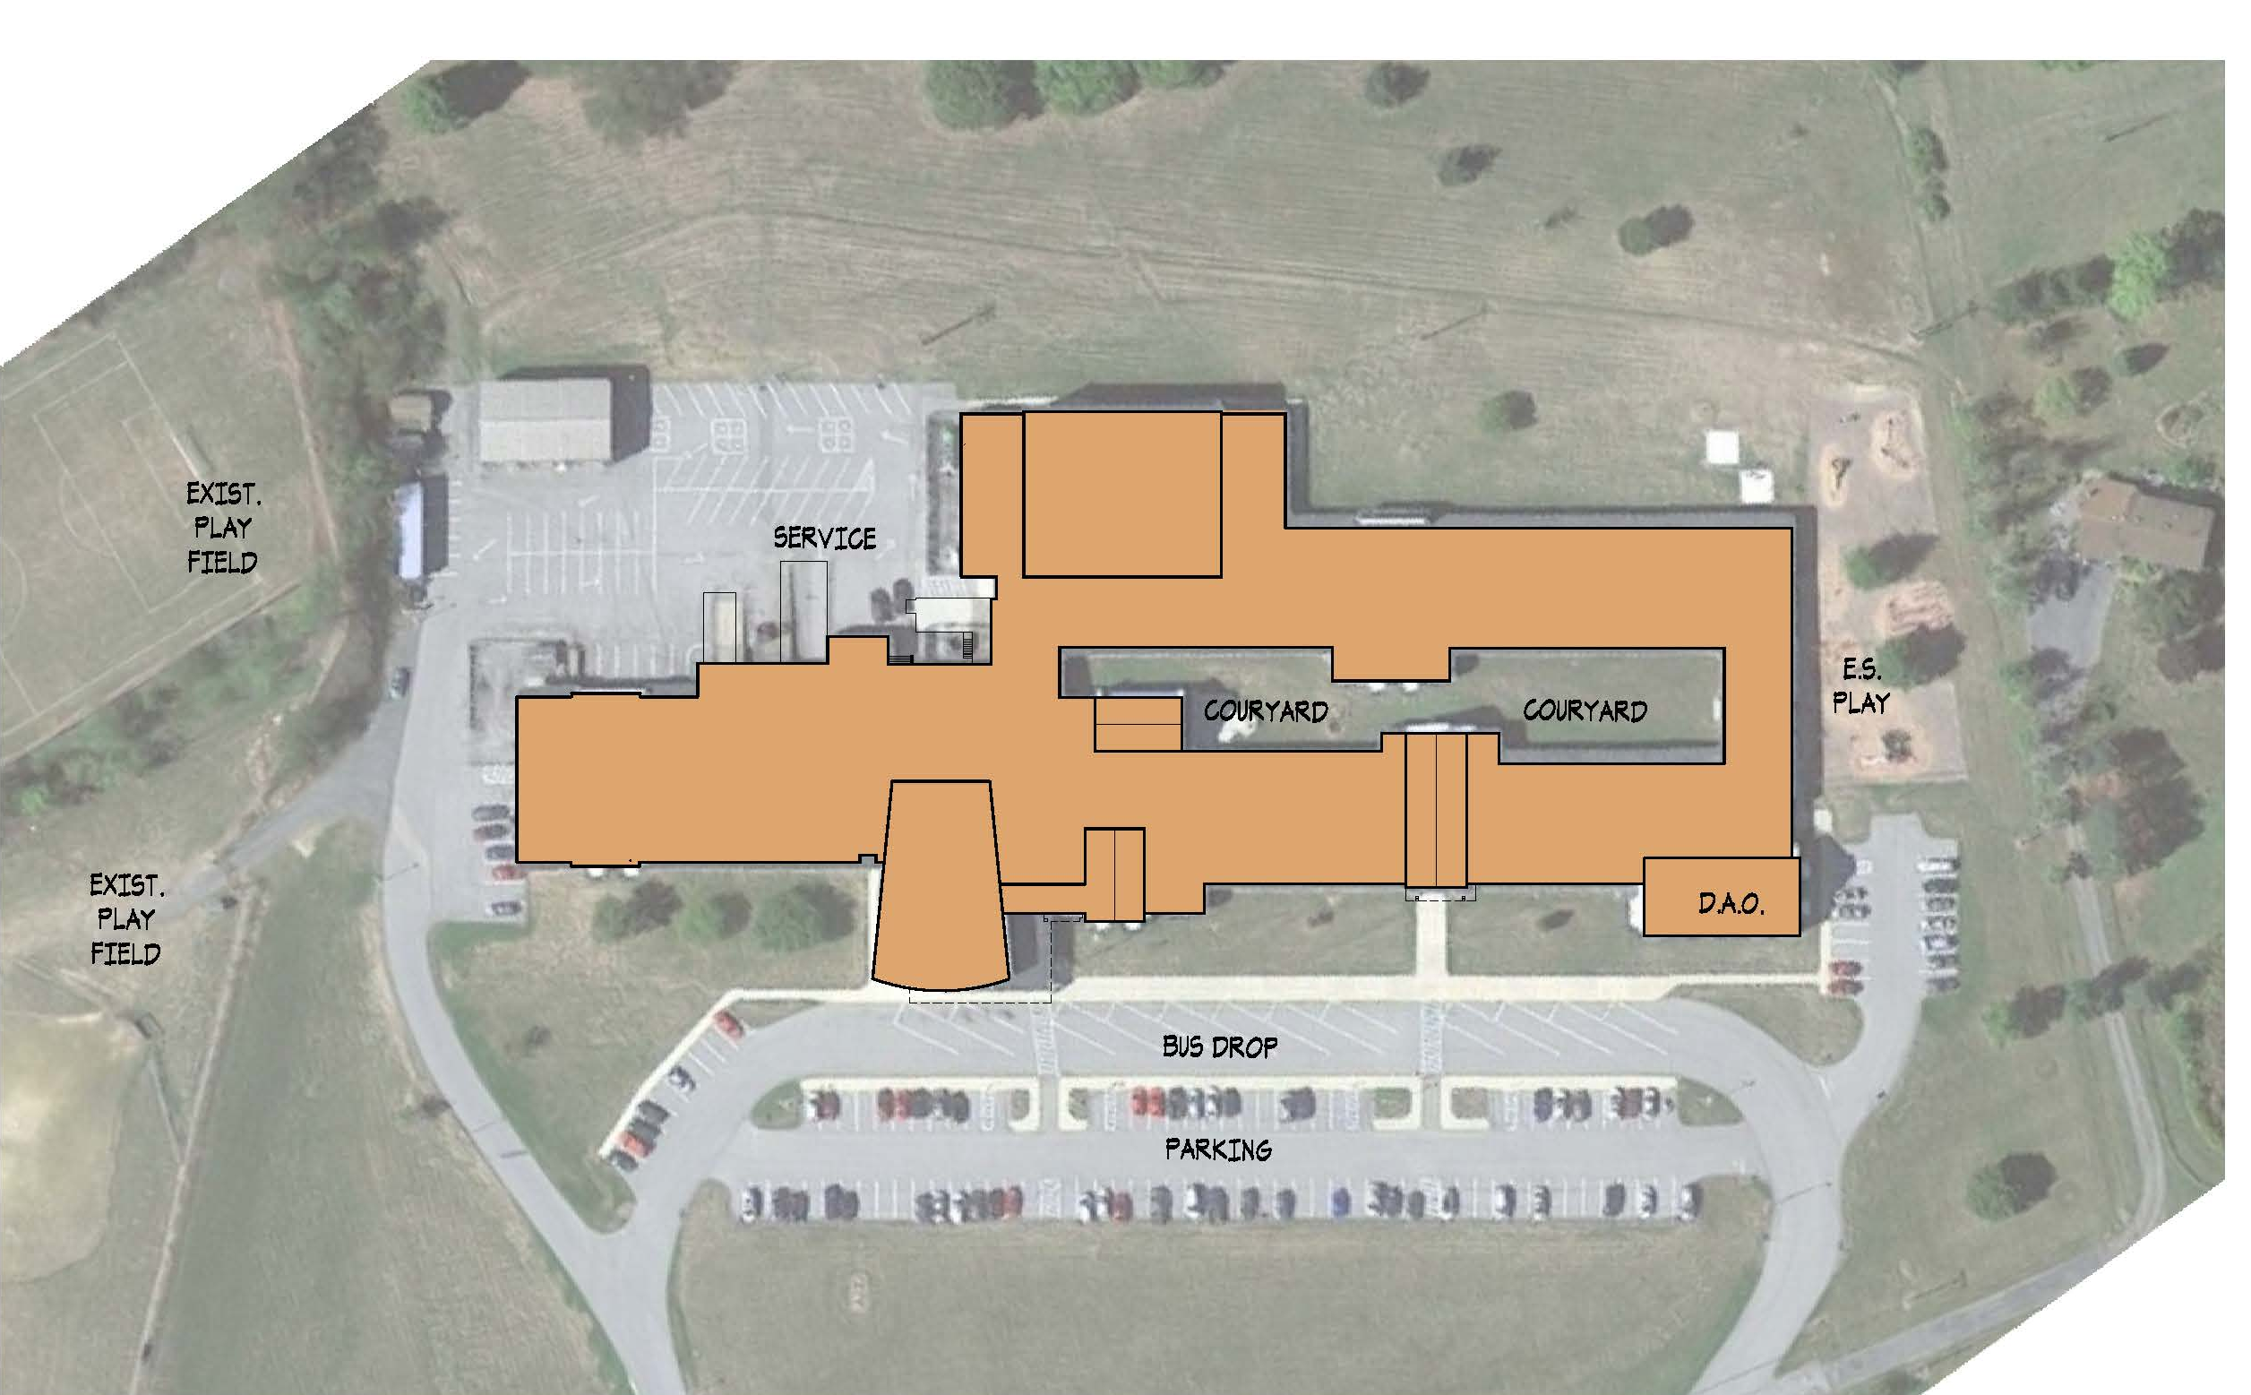
PK-4 Elementary School @ M.S.
Option 5

Slide 20
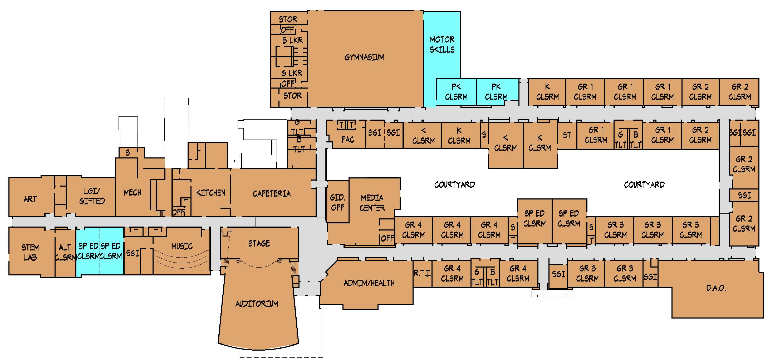
PK-4 Elementary School @ M.S.
Option 5
Grades PK-4

Slide 21
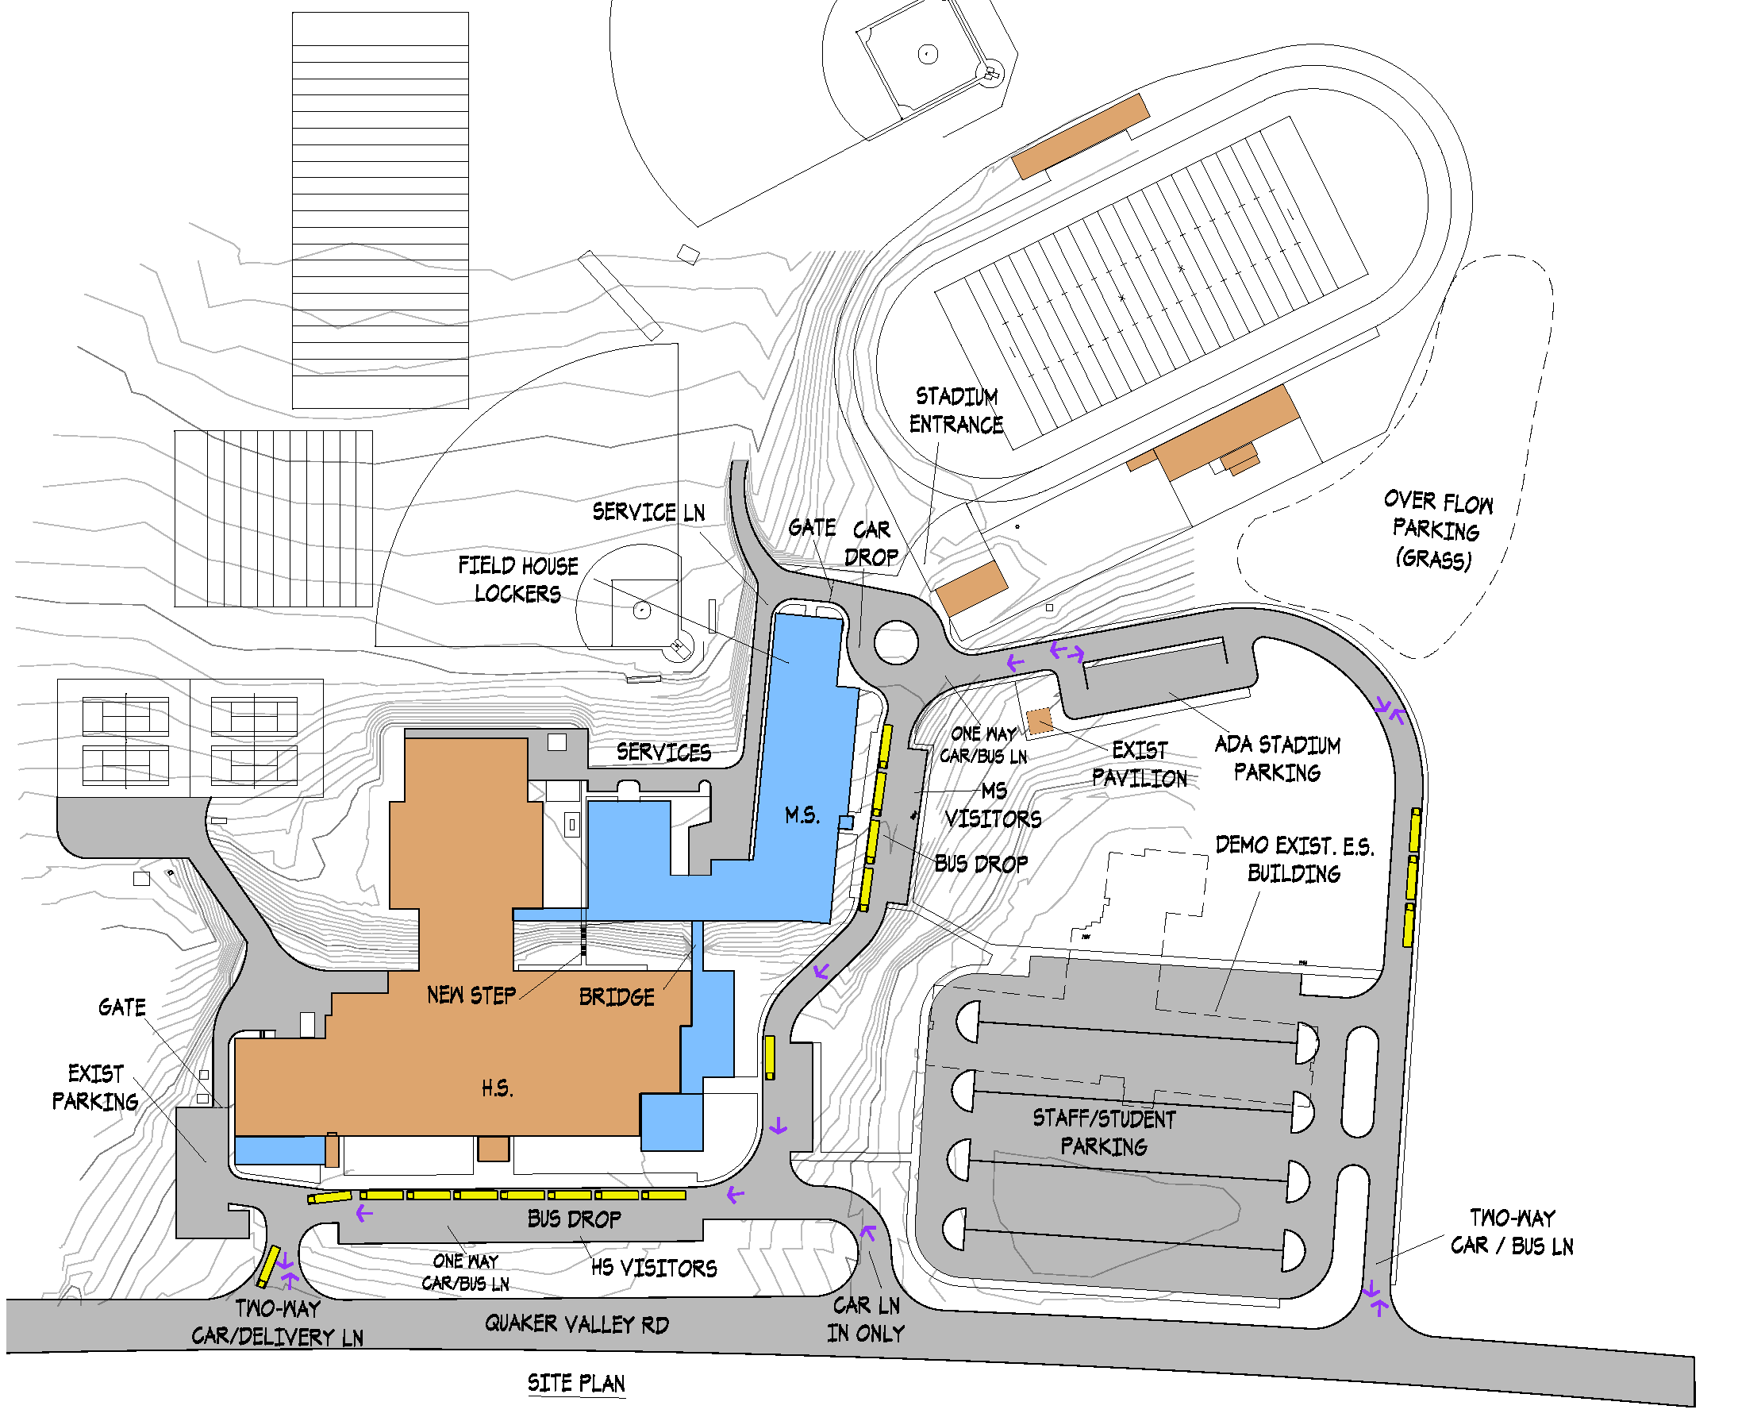
5-8 Middle / 9-12 High School @ H.S.
Option 5

Slide 22
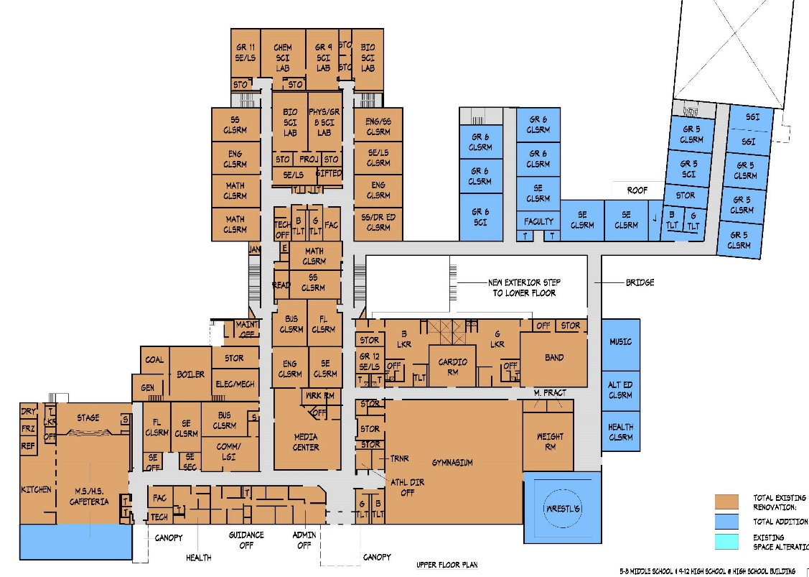
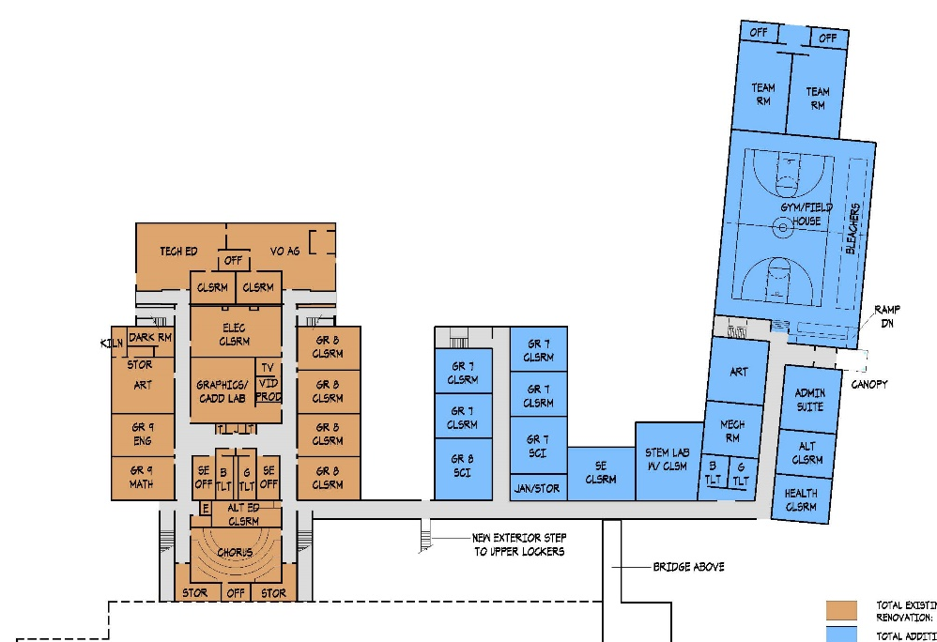
5-8 Middle / 9-12 High School @ H.S.
Option 5
Grades 5-12
LOWER FLOOR
UPPER FLOOR

Slide 23
Chestnut Ridge SD Feasibility Study
Option 5 - Cost Summary
Total Construction Cost: $400,000
x 1.25
Total Project Cost: $500,000
ES
(Grades PK-4)
Total Construction Cost: $16,760,000
x 1.25
Total Project Cost: $20,950,000
MSHS
(Grades 5-12)
Option 5 Total Project Cost: $21,450,000
+ Construction Market Contingency: $1,000,000
Option 5 Total Project Cost: $22,450,000

Slide 24
Chestnut Ridge SD Feasibility Study
Option 6
6
OPTION
3 SCHOOLS: PK-4 E.S.; 5-8 M.S.; 9-12 H.S.
New PK-4 Elementary School
Middle School with 5-8 grade re-alignment; No renovation work
High School with 9-12 grade re-alignment
Add Wrestling Room; No renovation work

Slide 25
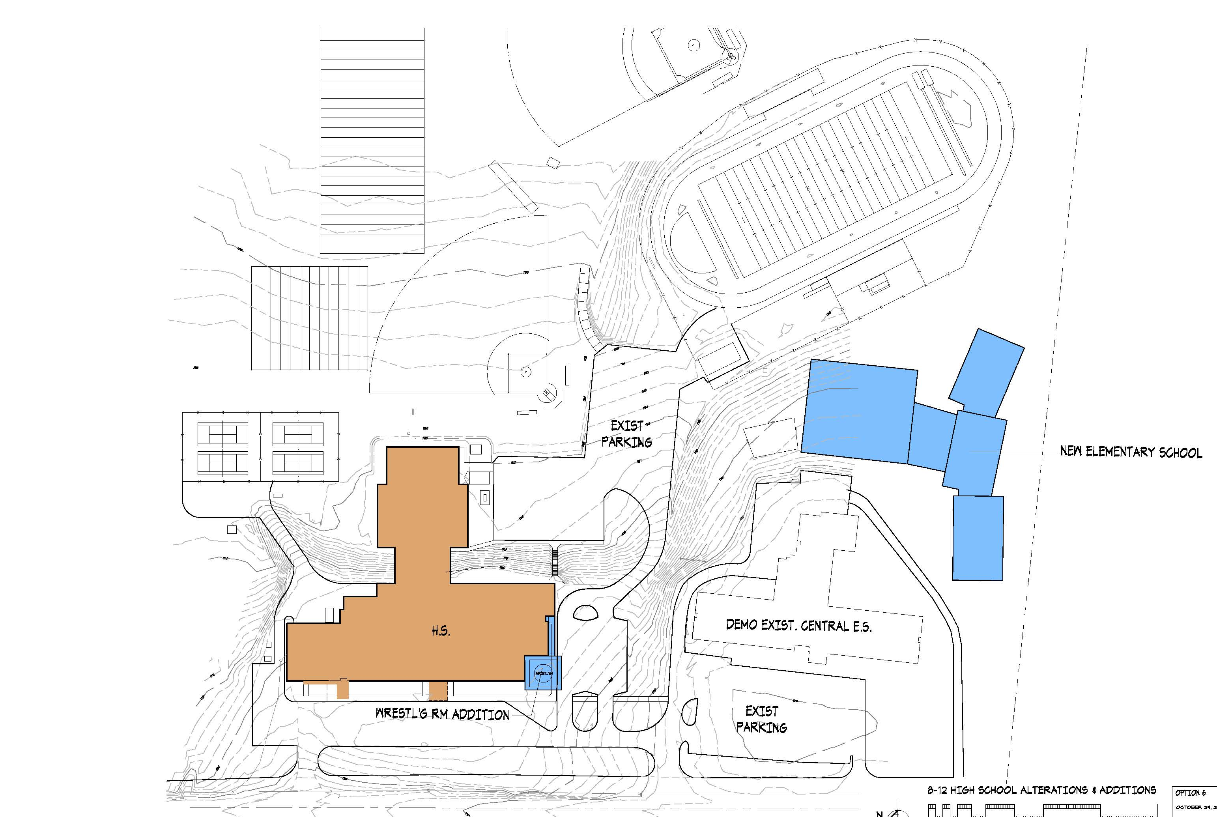
New PK-4 Elementary School @ E.S. Site
Option 6

Slide 26

5-8 Middle School @ M.S.
Option 6

Slide 27
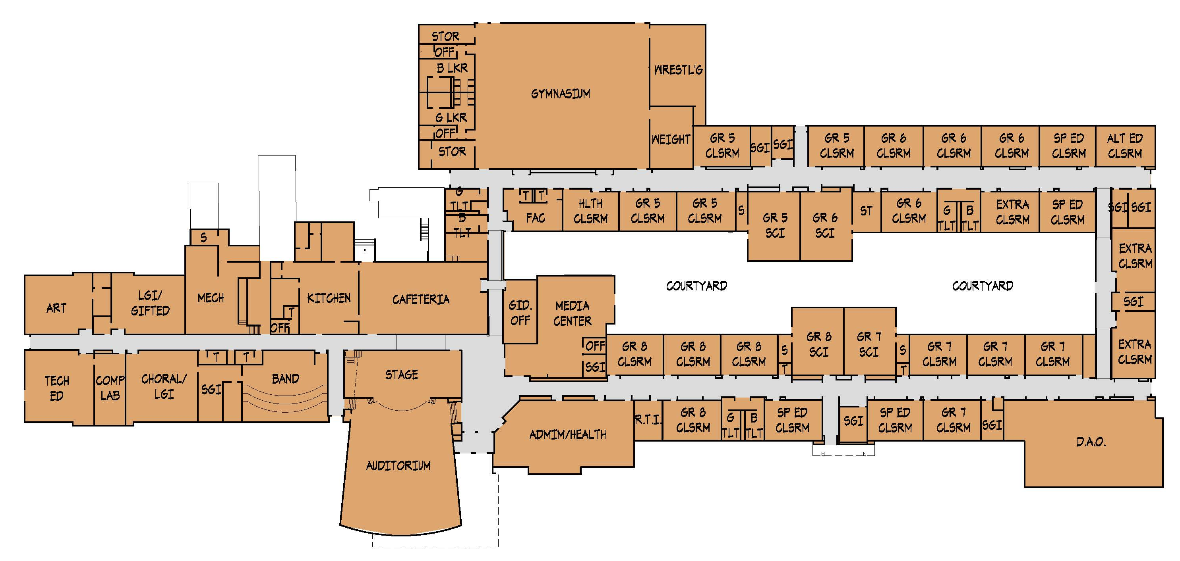
5-8 Middle School @ M.S.
Option 6
Grades 5-8

Slide 28
9-12 High School @ H.S.
Option 6

Slide 29
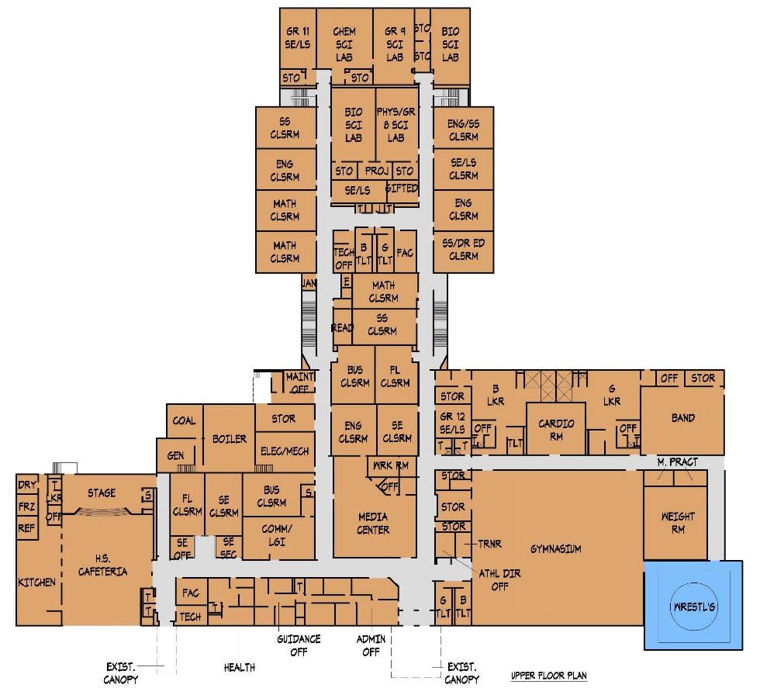
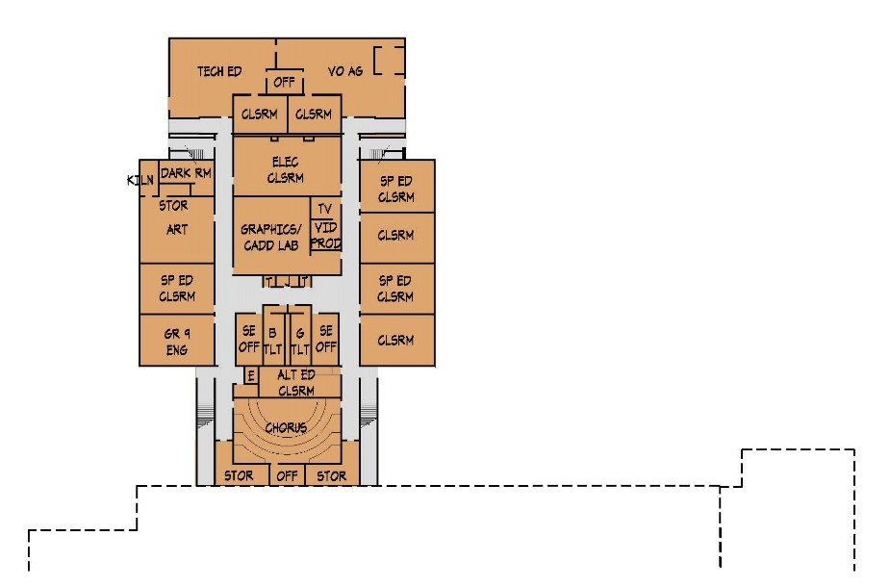
9-12 High School @ H.S.
Option 6
Grades 9-12
LOWER FLOOR
UPPER FLOOR

Slide 30
Chestnut Ridge SD Feasibility Study
Option 6 - Cost Summary
ES
(Grades PK-4)
Total Construction Cost: $19,725,000
x 1.25
Total Project Cost: $24,656,000
MS
(Grades 5-8)
Total Construction Cost: $0
x 1.25
Total Project Cost: $0
HS
(Grades 9-12)
Total Construction Cost: $1,000,000
x 1.25
Total Project Cost: $1,250,000
Option 6 Total Project Cost: $25,906,000
+ Construction Market Contingency: $1,000,000
Option 6 Total Project Cost: $26,906,000

Slide 31
Chestnut Ridge SD Feasibility Study
Options Cost Summary
Option 4B
(Status Quo)
PK-2; 3-7; 8-12
Total Project Cost: $26,190,000
Option 5
PK-4; 5-12
Total Project Cost: $22,450,000
Option 6
PK-4; 5-8; 9-12
Total Project Cost: $26,906,000

Slide 32
Chestnut Ridge SD Feasibility Study
Options Cost Summary
One-time
General Fund Addition to $20M Bond
$20M Bond Annual Net Share
@ 25 years
Total Project Cost
$26,190,000
$20M + $6.2 M = $1.5 M
Option 4B
(Status Quo)
PK-2; 3-7; 8-12
$22,450,000
$20M + $2.5 M = $1.5 M
$26,906,000
$20M + $6.9 M = $1.5 M
Option 5
PK-4; 5-12
Option 6
PK-4; 5-8; 9-12

Slide 33
Chestnut Ridge SD Feasibility Study
Proposed Schedule
December 2019 / January 2020
School Board Authorizes Project Beginning
January 2020
Architect / Engineers Begin Production & Permits
January / February 2021
Bidding of Project
June - August 2022
Complete Construction / Move-In
(18-20 months maximum)

Slide 34
Chestnut Ridge School District
DRAFT
Part 2 - Study
14 November 2019

Slide 35
Chestnut Ridge SD Feasibility Study
Option 4 - Status Quo
4 (Status Quo)
OPTION
3 SCHOOLS: PK-2 E.S.; 3-7 M.S.; 8-12 H.S.

Slide 36
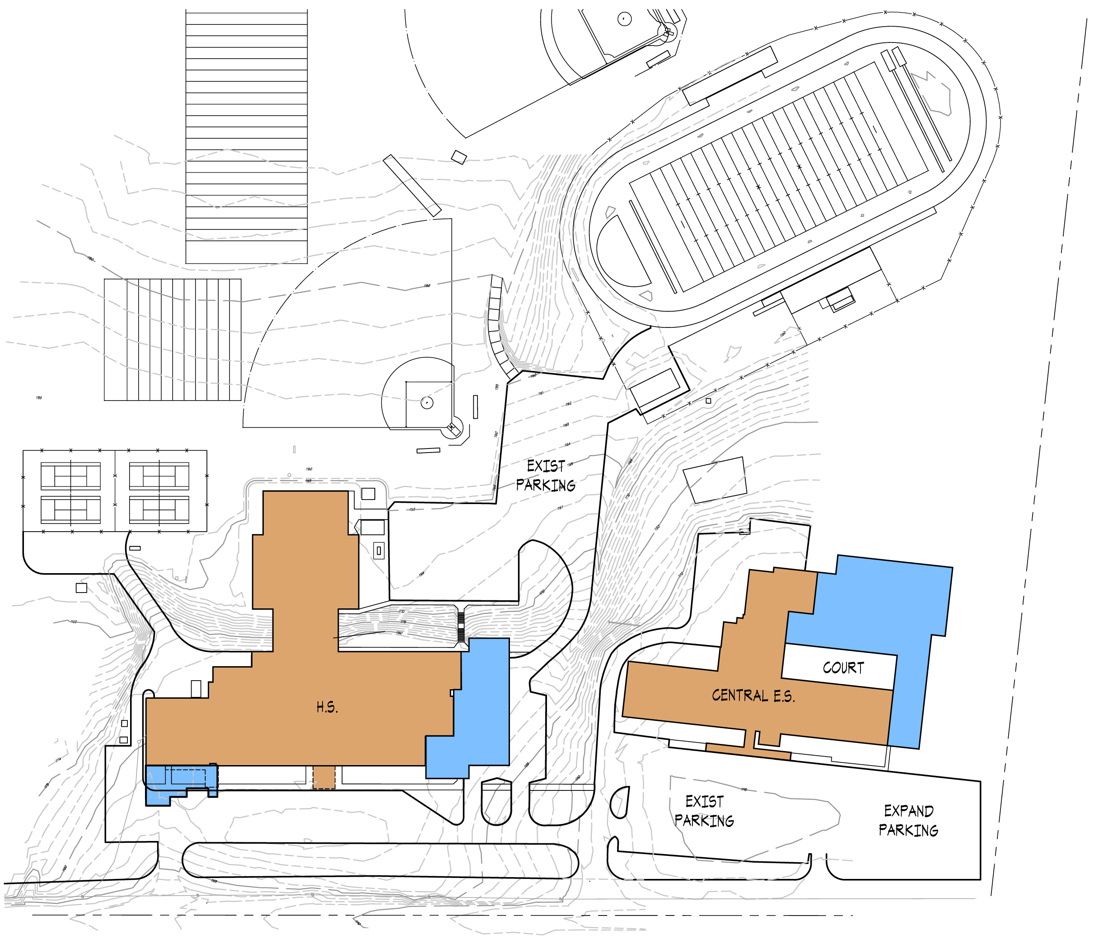
Chestnut Ridge Central Elementary School
Option 4 - Status Quo
Site Improvements:
Existing site accommodates the new additions.

Slide 37
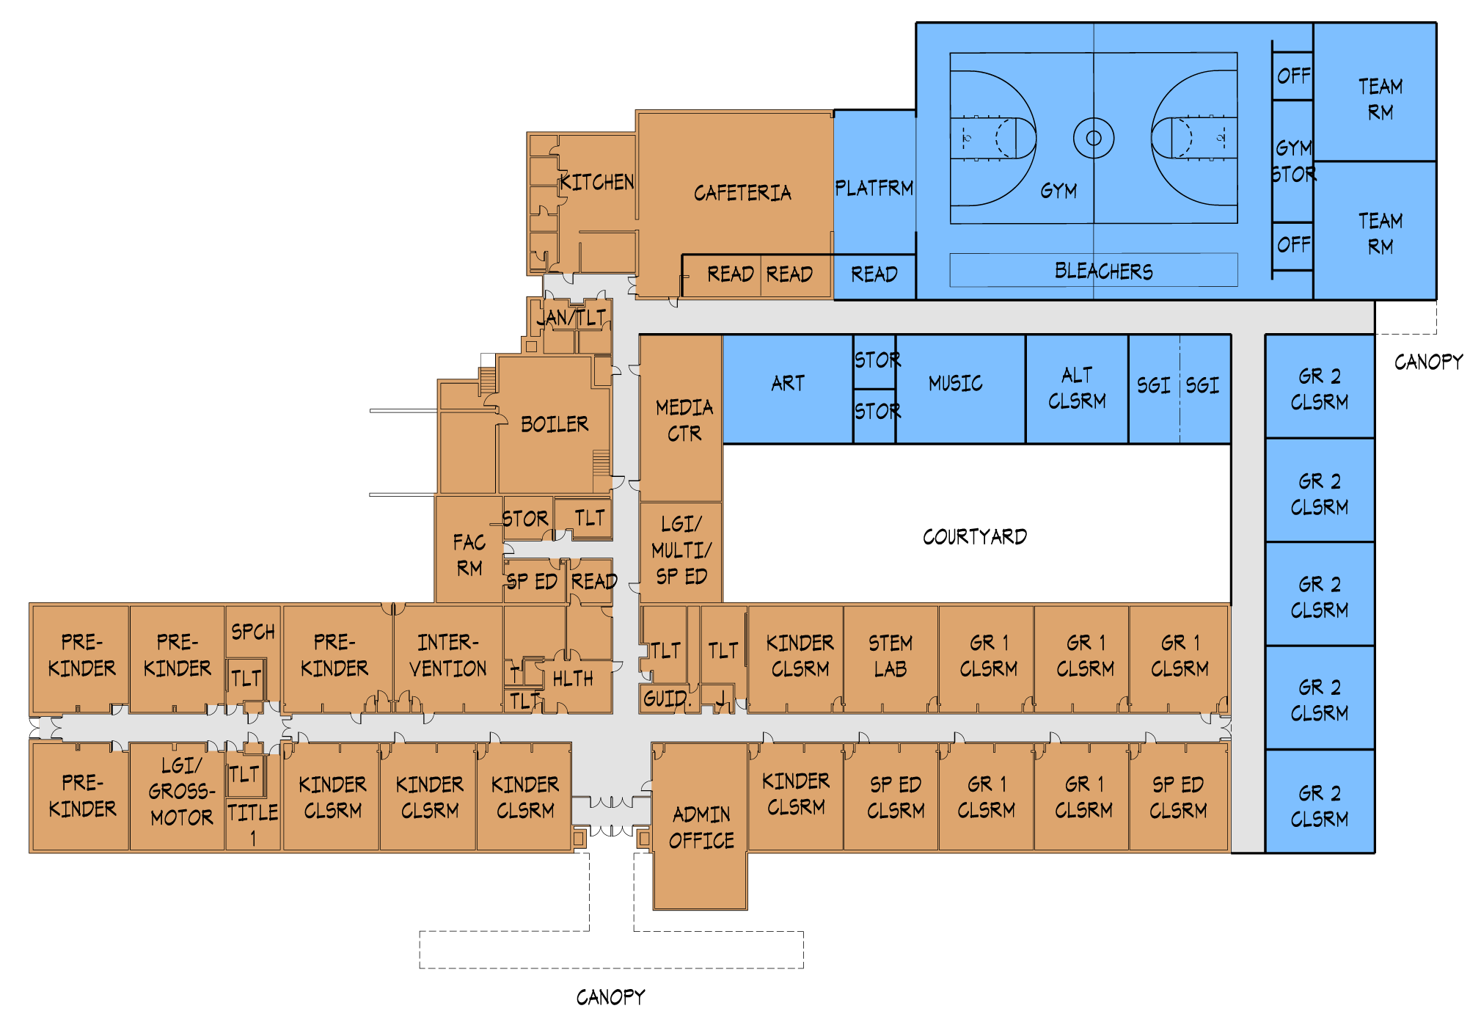
Chestnut Ridge Central Elementary School
Option 4 - Status Quo
Grades PK-2
Educational Program Improvements:
Added:
2 Classrooms (5 / grade)
2 Pre-K Classrooms (3 years old)
2 Special Education S.G.I.s
1 Alternative Education Classroom
Music Classroom (from Modular)
New Gym with Locker Rooms, Storage, 2 P.E. Offices
Enlarged Kitchen Area
Enlarged Health Suite
Relocated and Enlarged Art Classroom
Relocated and Enlarged Media Center

Slide 38
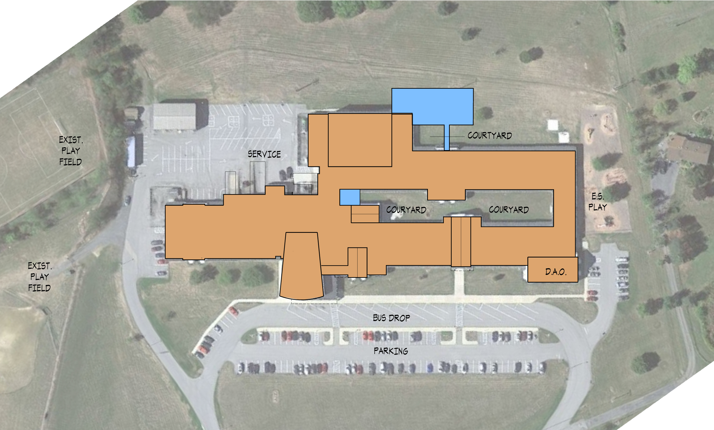
Chestnut Ridge Middle School / DAO
Option 4 - Status Quo
Site Improvements:
Existing site accommodates the new additions.

Slide 39
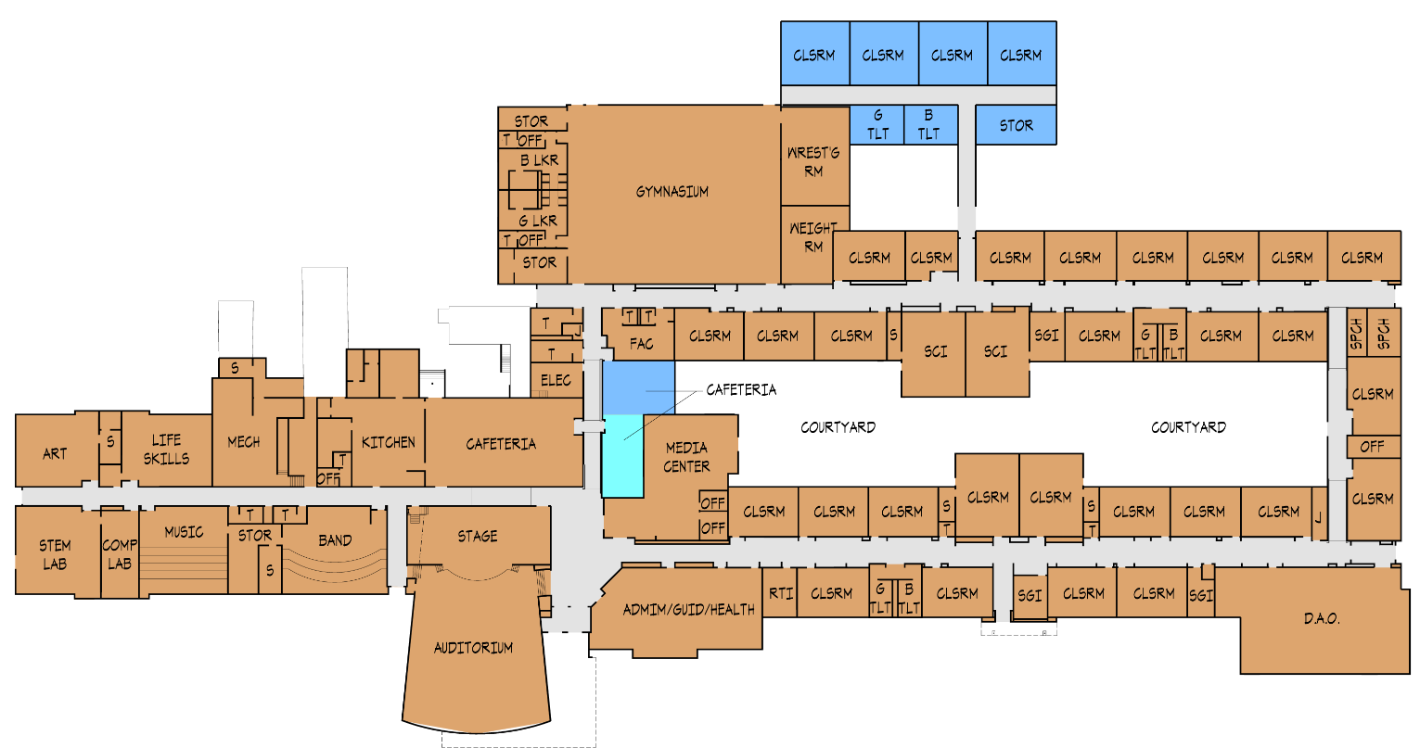
Chestnut Ridge Middle School / DAO
Option 4 - Status Quo
Grades 3-7
Educational Program Improvements:
Added:
1 Special Education S.G.I.
2 S.G.I.s (Divided Classroom)
1 Alternative Education Classroom
Enlarged Cafeteria Area

Slide 40
Chestnut Ridge Senior High School
Option 4 - Status Quo
Site Improvements:
Existing site accommodates the new additions.

Slide 41
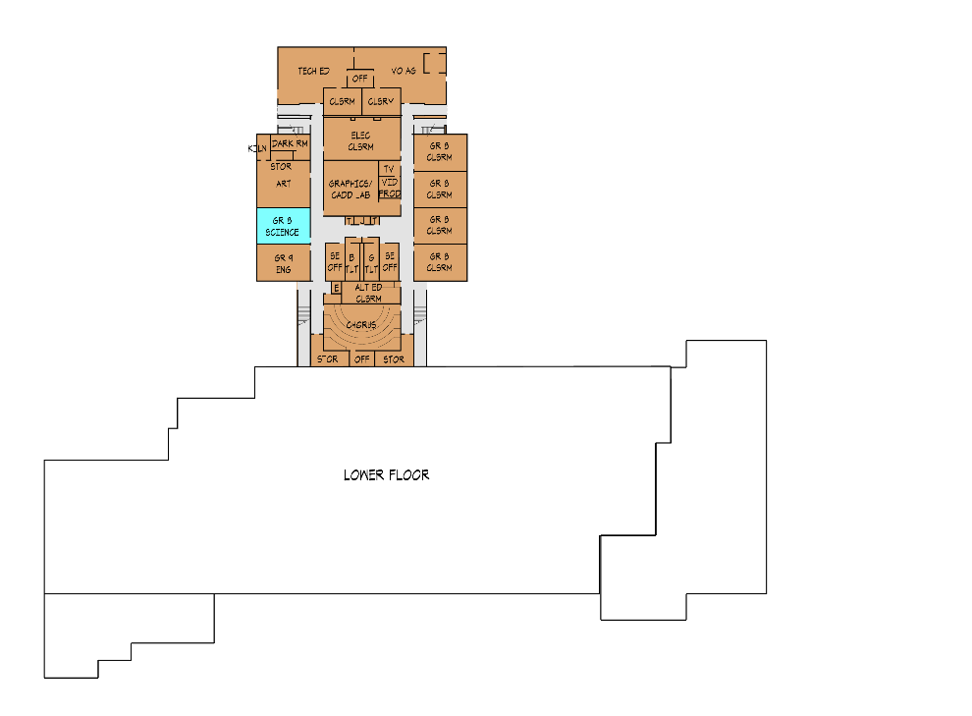
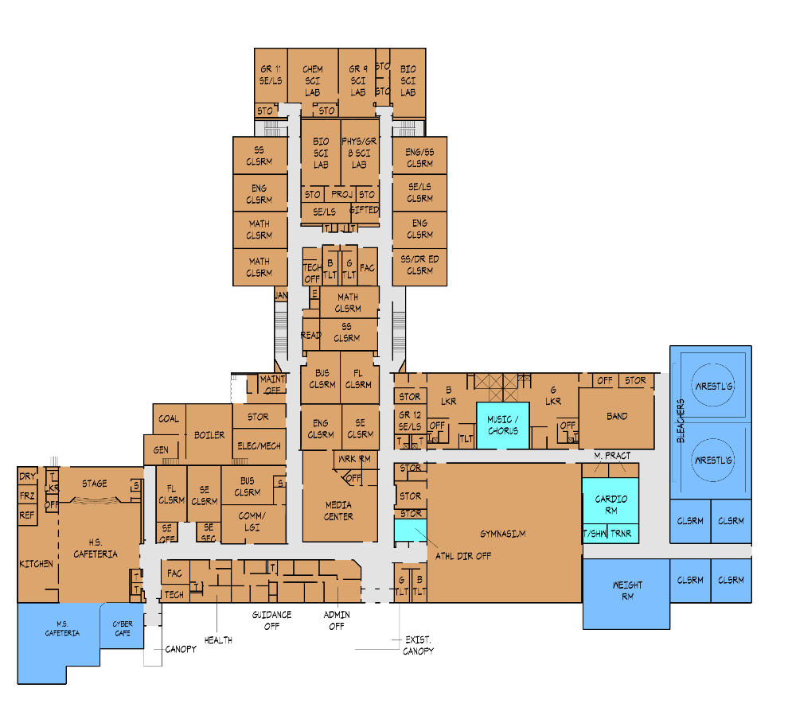
Chestnut Ridge Senior High School
Option 4 - Status Quo
Grades 8-12
Educational Program Improvements:
Added:
1 8th Grade Science Lab
3 Special Education / Learning Support Classrooms
Expanded Cafeteria Area
Cyber Café Area
1 Cardio Room
1 Weight Room
1 Wrestling Room
1 Athletic Director’s Office
1 Trainer’s Office
LOWER FLOOR
FIRST FLOOR

Slide 42
Chestnut Ridge SD Feasibility Study
Option 1
1
OPTION
2 SCHOOLS: PK-4 E.S. @ M.S.; 5-8 M.S. & 9-12 H.S. @ H.S.

Slide 43
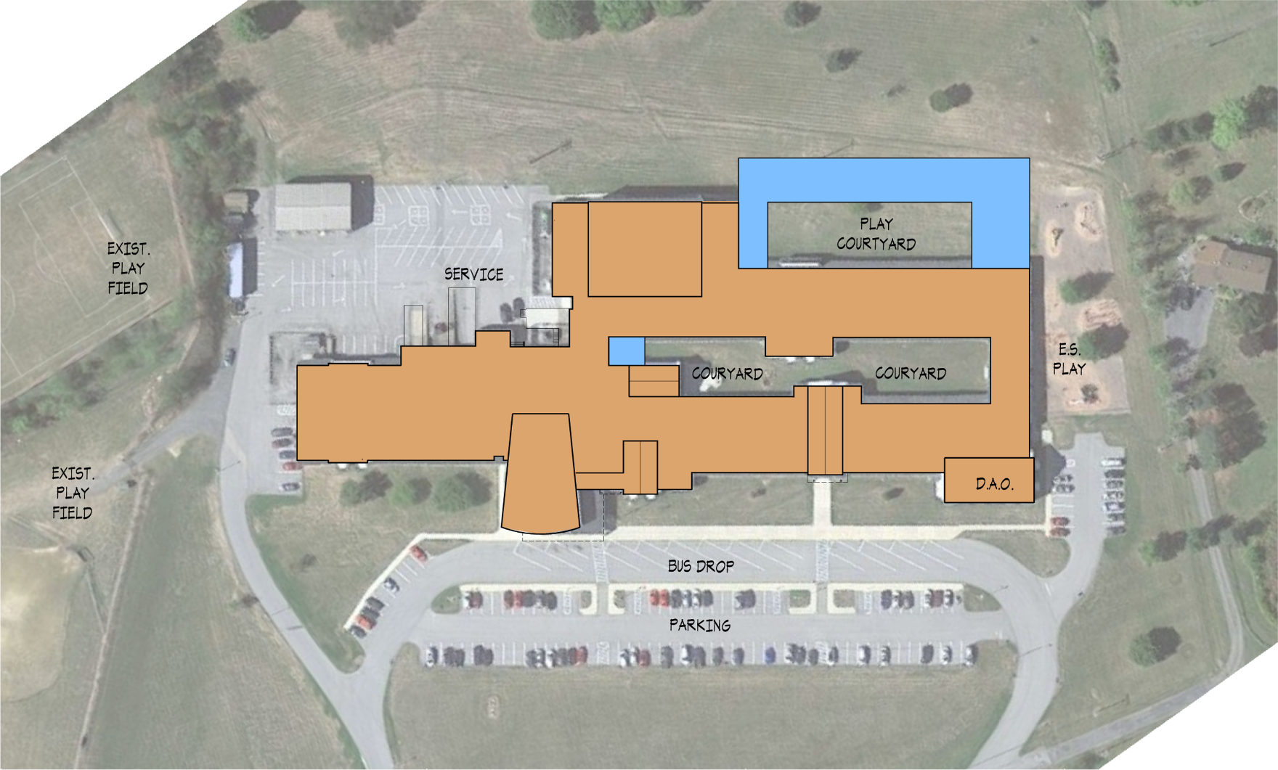
PK-4 Elementary School @ M.S.
Option 1
Site Improvements:
Existing site accommodates the new additions.

Slide 44
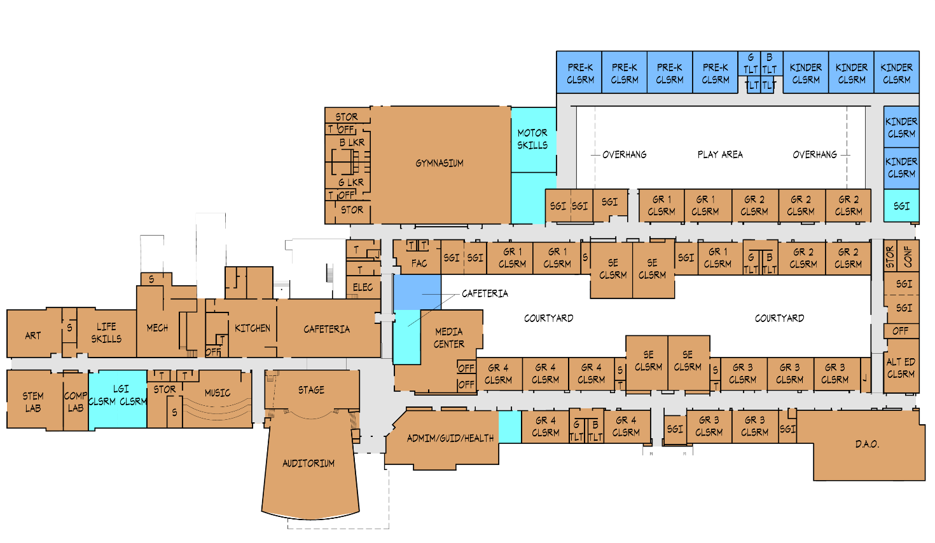
PK-4 Elementary School @ M.S.
Option 1
Grades PK-4
Educational Program Improvements:
Added:
5 Kindergarten Classrooms
4 Pre-Kindergarten Classrooms (3 & 4 years old)
Expanded Cafeteria Area
Converted Spaces to Accommodate:
Chorus Room into L.G.I. (divided)
  1 Alternative Education Classroom
  S.G.I.s & S.E. Classrooms
  Expansion of Administration Suite
  Motor Skills Room & Student Commons
  All grades 1-4 Classrooms
  Band Room remains as Music Room

Slide 45
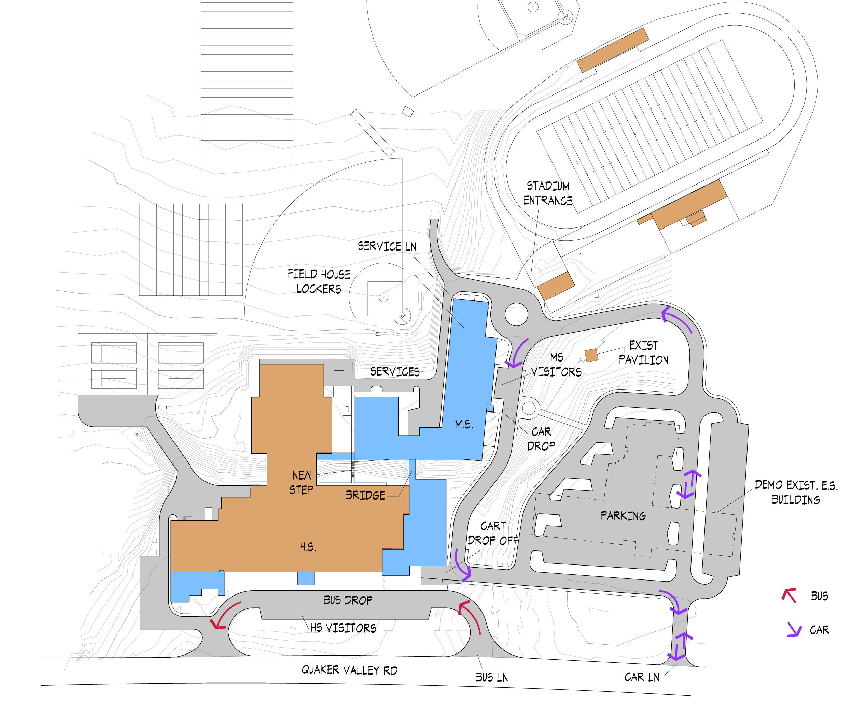
5-8 Middle / 9-12 High School @ H.S.
Option 1
Site Improvements:
Demolition of Central ES Building
New Parking Areas @ Central ES Site
New Car Drop-Off Loop and Service Drive
Existing Site accommodates New Additions
Lower HS parking relocated and Service Drive Reconfigured

Slide 46
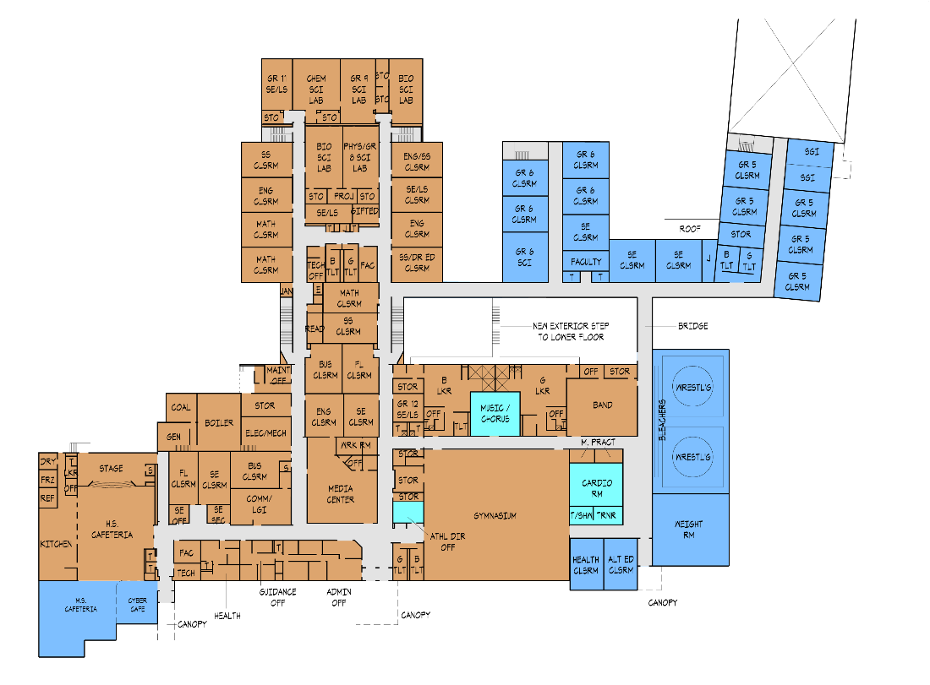
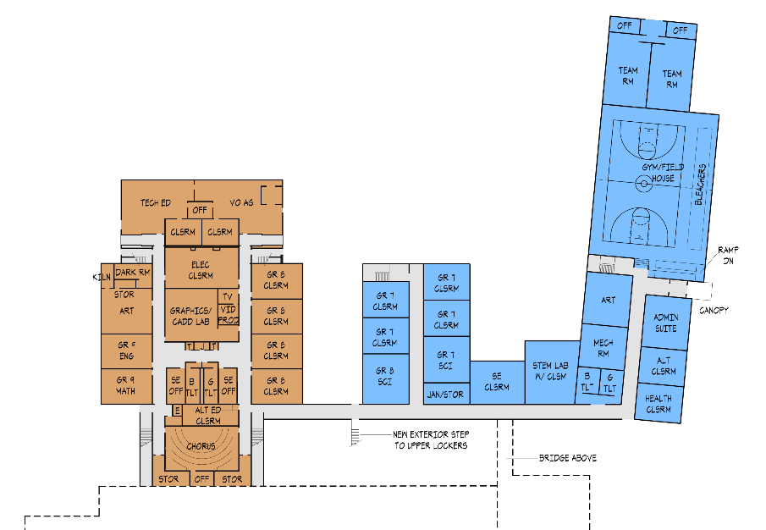
5-8 Middle / 9-12 High School @ H.S.
Option 1
Grades 5-12
Educational Program Improvements:
Added:
MS Gym with Locker Rooms, Storage, 2 P.E. Offices
MS Administration Suite
M.S. Art Room
MS Health Classroom
Faculty Room
MS STEM Lab
4 Special Education Classroom
5 Grade 7 Classrooms
1 Grade 8 Classroom
5 Grade 6 Classrooms
5 Grade 5 Classrooms
1 Divided Classroom (2 S.G.I.s)
MS Alternative Education Classroom
Health Classroom
Expanded Cafeteria Area (with Cyber Café)
Wrestling Room
Weight Room
Converted Space to Accommodate:
  1 Alternative Education Classroom
  S.G.I.s & S.E. Classrooms
  Expansion of Administration Suite
LOWER FLOOR
UPPER FLOOR

Slide 47
Chestnut Ridge SD Feasibility Study
Option 1 - Cost Summary
Total Construction Cost: $4,390,500
x 1.25
Total Project Cost: $5,488,000
ES
(Grades PK-4)
Total Construction Cost: $20,454,100
x 1.25
Total Project Cost: $25,568,000
MSHS
(Grades 5-12)
Option 1 Total Project Cost: $31,056,000

Slide 48
Chestnut Ridge SD Feasibility Study
Option 2
2
OPTION
2 SCHOOLS: PK-5 E.S. @ M.S.; 6-8 M.S. & 9-12 H.S. @ H.S.

Slide 49
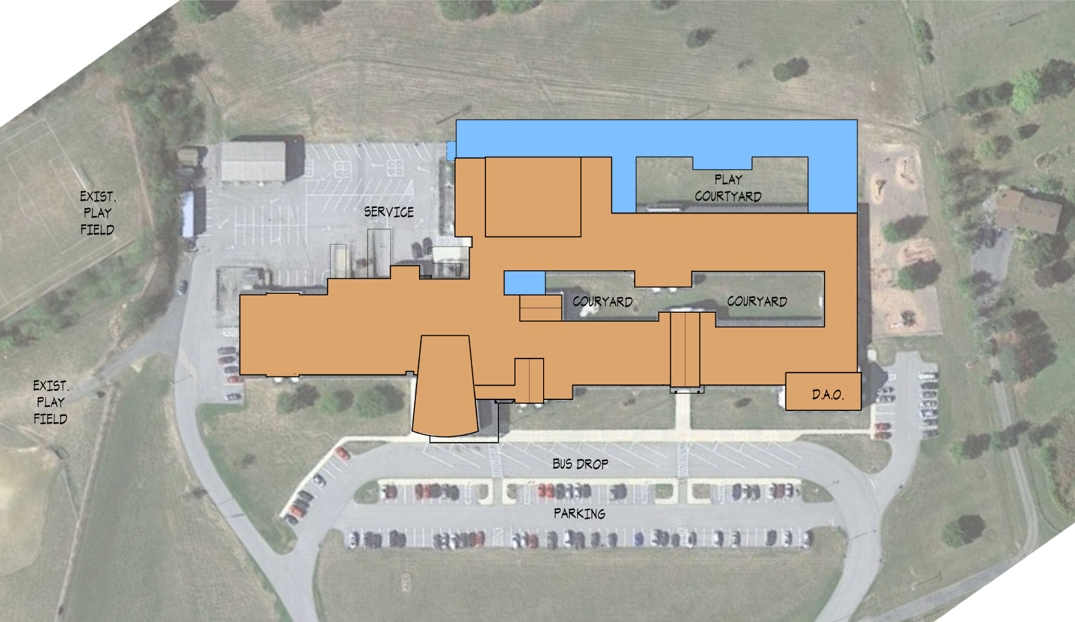
PK-5 Elementary School @ M.S.
Option 2
Site Improvements:
Existing site accommodates the new additions.

Slide 50
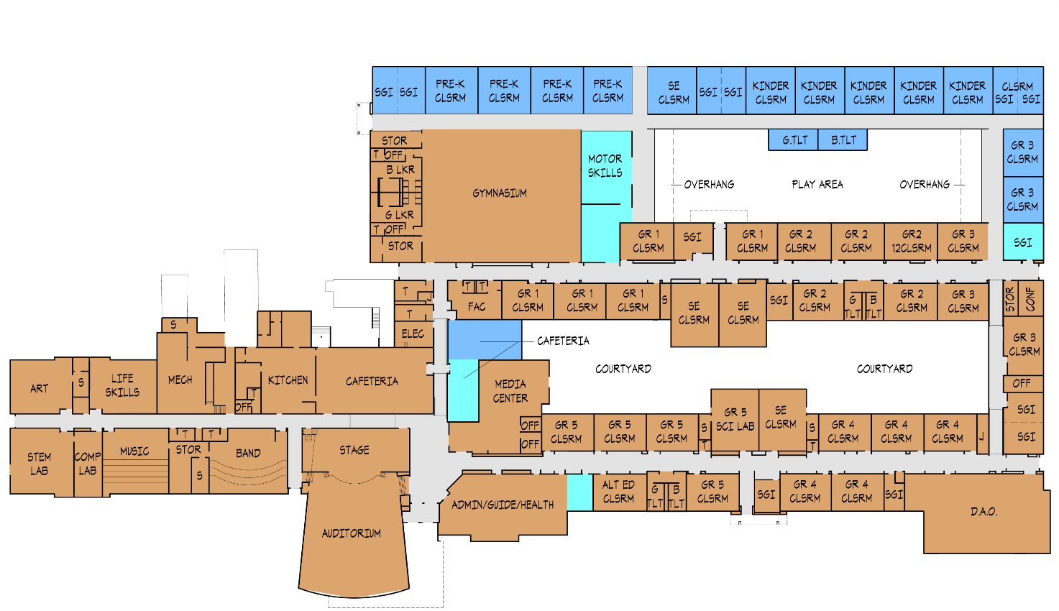
PK-5 Elementary School @ M.S.
Option 2
Grades PK-5
Educational Program Improvements:
Added:
5 Kindergarten Classrooms
4 Pre-Kindergarten Classrooms (3 & 4 years old)
2 Grade 3 Classrooms
3 Divided Classrooms (6 S.G.I.s)
Expanded Cafeteria Area
Converted Spaces to Accommodate:
  1 Alternative Education Classroom
  S.G.I.s & S.E. Classrooms
  Expansion of Administration Suite
  Motor Skills Room & Student Commons
  All grades 1-5 Classrooms
  1 Science Lab
  Chorus and Band Rooms remain

Slide 51
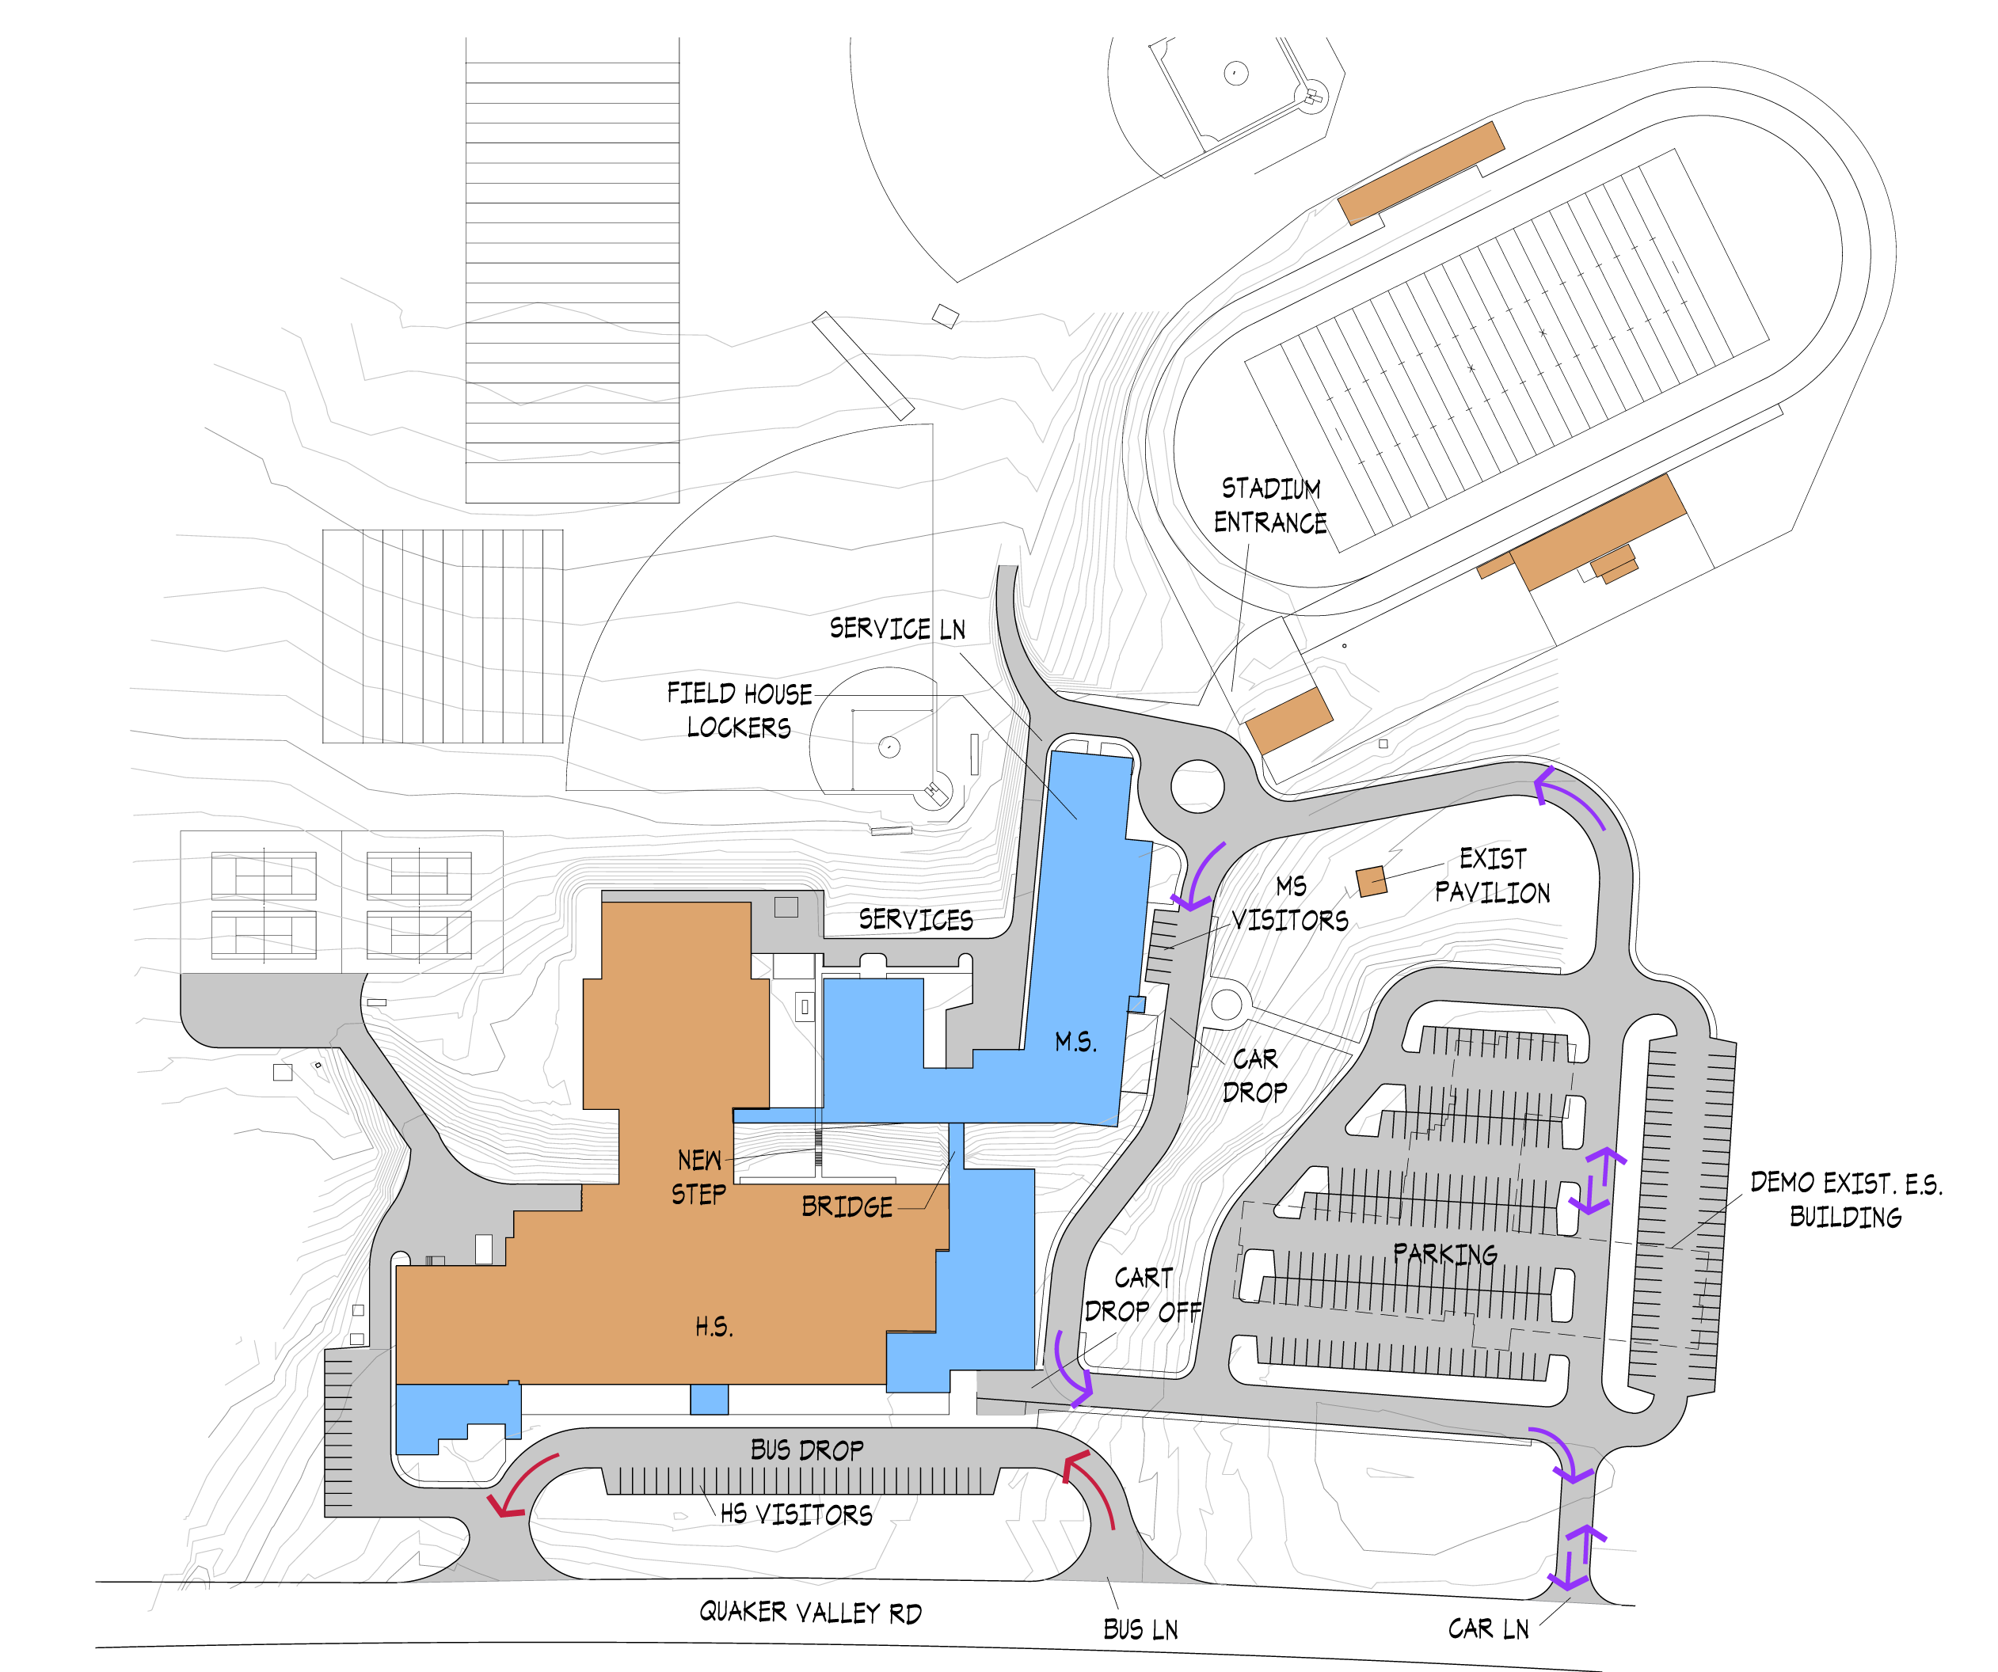
6-8 Middle / 9-12 High School @ H.S.
Option 2
Site Improvements:
Demolition of Central ES Building
New Parking Areas @ Central ES Site
New Car Drop-Off Loop and Service Drive
Existing Site accommodates New Additions
Lower HS parking relocated and Service Drive Reconfigured

Slide 52
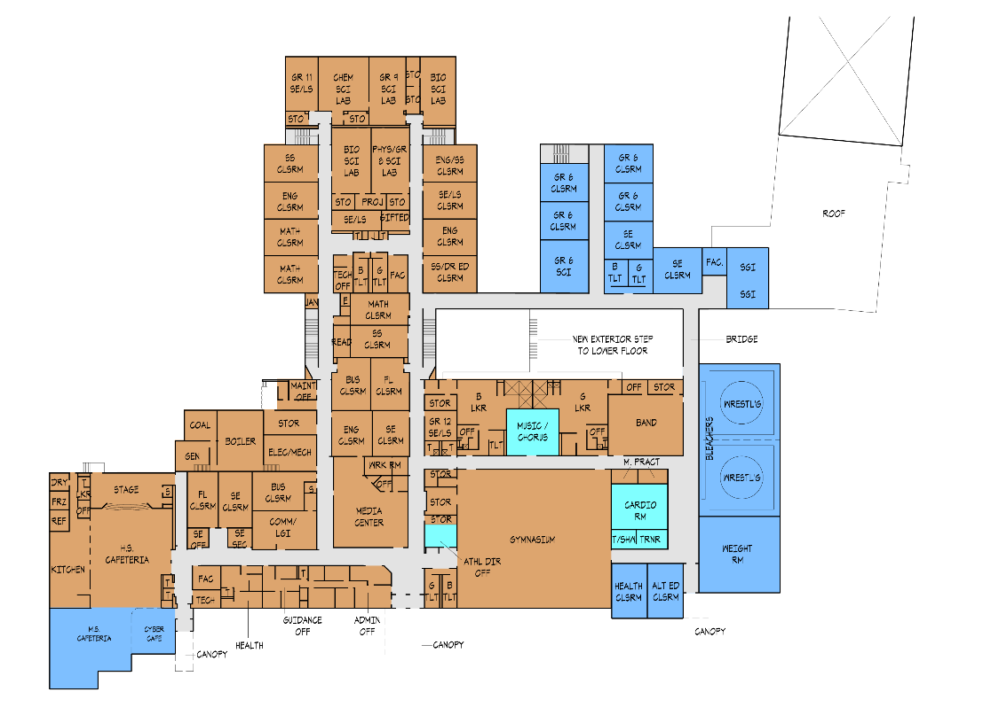
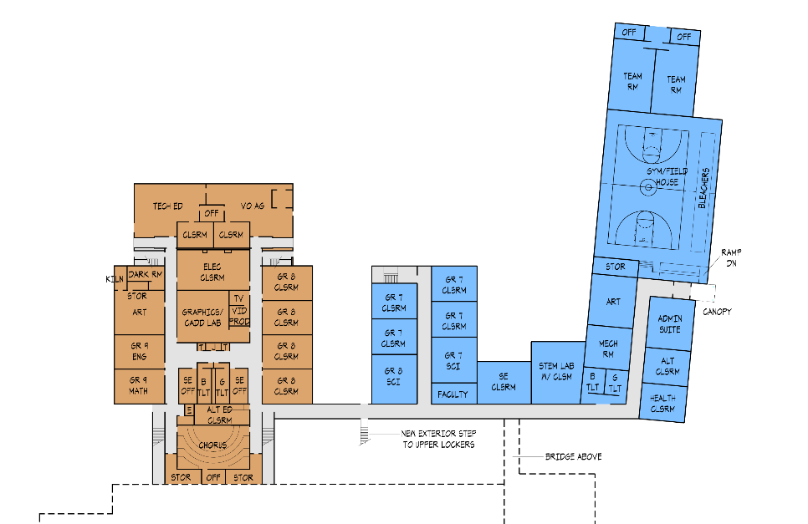
6-8 Middle / 9-12 High School @ H.S.
Option 2
Grades 6-12
Educational Program Improvements:
Added:
MS Gym with Locker Rooms, Storage, 2 P.E. Offices
MS Administration Suite
MS Art Room
MS Health Classroom
Faculty Room
MS STEM Lab
2 Special Education Classroom
5 Grade 7 Classrooms
1 Grade 8 Classroom
5 Grade 6 Classrooms
1 Divided Classroom (2 S.G.I.s)
MS Alternative Education Classroom
Expanded Cafeteria Area
Wrestling Room
Weight Room
Converted Space to Accommodate:
  Music Classroom
  Cardio Room
  Athletic Director’s Office
LOWER FLOOR
UPPER FLOOR

Slide 53
Chestnut Ridge SD Feasibility Study
Option 2 - Cost Summary
Total Construction Cost: $6,365,500
x 1.25
Total Project Cost: $7,957,000
ES
(Grades PK-5)
Total Construction Cost: $18,204,100
x 1.25
Total Project Cost: $22,755,000
MSHS
(Grades 6-12)
Option 2 Total Project Cost: $30,712,000

Slide 54
Chestnut Ridge SD Feasibility Study
Option 3
3
OPTION
2 SCHOOLS: PK-6 E.S. @ M.S.; 7-8 M.S. & 9-12 H.S. @ H.S.

Slide 55
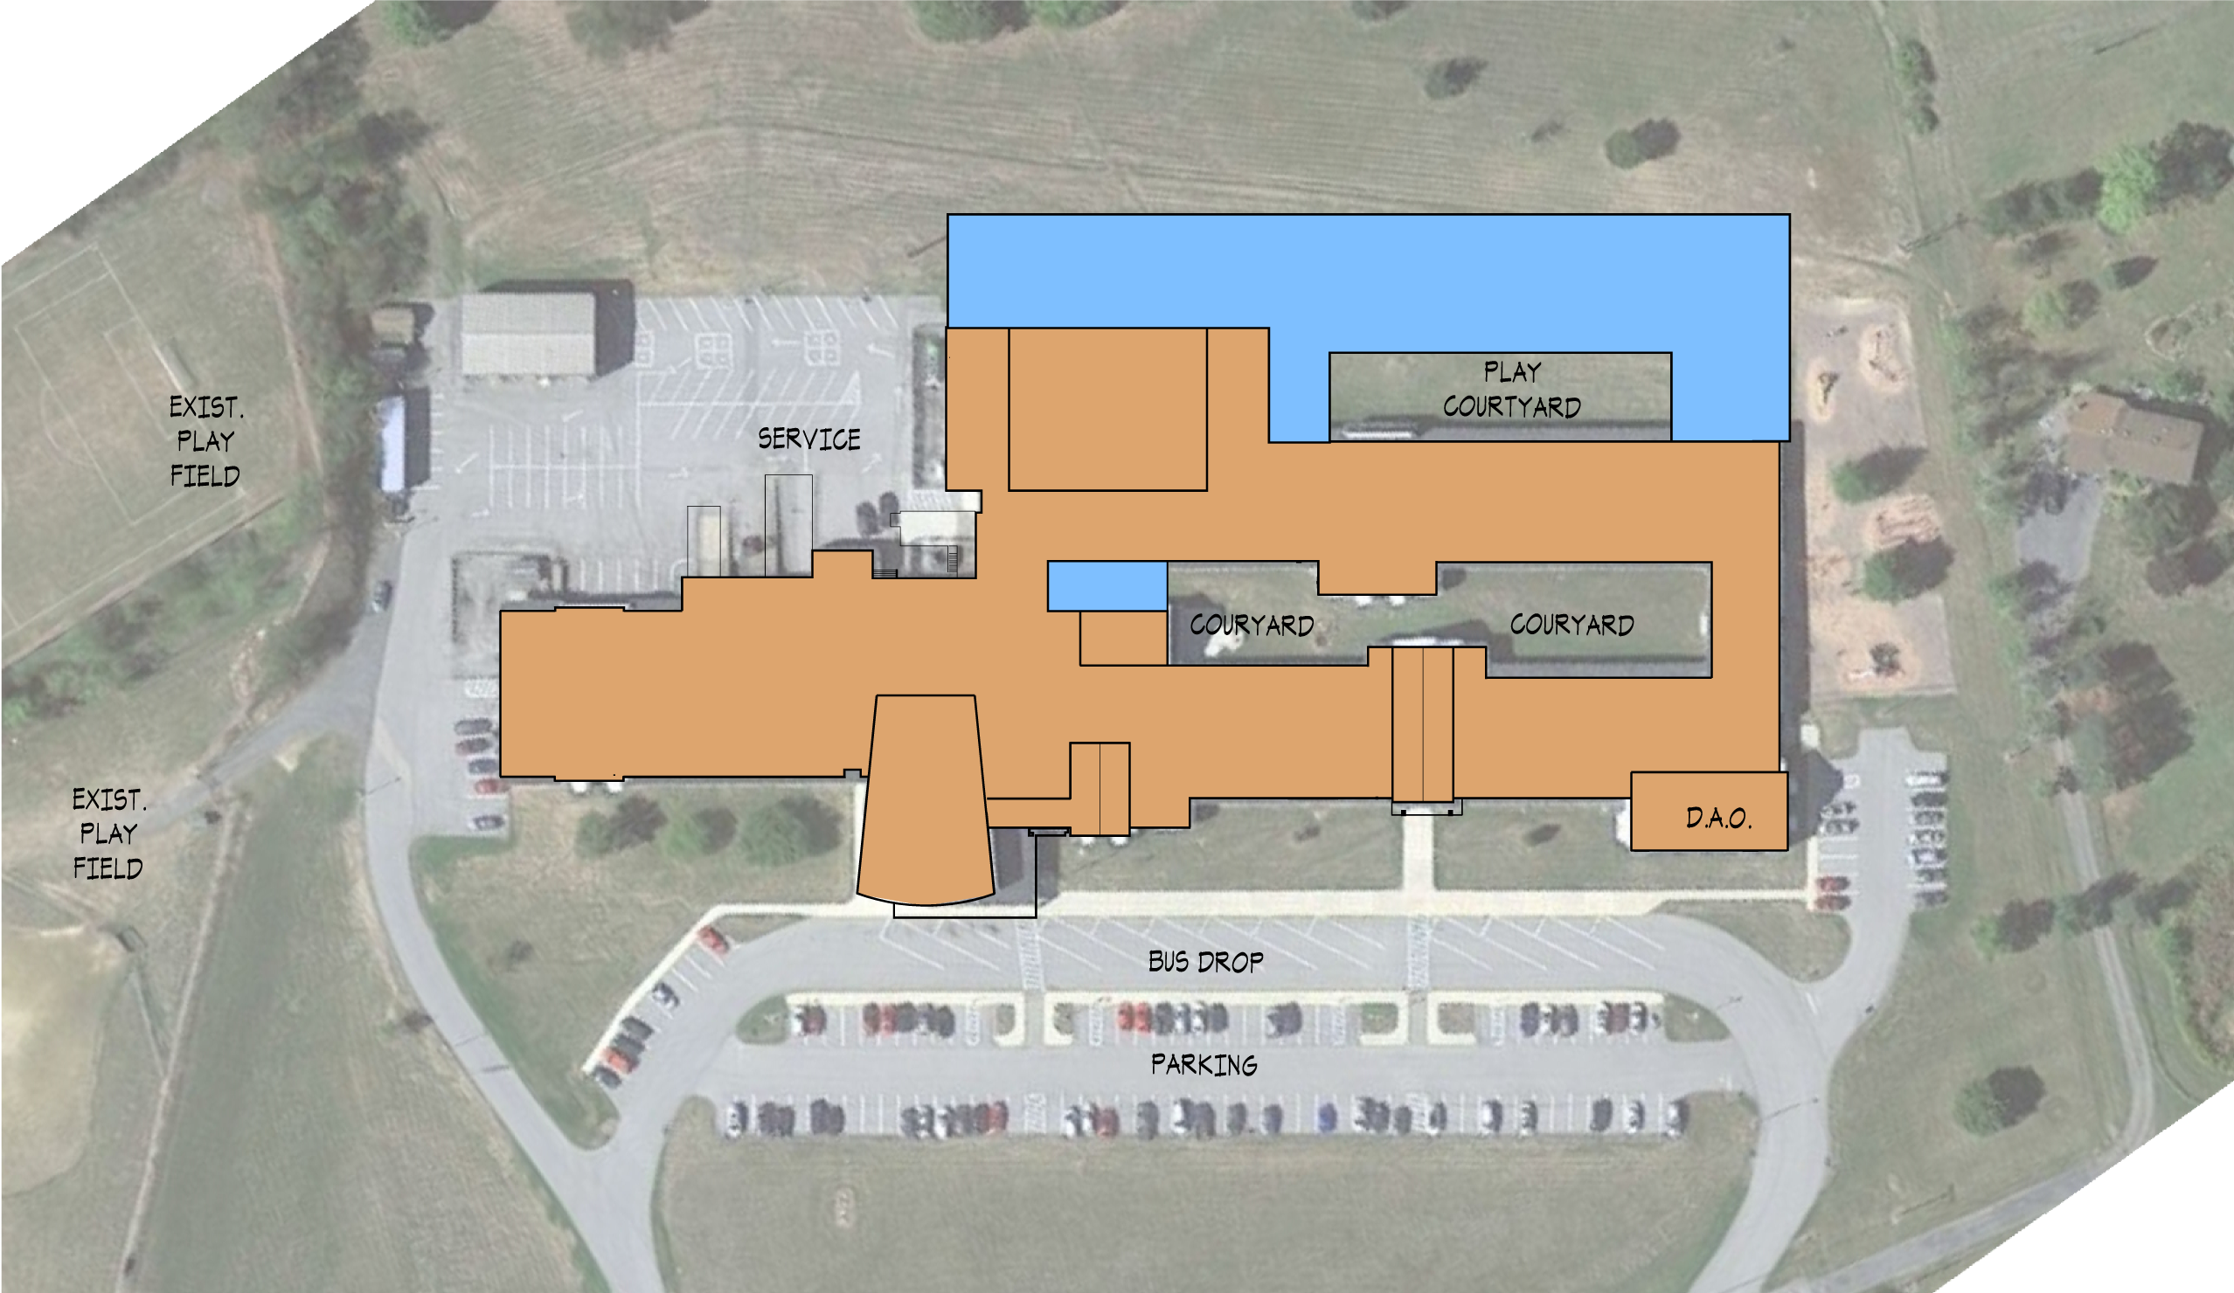
PK-6 Elementary School @ M.S.
Option 3
Site Improvements:
Existing site accommodates the new additions.

Slide 56
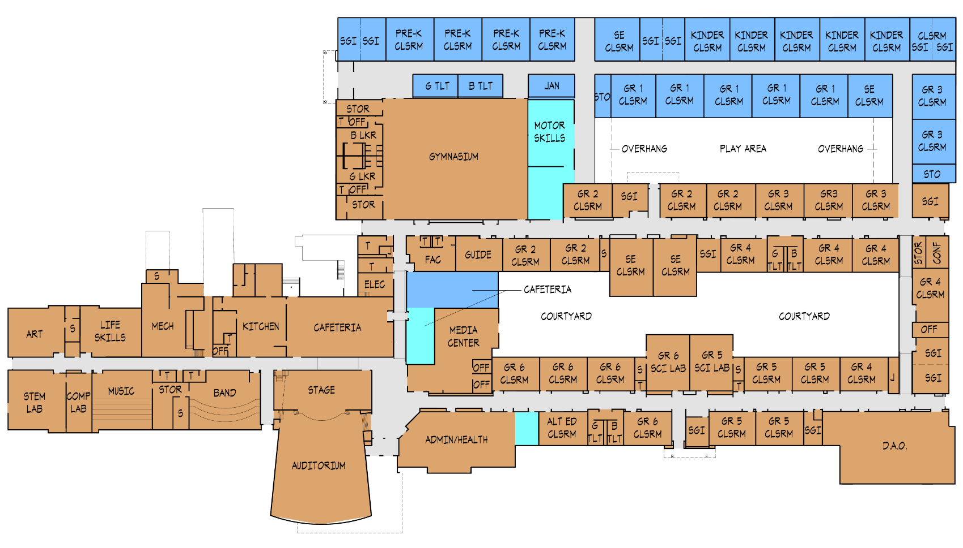
PK-6 Elementary School @ M.S.
Option 3
Grades PK-6
Educational Program Improvements:
Added:
5 Kindergarten Classrooms
4 Pre-Kindergarten Classrooms (3 & 4 years old)
2 Grade 3 Classrooms
3 Divided Classrooms (6 S.G.I.s)
2 Special Education Classrooms
5 Grade 1 Classrooms
Expanded Cafeteria Area
Converted Spaces to Accommodate:
  1 Alternative Education Classroom
  S.G.I.s & S.E. Classrooms
  Expansion of Administration Suite
  Motor Skills Room & Student Commons
  All grades 1-6 Classrooms
  2 Science Labs
  Chorus and Band Rooms remain

Slide 57
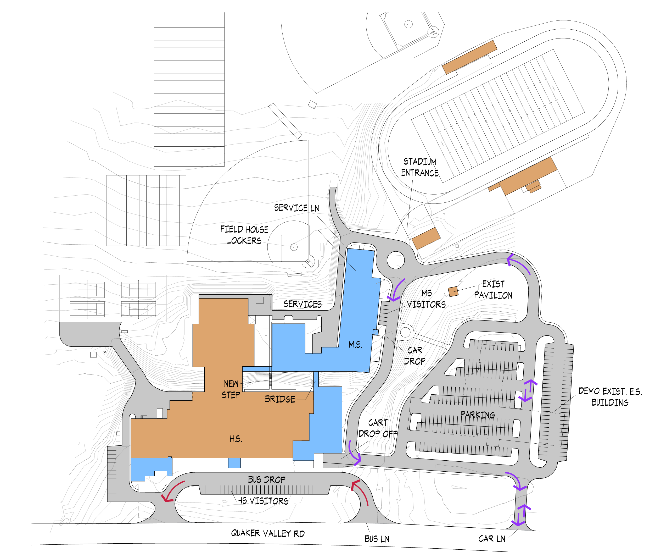
7-8 Middle / 9-12 High School @ H.S.
Option 3
Site Improvements:
Demolition of Central ES Building
New Parking Areas @ Central ES Site
New Car Drop-Off Loop and Service Drive
Existing Site accommodates New Additions
Lower HS parking relocated and Service Drive Reconfigured

Slide 58
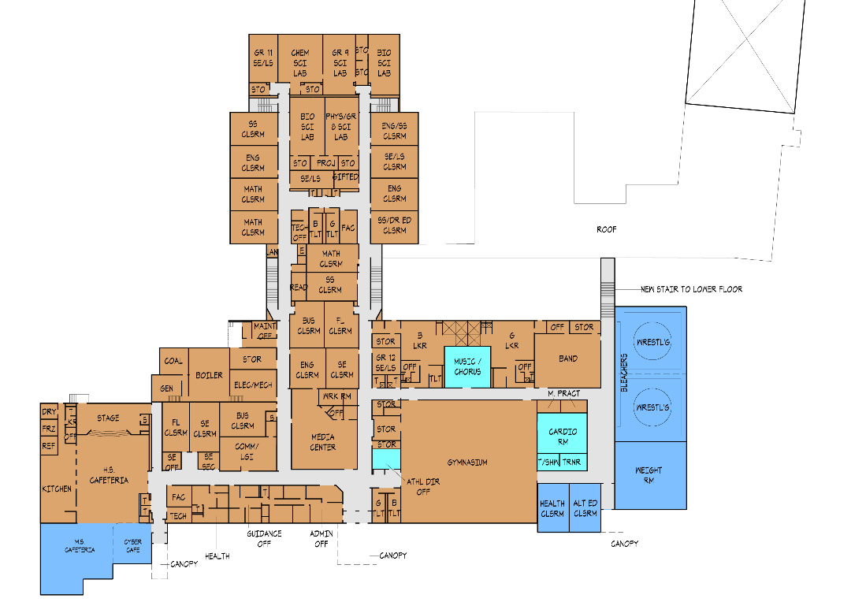

7-8 Middle / 9-12 High School @ H.S.
Option 3
Grades 7-12
Educational Program Improvements:
Added:
MS Gym with Locker Rooms, Storage, 2 P.E. Offices
MS Administration Suite
MS Art Room
MS Health Classroom
HS Health Classroom
Faculty Room
MS STEM Lab
1 Special Education Classroom
5 Grade 7 Classrooms
1 Grade 8 Classroom
1 Divided Classroom (2 S.G.I.s)
MS Alternative Education Classroom
HS Alternative Education Classroom
Expanded Cafeteria Area with Cyber Café
Wrestling Room
Weight Room
Converted Space to Accommodate:
  Music Classroom
  Cardio Room
  Athletic Director’s Office
LOWER FLOOR
UPPER FLOOR

Slide 59
Chestnut Ridge SD Feasibility Study
Option 3 - Cost Summary
Total Construction Cost: $8,615,500
x 1.25
Total Project Cost: $10,769,000
ES
(Grades PK-6)
Total Construction Cost: $15,954,100
x 1.25
Total Project Cost: $19,943,000
MSHS
(Grades 7-12)
Option 3 Total Project Cost: $30,712,000

