Slide 1



Schuylkill Valley School District
District-Wide Feasibility Study
7 March 2020

Slide 2






Schuylkill Valley SD Feasibility Study
Project Team
Schuylkill Valley School District
Owner
EI Associates
Architects & Educational Facilities Planners
K&W
Civil / Site Engineering
SitelogiQ (formerly Reynolds)
Mechanical, Electrical, Plumbing Engineering / Estimates
Advanced Foodservice Solutions
Food Service / Kitchen Design
Baker, Ingram & Associates
Structural Engineering

Slide 3

Schuylkill Valley SD Feasibility Study
Process / Contents of the Study
Demographic Review
(Student Enrollment, Population, Housing)
Facilities Study
(Building Improvements & Construction Cost)
Educational Program Review
(Requirements / Needs)
Solutions (Construction Options)
Cost of Options
Schedule
Note: Study per PDE Requirements

Slide 4
Schuylkill Valley SD Feasibility Study
Demographic Exploration - Population
2000 - 2010
Gain of Population
+ 1046
2010 - 2017
Gain of Population
+ 772
2000 - 2017
Gain of Population
+ 1818

Slide 5
Schuylkill Valley SD Feasibility Study
Demographic Exploration - Housing
2000 - 2010
Gain of Housing
+ 575
2010 - 2017
Gain of Housing
+ 108
2000 - 2017
Gain of Housing
+ 683

Slide 6
Schuylkill Valley SD Feasibility Study
Demographic Exploration – Historical Student Enrollment
2000 - 2010
Gain of Students
+ 58
2010 - 2017
Gain of Students
+ 117
2000 - 2017
Gain of Students
+ 175

Slide 7
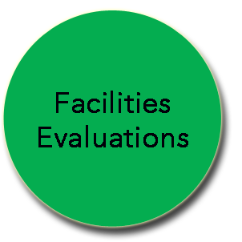
Facilities Evaluation Process
Improvement Lists: Itemized, Priced, and Prioritized
Architects, Civil and MEP Engineers, and Kitchen Designers survey buildings and sites
  Security
  Safety
  Codes
  Condition
PHYSICAL PLANT
  Mechanical
  Electrical
  Plumbing
  Site
EDUCATIONAL PROGRAMMING
  Efficient Program-Use of Facilities
  Size / Future Capacity of Schools
  Grade Realignment / Grade Levels
  Students per Classroom
  Use of Core Facilities
  Site – Parking, Drives, Playfields

Slide 8
Facilities Evaluation Process
Improvement Lists: Itemized, Priced, and Prioritized
Architects, Civil and MEP Engineers, and Kitchen Designers estimate costs for each work item individually
ITEMIZED ESTIMATED COSTS
  Estimates = 1 year window

Slide 9
Facilities Evaluation Process
Improvement Lists: Itemized, Priced, and Prioritized
Architect, Engineers, and SD Team prioritize the work items and assign ranking to each work item
RANK 1
HIGH PRIORITY
RANK 2
MEDIUM PRIORITY
RANK 3
LOW PRIORITY
FUTURE CONSIDERATION
RANK 4
OPTIONAL
SEPARATE FUTURE PROJECTS

Slide 10
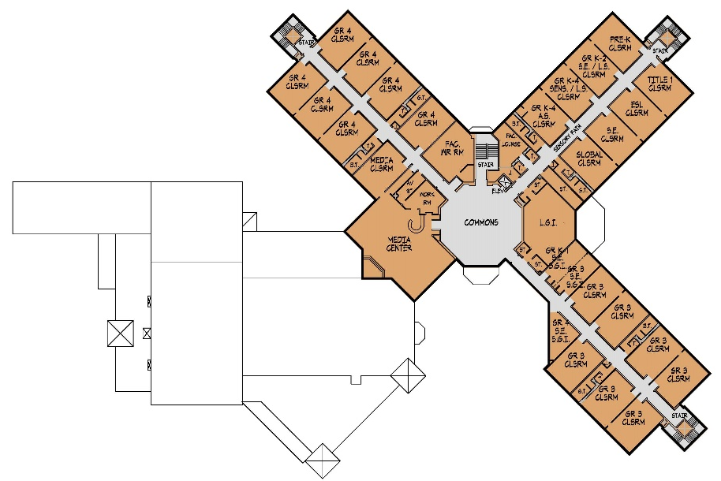
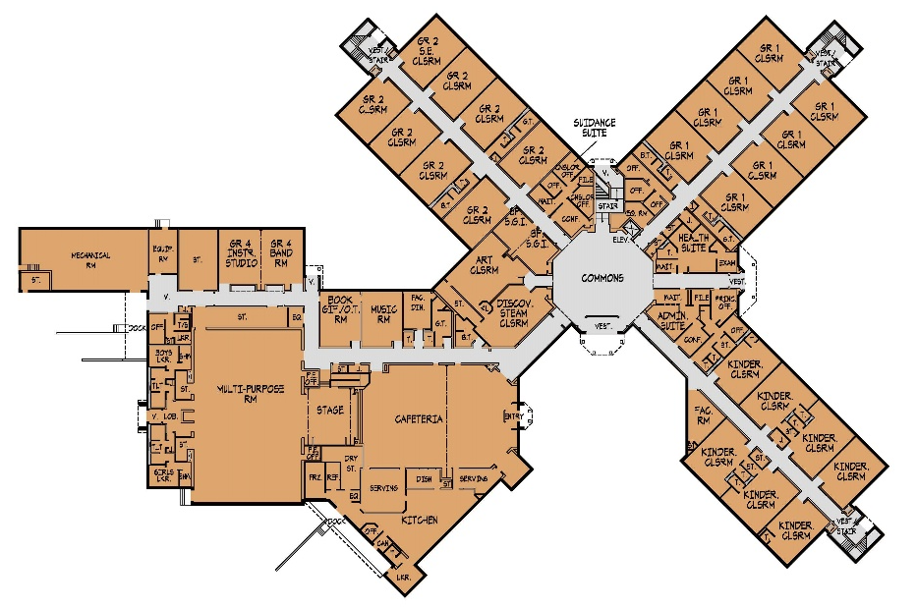
Schuylkill Valley Elementary School
Existing Conditions
Grades K-4
Built: 1993
Site: 110.41 acres*
Area: 112,000 SF
District Capacity: 792
2019-20 Enrollment: 791
FACILITIES IMPROVEMENTS:
Overall Campus Site Improvement
Roof Rehabilitation / Repair
Energy Efficient Doors & Windows
Interior Finishes
Casework Replacement
Kitchen Equipment Upgrades
MEP Replacement
Safety / Security Upgrades
Building Code Upgrades
Accessibility Upgrades
Fire Protection System Install
SECOND FLOOR
FIRST FLOOR

Slide 11
Schuylkill Valley SD Feasibility Study
Existing Conditions – MEP
Elementary School

Slide 12
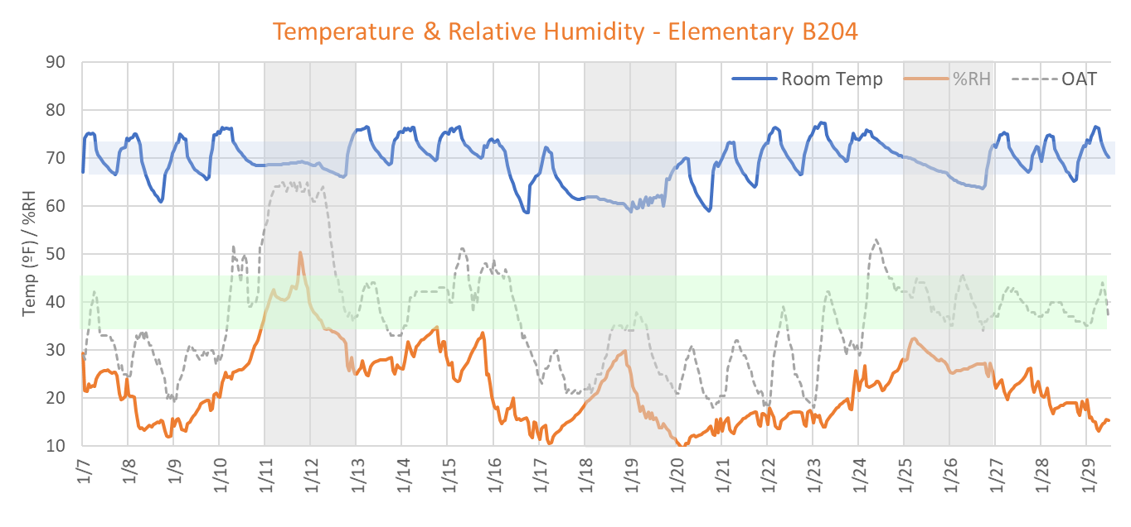
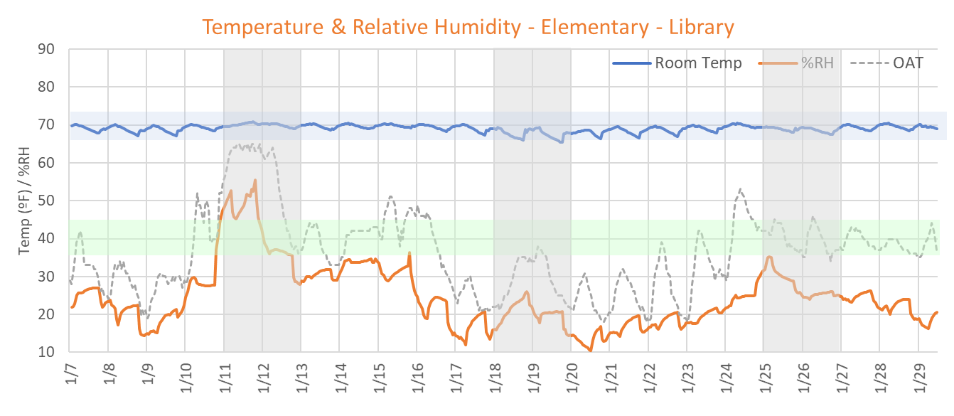
Schuylkill Valley SD Feasibility Study
Existing Conditions – MEP
Elementary School

Slide 13
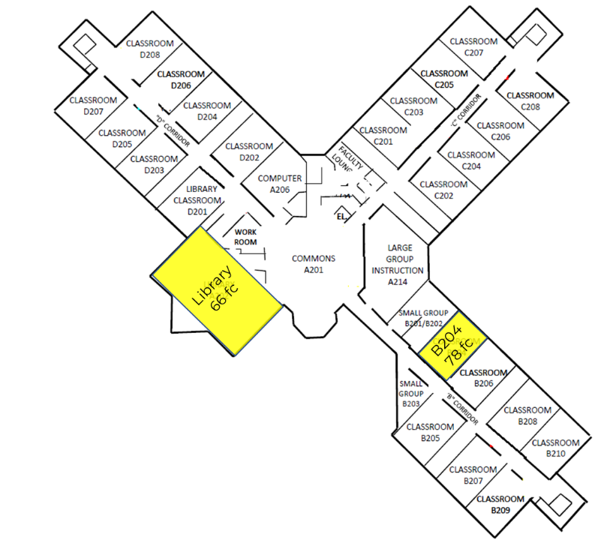
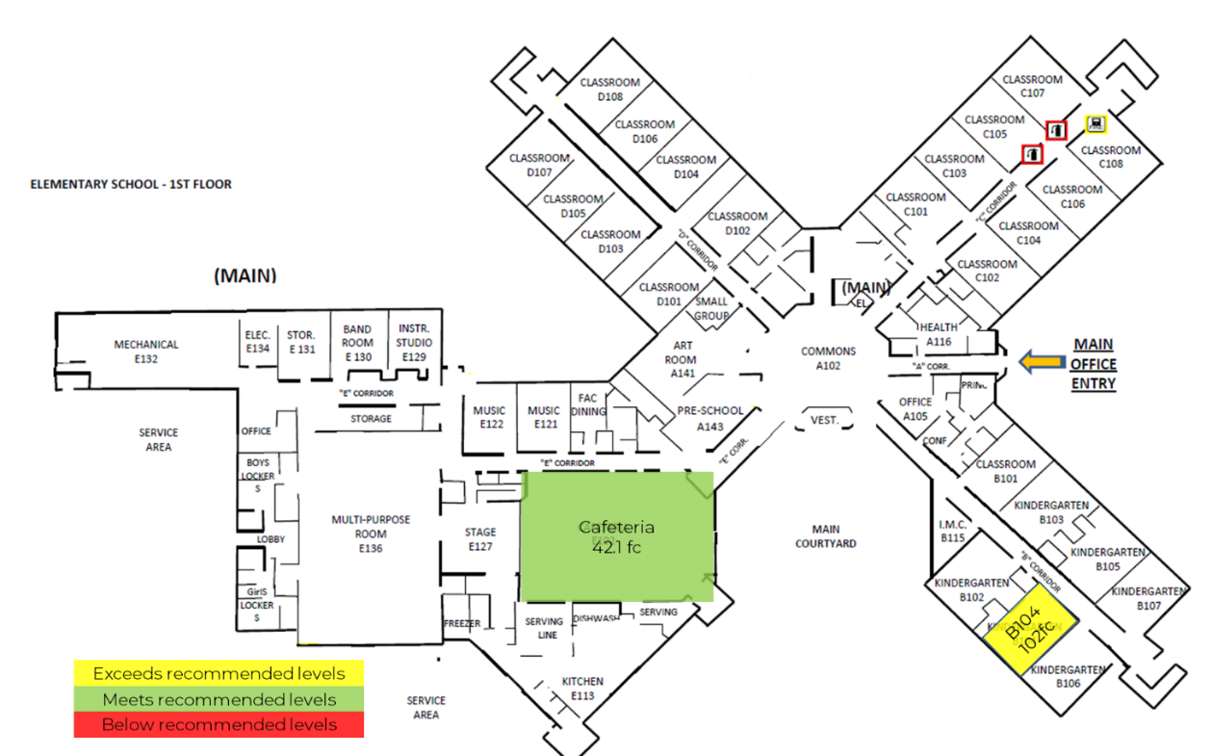
Schuylkill Valley SD Feasibility Study
Existing Conditions – MEP
Elementary School
Room # | Space Type | Sound Level (dB)
B204 | Classroom - General | 43.9
B104 | Classroom - General | 0.0
Library | Library - Reading/Studying | 44.6
Sound Levels
Lighting Levels – Foot-Candles

Slide 14
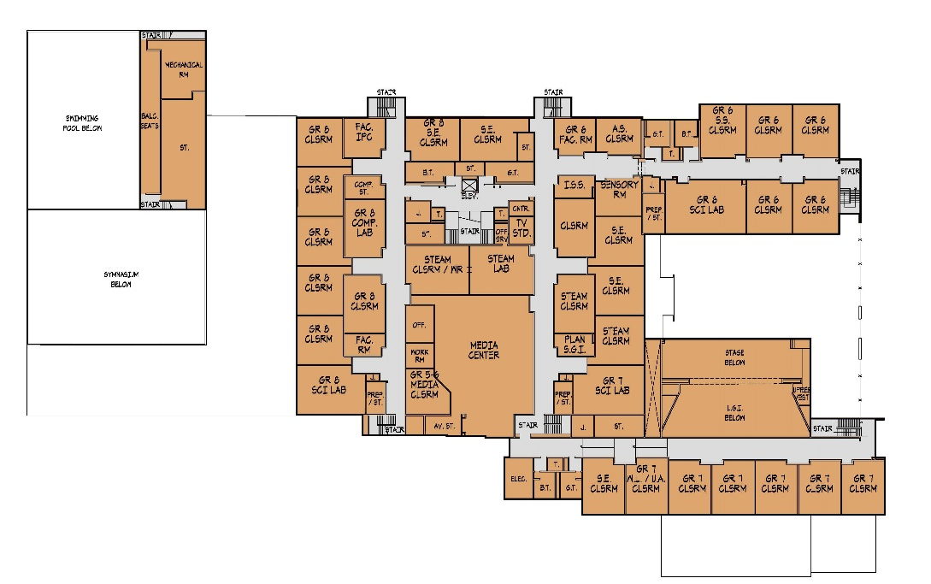
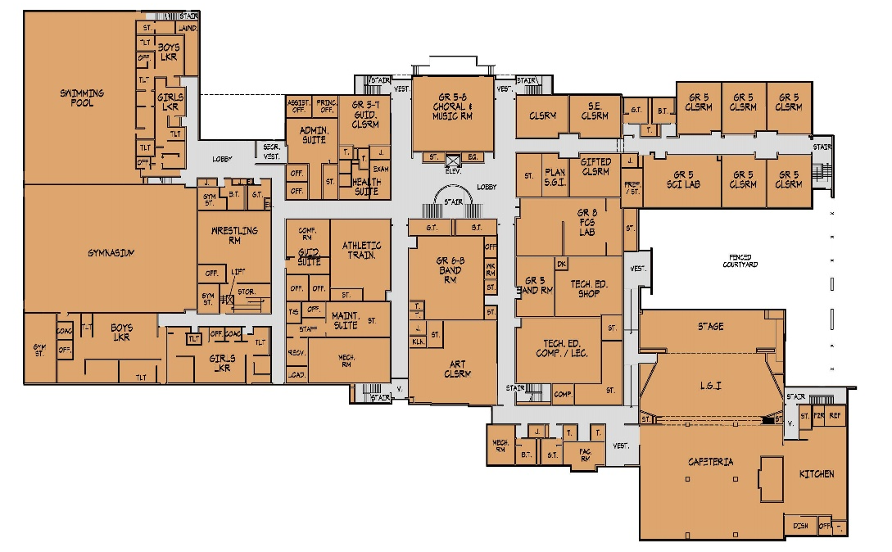
Schuylkill Valley Middle School
Existing Conditions
Grades 5-8
Built: 1974(B), 1998(A), 2007(A&A)
Site: 110.41 acres*
Area: 152,000 SF
District Capacity: 718
2019-20 Enrollment: 684
FACILITIES IMPROVEMENTS:
Overall Campus Site Improvement
Roof Rehabilitation / Repair
Exterior Wall Repair / Cleaning
Limited Interior Finishes Upgrades
Limited Interior Acoustic Improvement
Limited MEP Upgrades
Building Code Upgrades
Accessibility Upgrades
SECOND FLOOR
FIRST FLOOR

Slide 15
Schuylkill Valley SD Feasibility Study
Existing Conditions – MEP
Middle School

Slide 16
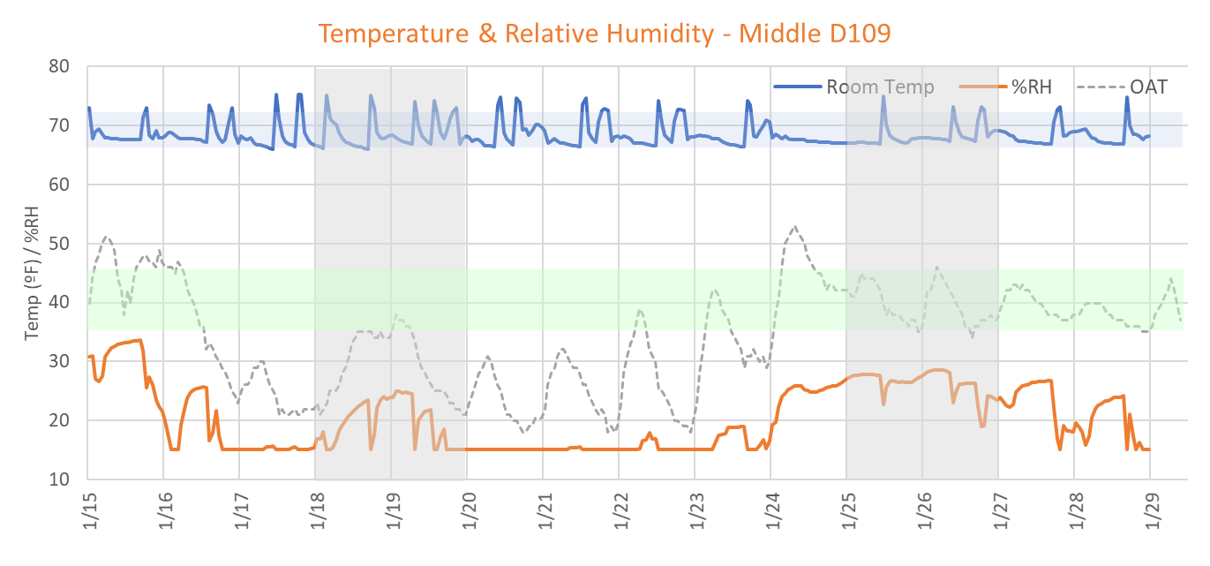
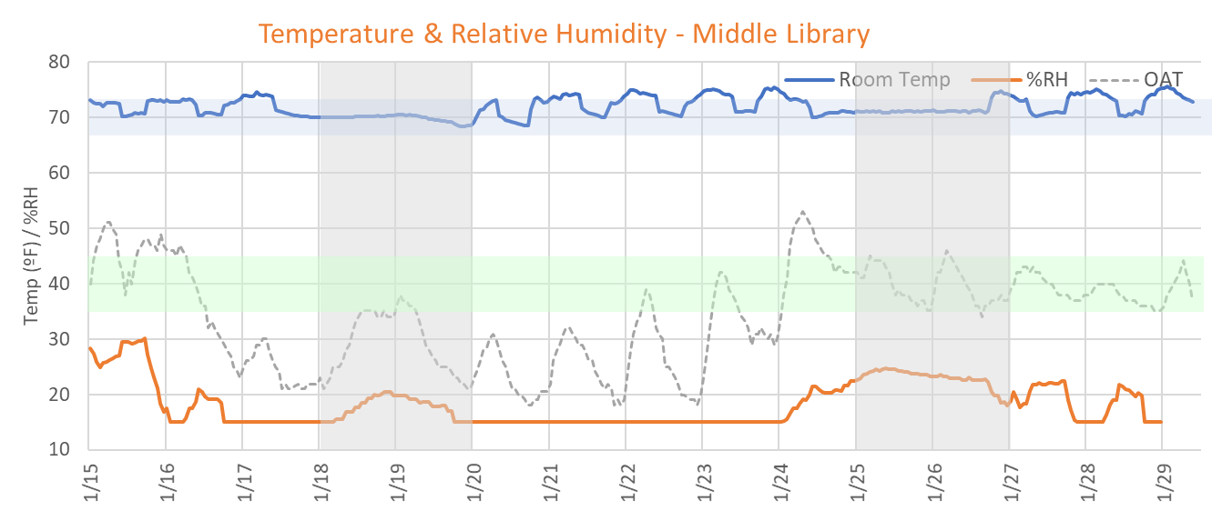
Schuylkill Valley SD Feasibility Study
Existing Conditions – MEP
Middle School

Slide 17
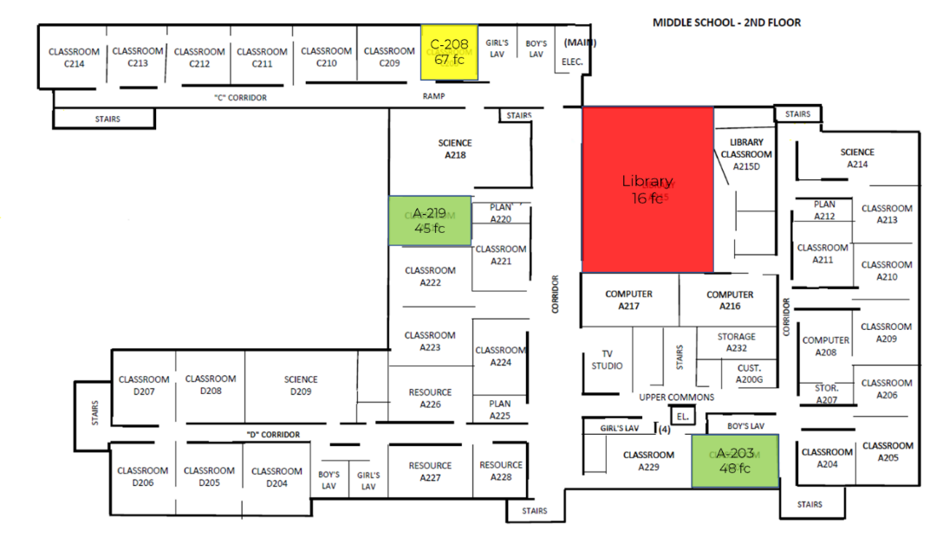
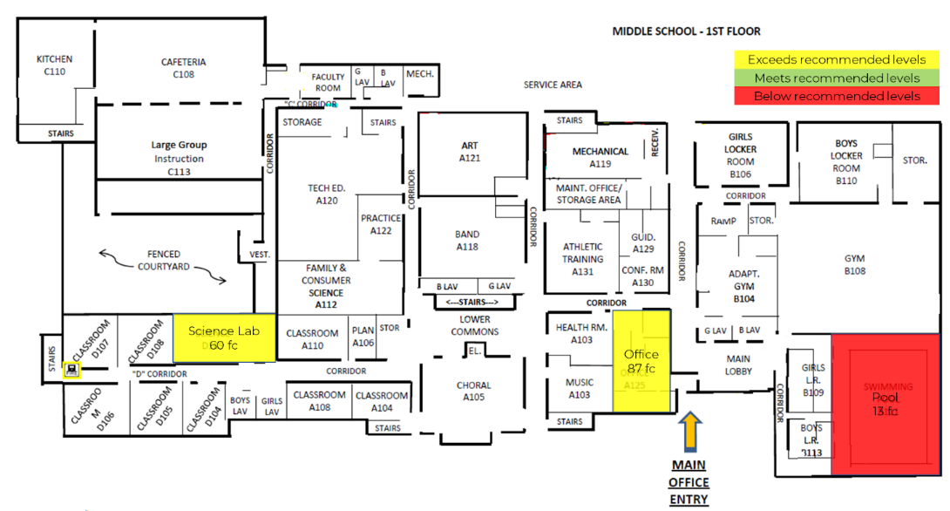
Schuylkill Valley SD Feasibility Study
Existing Conditions – MEP
Middle School
Room # | Space Type | Sound Level (dB)
D109 | Classroom - General | 52.6
C208 | Classroom - General | 0.0
A219 | Classroom - General | 50.3
Library | Library - Reading/Studying | 42.1
Sound Levels
Lighting Levels – Foot-Candles

Slide 18
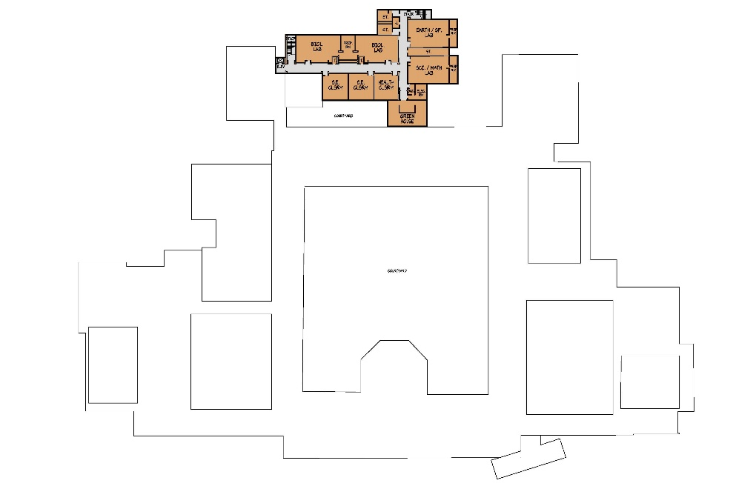
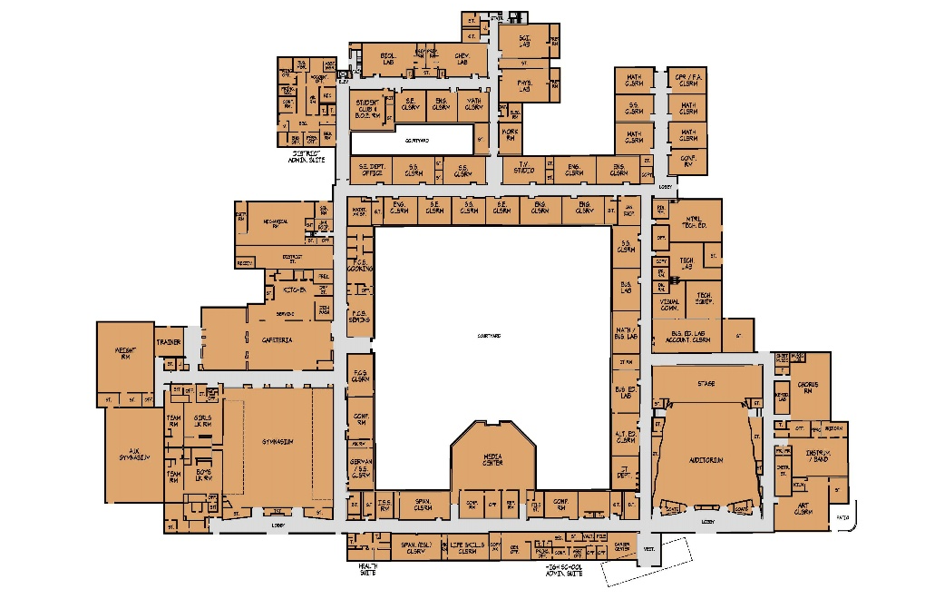
Schuylkill Valley High School / DAO
Existing Conditions
Grades 9-12
Built: 1959(B), 1995(A&A) 2000(DAO, A&A), 2006(A&A)
Site: 110.41 acres*
Area: 182,000 SF (with DAO)
District Capacity: 752
2019-20 Enrollment: 636
FACILITIES IMPROVEMENTS:
Overall Campus Site Improvement
Roof Rehabilitation / Repair
Exterior Wall Repair / Cleaning
Limited Interior Finishes Upgrades
Limited Interior Acoustic Improvement
MEP Upgrades
Building Code Upgrades
Accessibility Upgrades
SECOND FLOOR
FIRST FLOOR

Slide 19
Schuylkill Valley SD Feasibility Study
Existing Conditions – MEP
High School

Slide 20
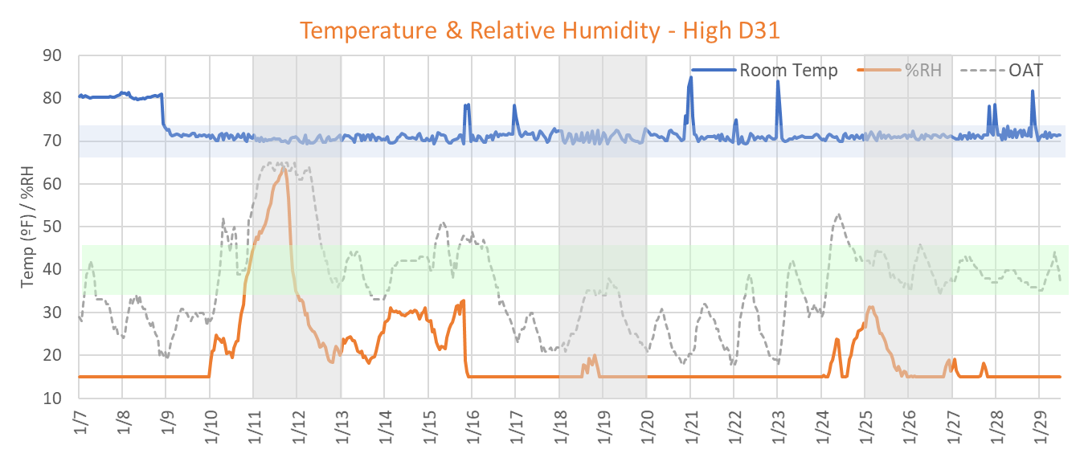
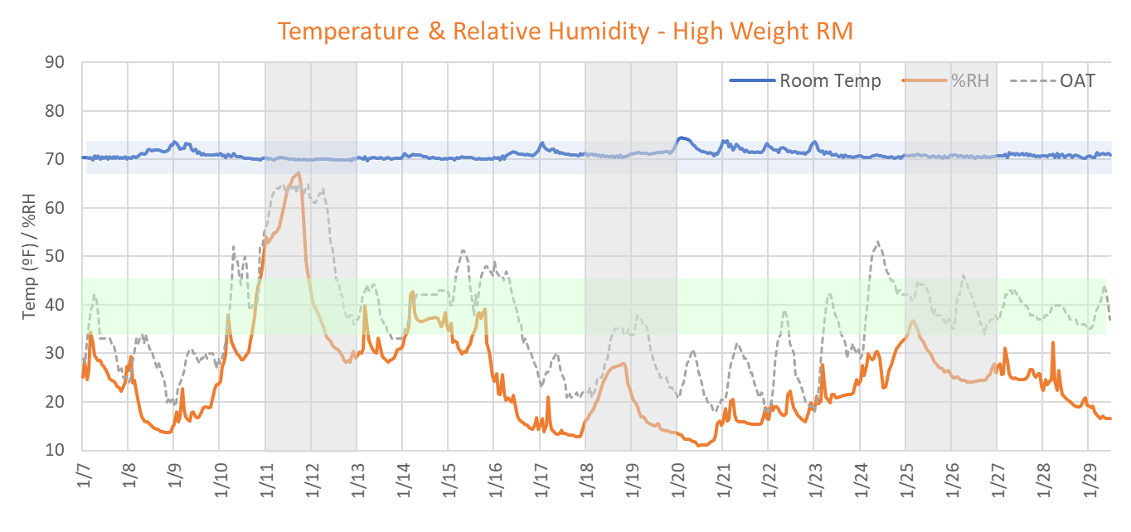
Schuylkill Valley SD Feasibility Study
Existing Conditions – MEP
High School

Slide 21
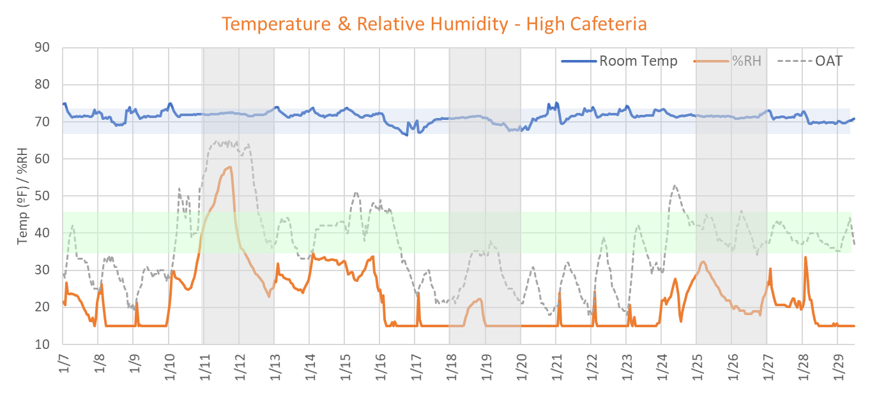
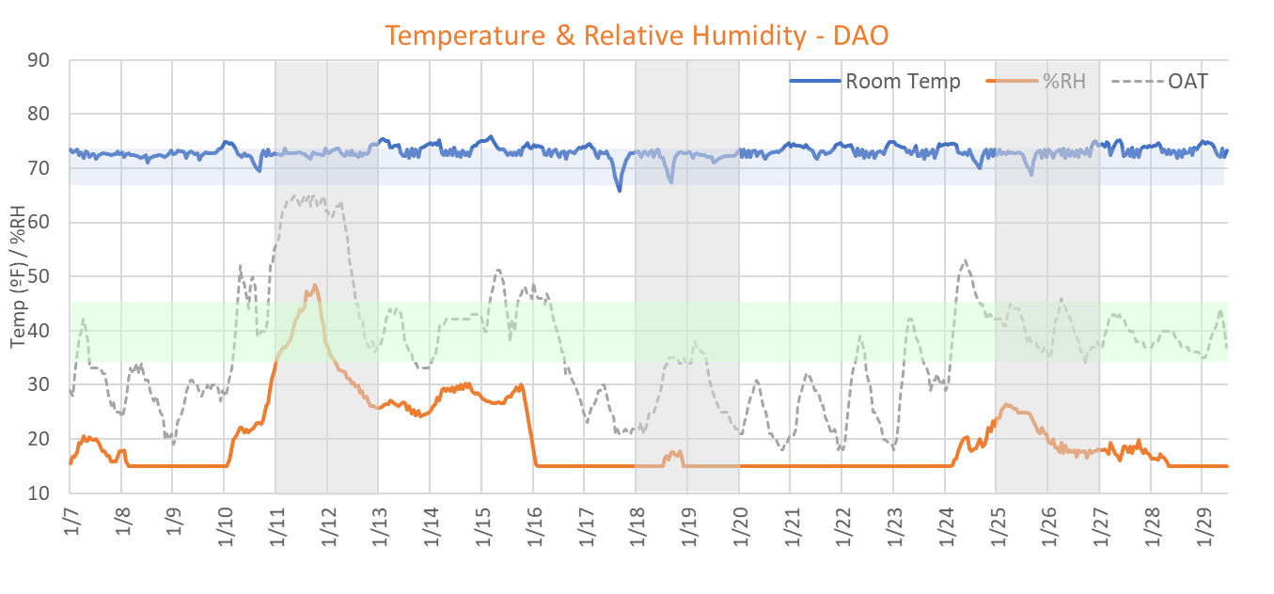
Schuylkill Valley SD Feasibility Study
Existing Conditions – MEP
High School

Slide 22
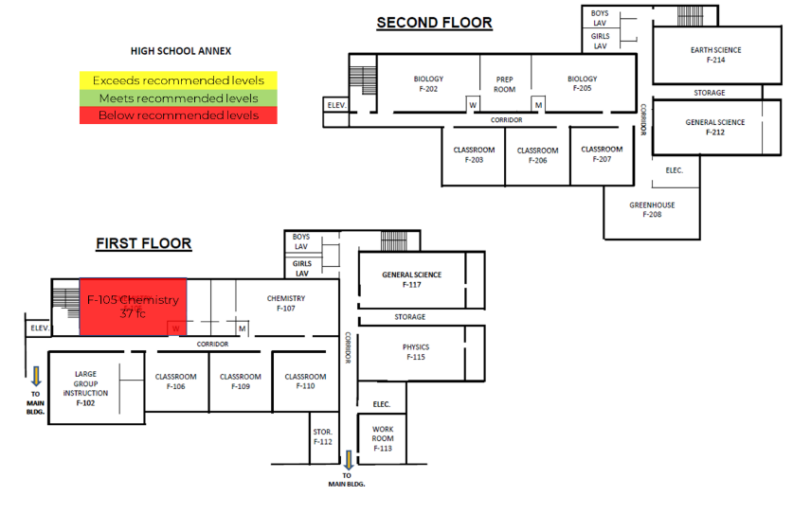
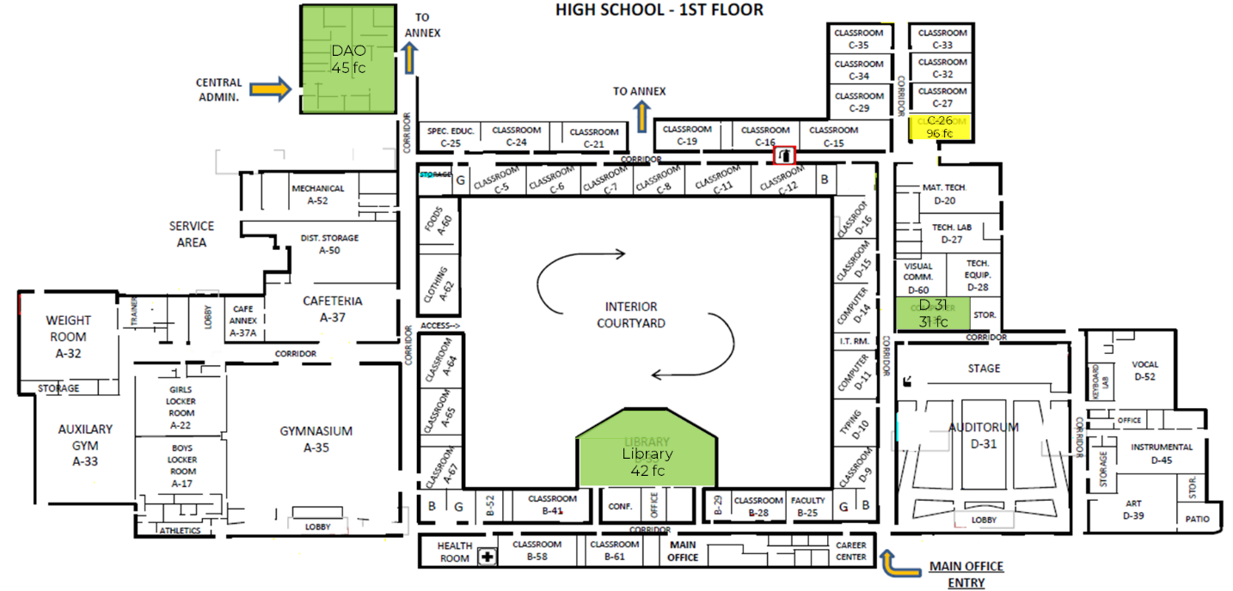
Schuylkill Valley SD Feasibility Study
Existing Conditions – MEP
High School
Room # | Space Type | Sound Level (dB)
D31 | Classroom - General | 42.5
C-26 | Classroom - General | 48.1
F-105 | Classroom - General | 44.5
Library | Library - Reading/Studying | 51.3
Weight Room | Gymnasium - General Exercise | 49.8
Sound Levels
Lighting Levels – Foot-Candles

Slide 23
Schuylkill Valley School District
Summary - Building Improvement Construction Costs
Elementary School

Slide 24
Schuylkill Valley School District
Summary - Building Improvement Construction Costs
Middle School

Slide 25
Schuylkill Valley School District
Summary - Building Improvement Construction Costs
High School

Slide 26
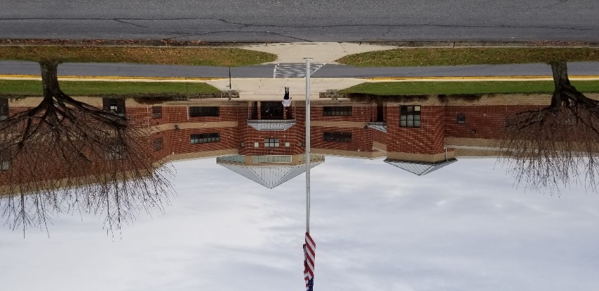
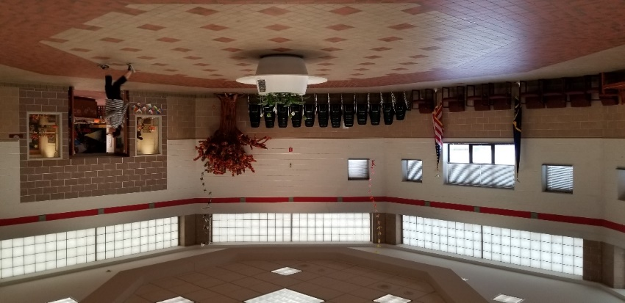
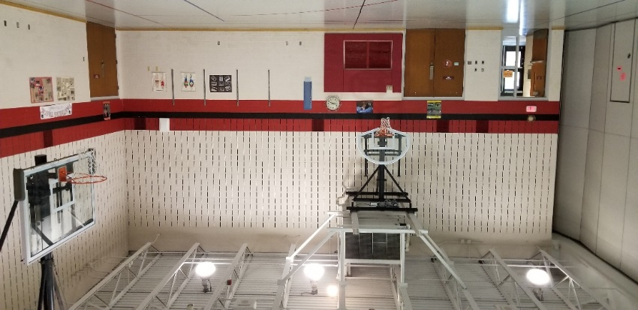
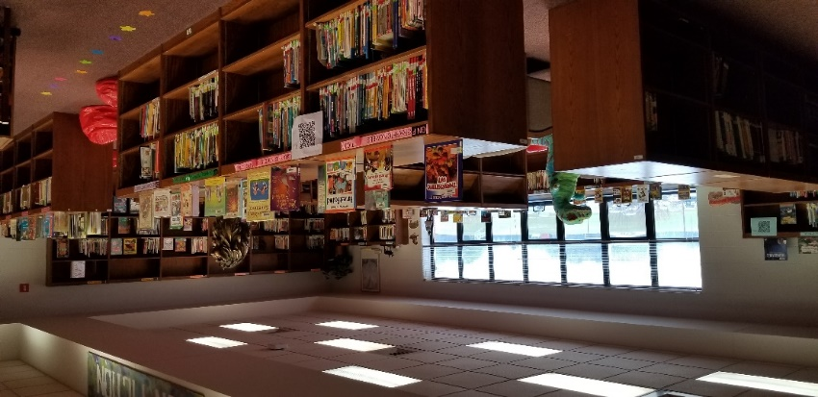
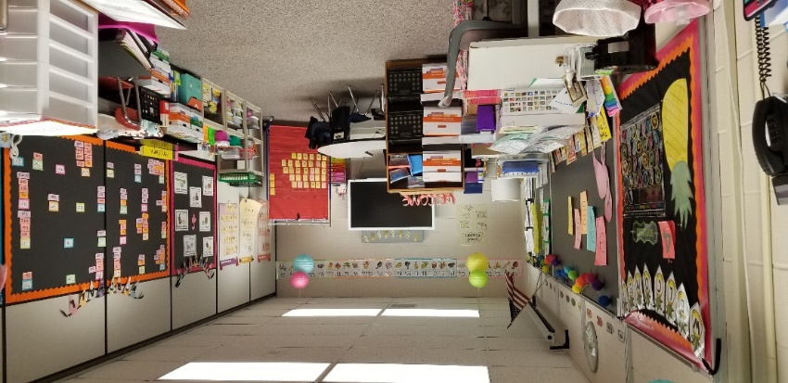
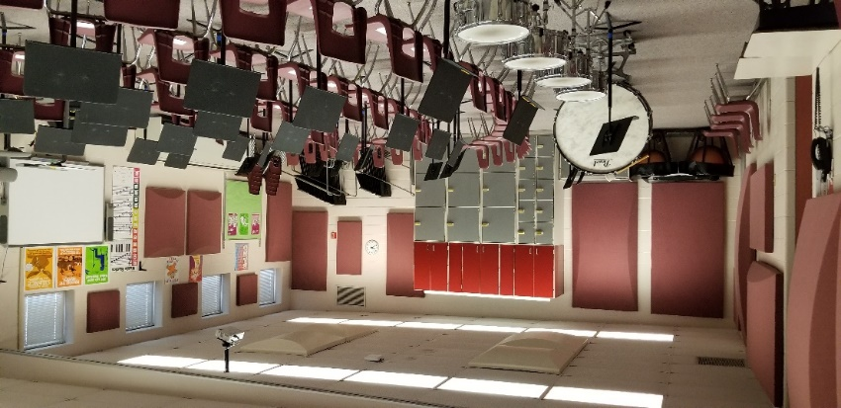
Schuylkill Valley Elementary School
Existing Conditions
EDUCATIONAL PROGRAM IMPROVEMENTS:
(2) Additional Graded Classrooms per Grade K-4
Additional Support Classrooms
(5) Additional Divided Support Classrooms (1 per Grade)
Additional S.E. Seminar Room / S.G.I.
Additional Art Classroom
Add Auxiliary Gymnasium
Enlarged Student Dining
Enlarged Kitchen Area
Enlarged Administration Office
Additional Faculty Room / I.P.C.
Additional Faculty Dining / Work Room

Slide 27
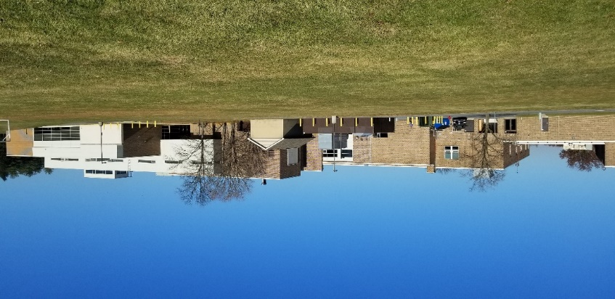
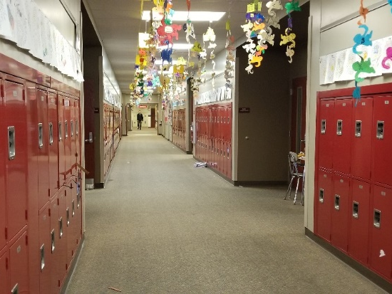
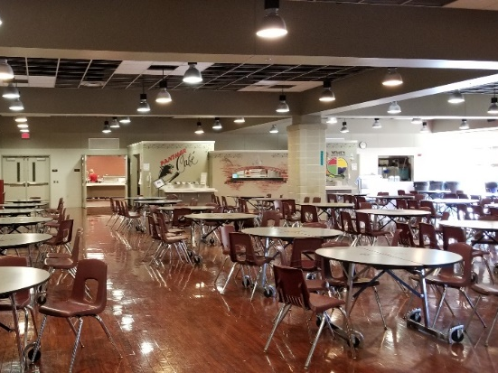
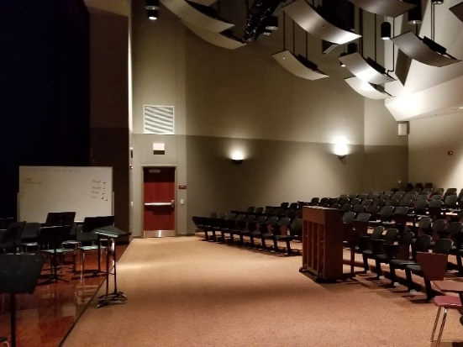
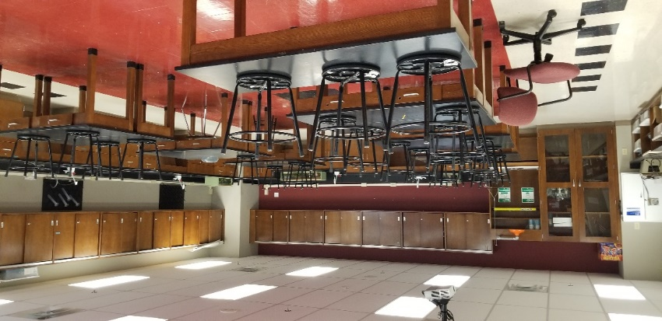
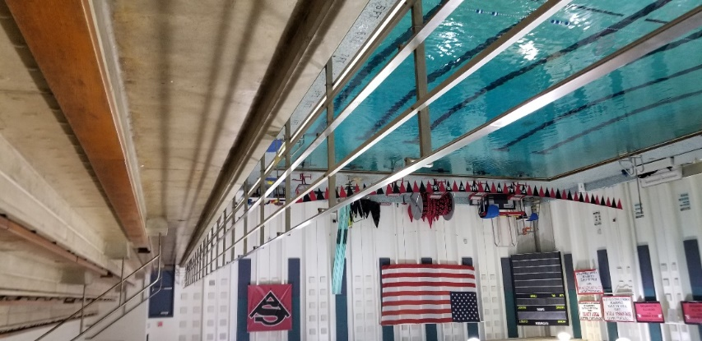
Schuylkill Valley Middle School
Existing Conditions
EDUCATIONAL PROGRAM IMPROVEMENTS:
(2) Additional Graded Classrooms per Grade 5-8
Additional Support Classroom
(4) Additional Divided Support Classrooms (1 per Grade)
Additional S.E. Seminar Room / S.G.I.
Enlarged Administration Office

Slide 28
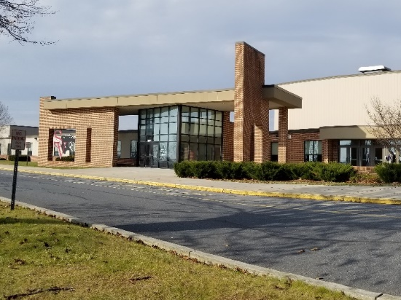
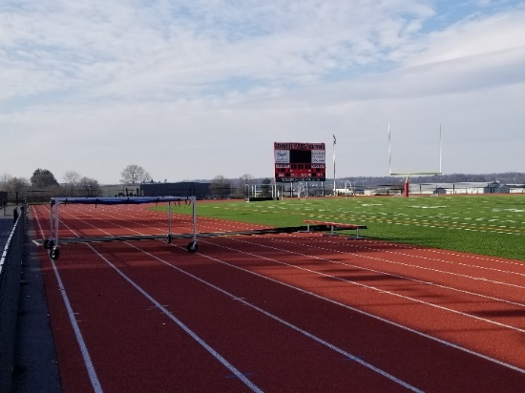
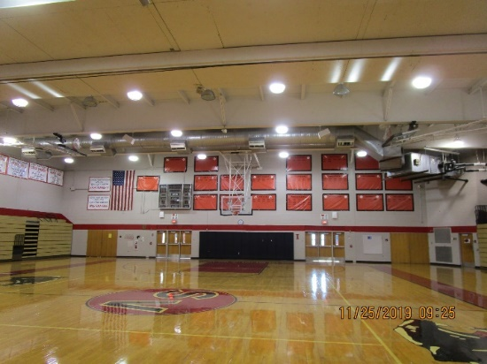
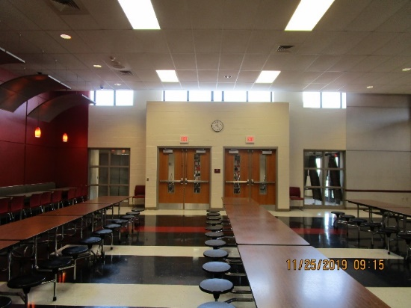
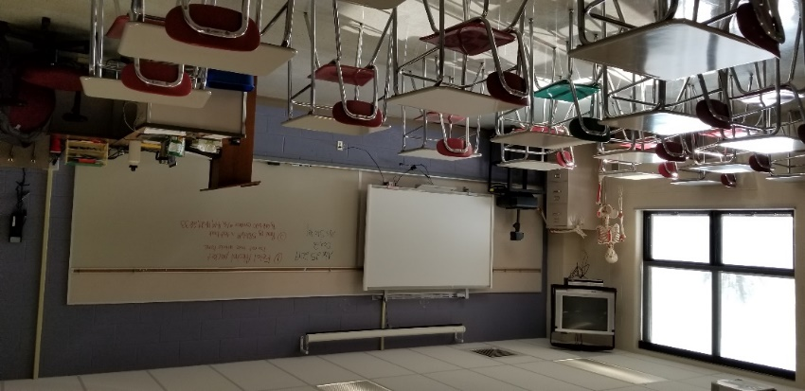
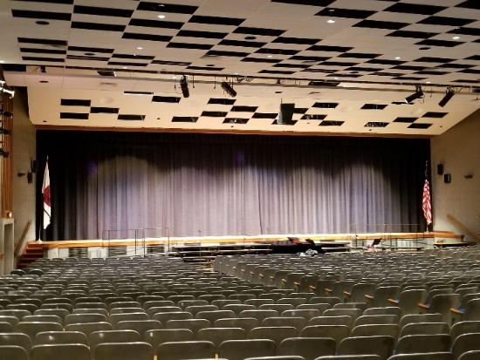
Schuylkill Valley High School / DAO
Existing Conditions
EDUCATIONAL PROGRAM IMPROVEMENTS:
Additional Support Classrooms
Additional Divided Support Classrooms
Additional Conference /Seminar / S.G.I.
Additional S.E. / Gifted Classroom
Student Commons / L.G.I.
Enlarged Kitchen Area

Slide 29
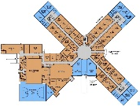
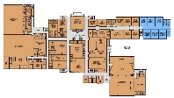
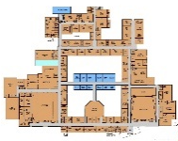
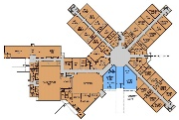
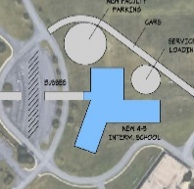
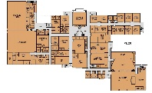
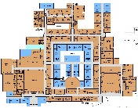
Schuylkill Valley SD Feasibility Study
Option Profiles Considered
New
Intermediate
School
Elementary
School
Middle
School
High
School
K-4
--
5-8
9-12
Option 1
(Status Quo)
K-3
4-5
6-8
9-12
Option 2
K-3
--
4-6
7-12
Option 3

Slide 30

Schuylkill Valley SD Feasibility Study
Options
1
OPTION

Slide 31
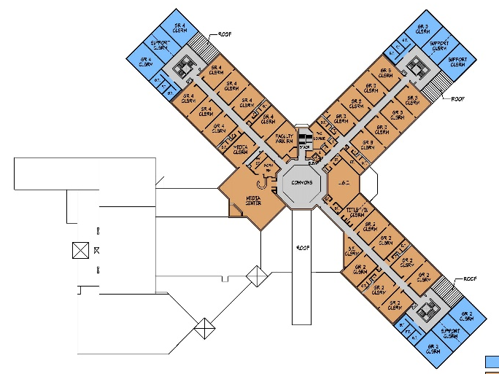
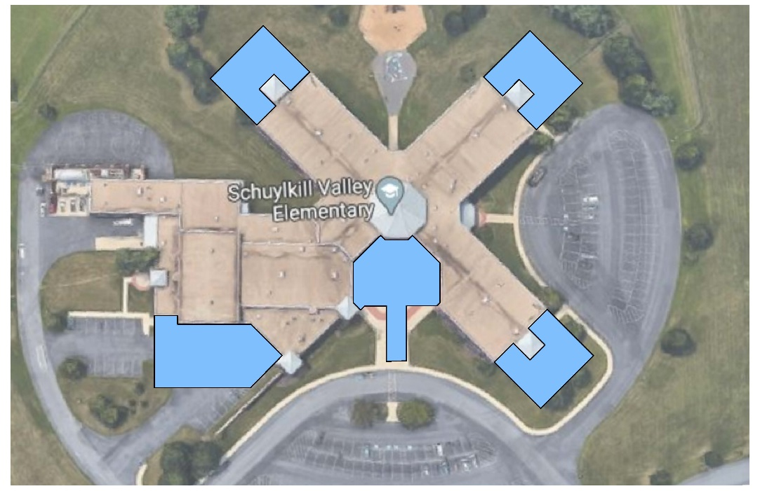


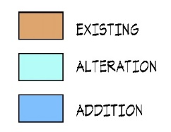
Schuylkill Valley SD Feasibility Study
Options
1
OPTION
Elementary School
SECOND FLOOR
New Gym
Optional
FIRST FLOOR
Design for 1000-1125 Students

Slide 32
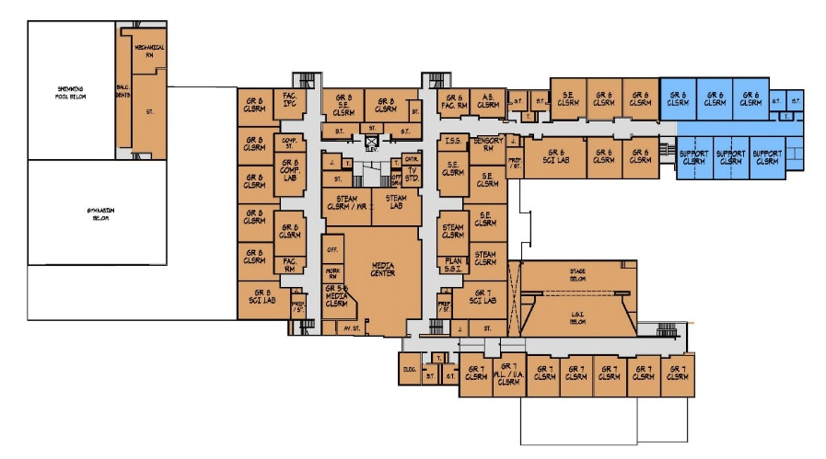


Schuylkill Valley SD Feasibility Study
Options
1
OPTION
Middle School
SECOND FLOOR
FIRST FLOOR
Design for 800-900 Students

Slide 33



Schuylkill Valley SD Feasibility Study
Options
1
OPTION
High School
SECOND FLOOR
FIRST FLOOR
Design for 800-900 Students

Slide 34
Schuylkill Valley SD Feasibility Study
Options
2
OPTION

Slide 35



Schuylkill Valley SD Feasibility Study
Options
2
OPTION
Elementary School
SECOND FLOOR
FIRST FLOOR
Design for 800-900 Students

Slide 36

Schuylkill Valley SD Feasibility Study
Options
2
OPTION
New Intermediate School
Design for 400-450 Students

Slide 37



Schuylkill Valley SD Feasibility Study
Options
2
OPTION
Middle School
SECOND FLOOR
FIRST FLOOR
Design for 600-675 Students

Slide 38
Schuylkill Valley SD Feasibility Study
Options
2
OPTION
High School
SECOND FLOOR
FIRST FLOOR
Design for 800-900 Students

Slide 39
Schuylkill Valley SD Feasibility Study
Options
3
OPTION

Slide 40
Schuylkill Valley SD Feasibility Study
Options
3
OPTION
Elementary School
SECOND FLOOR
FIRST FLOOR
Design for 800-900 Students

Slide 41


Schuylkill Valley SD Feasibility Study
Options
3
OPTION
Middle School
SECOND FLOOR
FIRST FLOOR
Design for 600-675 Students

Slide 42



Schuylkill Valley SD Feasibility Study
Options
3
OPTION
High School
SECOND FLOOR
FIRST FLOOR
Design for 1200-1350 Students

Slide 43
Schuylkill Valley SD Feasibility Study
Option Comparison
1
2
3
OPTION
OPTION
OPTIONS
Maintain K-4 Schuylkill Valley Elementary School
Recommended Alterations & Additions as required
E.S. building grade re-alignment to K-3 Elementary School
Recommended Alterations & Additions as required
E.S. building grade re-alignment to K-3 Elementary School
Recommended Alterations & Additions as required
Maintain 5-8 Schuylkill Valley Middle School
Recommended Alterations & Additions as required
Construct New 4-5 Intermediate School Building
(Relocate 4th grade from E.S. & 5th grade from M.S.)
M.S. building grade re-alignment to 4-6 Middle School
Recommended Alterations as required
Maintain 9-12 Schuylkill Valley High School
Recommended Alterations & Additions as required
M.S. building grade re-alignment to 6-8 Middle School
Recommended Alterations as required
H.S. building grade re-alignment to 7-8, 9-12 Jr./Sr. High School
Recommended Alterations & Additions as required
Maintain 9-12 Schuylkill Valley High School
Recommended Alterations & Additions as required
Total Construction Cost
$51,199,800
Total Project Cost
$64,000,000
Total Construction Cost
$57,839,800
Total Project Cost
$72,300,000
Total Construction Cost
$52,799,800
Total Project Cost
$66,000,000

Slide 44
5-8
$11.8M
$15M
Schuylkill Valley SD Feasibility Study
Option Comparison
1
2
3
OPTION
OPTION
OPTIONS
 | EST. CONST. COST | EST. TOTAL PROJ. COST
K-4 | $19.6M | $24.5M
5-8 | $12M | $15M
9-12 | $15.9M | $19.8M
SITE | $2.5M | $3.1M
SUB- TOTAL | $49.9M | $62.4M
CMC | $1.3M | $1.6M
TOTAL | $51.2M | $64M
 | EST. CONST. COST | EST. TOTAL PROJ. COST
K-3 | $13.4M | $16.7M
4-5 | $18M | $22.5M
5-8 | $6.9M | $8.6M
9-12 | $15.9M | $19.8M
SITE | $2.5M | $3.1M
SUB TOTAL | $56.6M | $70.7M
CMC | $1.3M | $1.6M
TOTAL | $57.8M | $72.3M
 | EST. CONST. COST | EST. TOTAL PROJ. COST
K-3 | $13.4M | $16.7M
4-6 | $6.9M | $8.6M
7-12 | $28.8M | $36M
SITE | $2.5M | $3.1M
SUB TOTAL | $51.5M | $64.4M
CMC | $1.3M | $1.6M
TOTAL | $52.8M | $66M
*Total Project Cost Includes construction cost of building and site / plus financing fees, contingency fund, moveable furniture, commissioning fees, construction testing / inspections, fees for Topographic / Geotechnical surveys, A/E fees, permit fees detailed estimates, and utility fees, etc.

Slide 45
Schuylkill Valley SD Feasibility Study
Option Comparison
RECOMMENDED OPTION 1
PHASE 1
Total Construction Cost Total Project Cost
ES Additions / Renovations
Totally renovate E.S. and add to accommodate
enrollment growth
High School
Selective infrastructure replacement due to
condition urgency (HVAC / Roofs)
$19.6M
$24.5M
$4.4M
$5.5M
$24M
$30M
Phase 1 Total:
PHASE 2
After ES project is completed, evaluate enrollment growth for MS and HS at that time to determine the need for additions
Wait until next reimbursable periods for MS and HS renovations
  PDE allows reimbursement only one every 20 years
  MS and HS received last reimbursements almost 13-14 years ago – State reimbursements might be available in next 6-7 years from now
  Wait for moratorium to lift to receive reimbursements
Balance of work of higher rank at MS and HS to scheduled in a 5-10 year long range plan

Slide 46
Schuylkill Valley SD Feasibility Study
Proposed Schedule
May 2020
School Board Authorizes Project Beginning
May / June 2020
Architect / Engineers Begin Production & Permits
September / October 2021
Bidding of Project
July / August 2023
Complete Construction / Move-In
(18-20 months maximum)
*Note: All governmental agency approvals must be in place before bid contract award; therefore, the target schedule is subject to length of agency review process.

Slide 47
Schuylkill Valley SD Feasibility Study
Process / Contents of the Study
Demographic Review
(Student Enrollment, Population, Housing)
Facilities Study
(Building Improvements & Construction Cost)
Educational Program Review
(Requirements / Needs)
Solutions (Construction Options)
Cost of Options
Schedule
Note: Study per PDE Requirements

Slide 48
Schuylkill Valley School District
District-Wide Feasibility Study
7 March 2020

